Slide 1
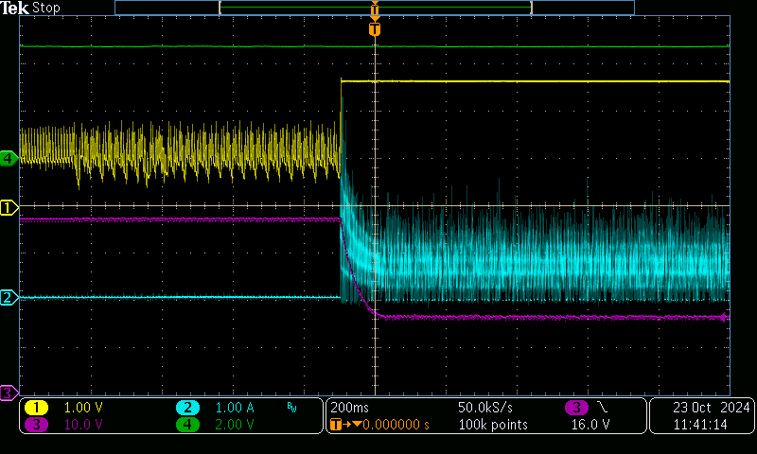
CH3: Vo; CH4: SS_SVR; CH2: Io; CH1: COMP

Slide 2
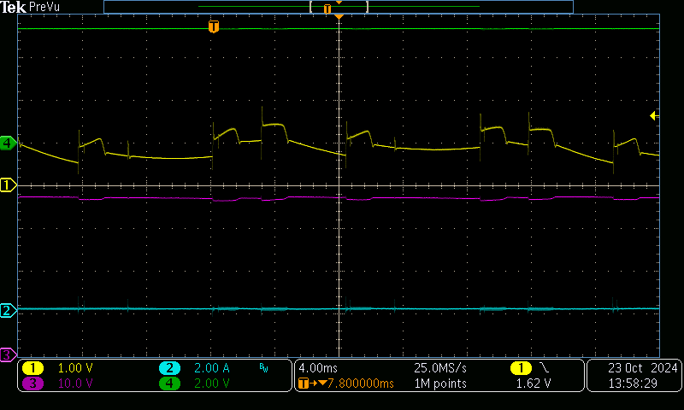
Group 3 = CH3: Vo; CH4: SS_SVR; CH2: Io; CH1: COMP

Slide 3
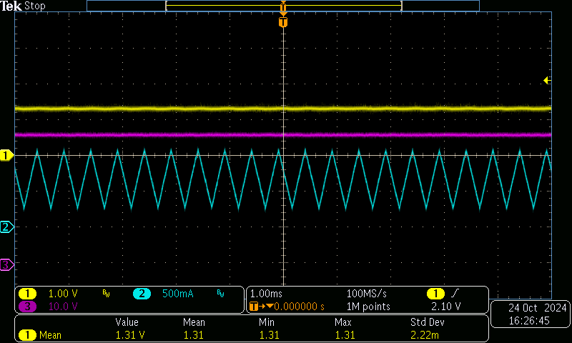
CH3: Vo; CH2: Io; CH1: COMP

