Slide 1
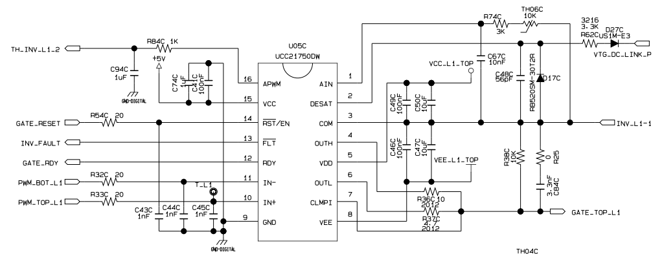
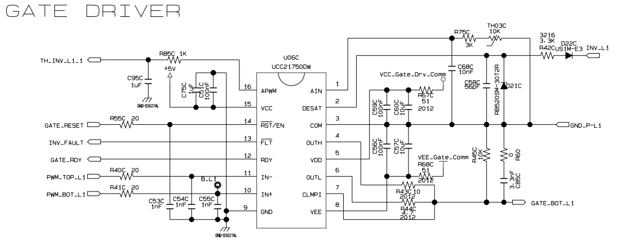
High side GATE driver bias power
High side GATE driver
Low side GATE driver
Low side GATE driver bias power

Slide 2
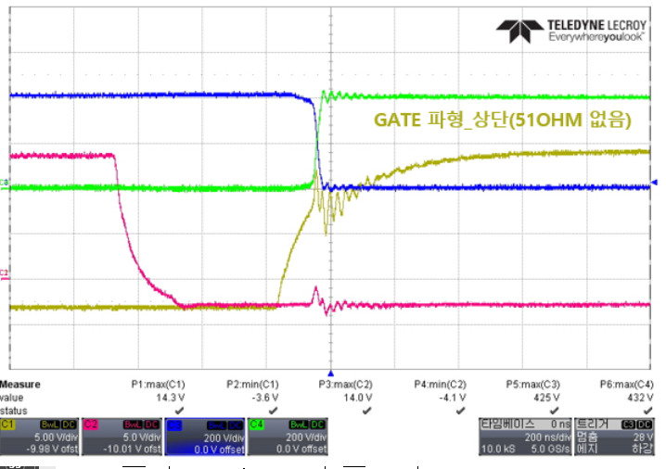
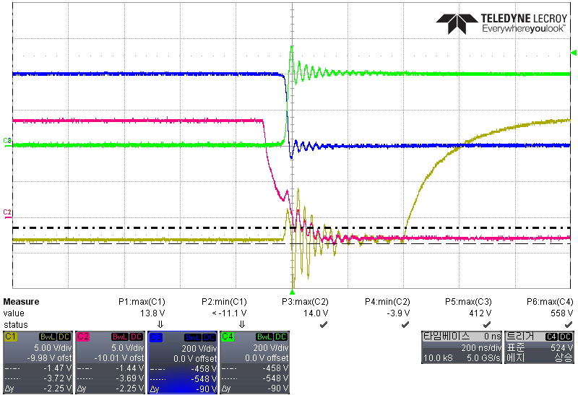
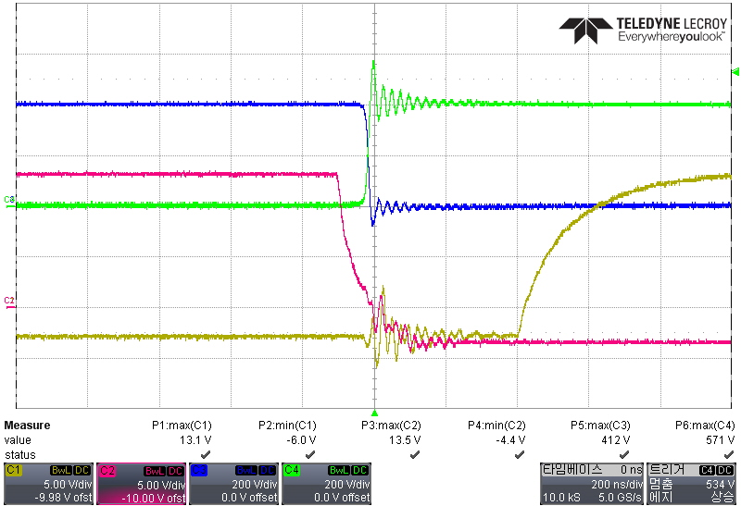
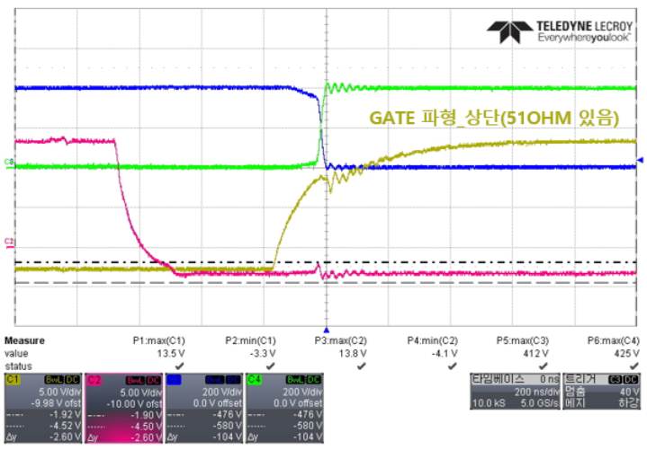
High side : No series resistor on VDD/VEE. Low side : 51 ohm on VDD/VEE
CH1 : high side Vgs, CH2 : low side Vgs, CH3 : high side Vds, CH4 : low side Vds
High side : Add 51 Ohm on VDD/VEE. Low side : 51 ohm on VDD/VEE
CH1 : high side Vgs, CH2 : low side Vgs, CH3 : high side Vds, CH4 : low side Vds

