Slide 1
UCC21750-Q1 DESAT Issue
Benjamin

Slide 2
Issue Description
The UCC21750 DESAT worked abnormal while the DC link voltage higher than 500V, and caused the SiC FET damaged.
Customer used UCC21750 + PUSH-PULL buffer to drive 6 PCs parallelized SiC FETs(C3M0016120K)

Slide 3
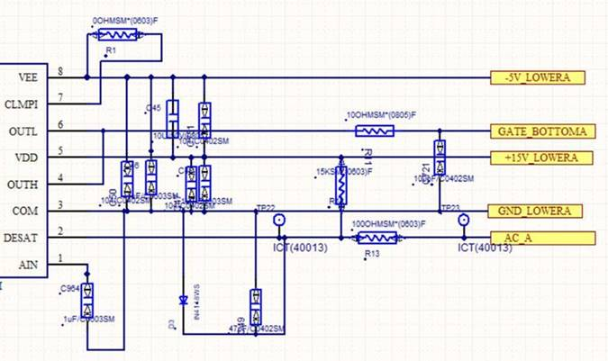
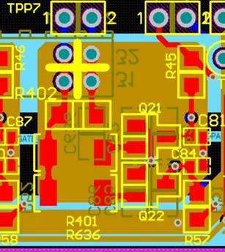
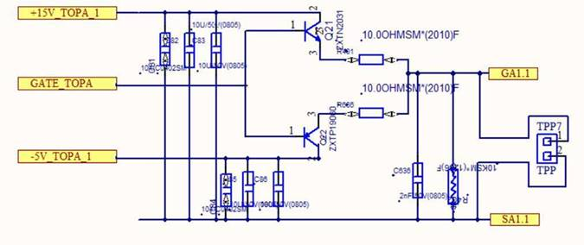
Schematic
6 PCs SiC FET parallelized and driven by UCC21750-Q1, the SiC FET part number is
C3M0016120K

Slide 4
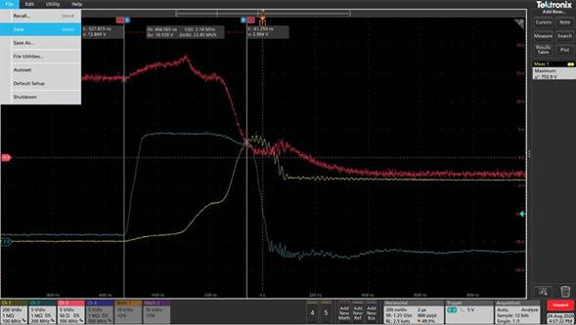
Test Waveform_Normal
While the DC Link is 450V, the DESAT
Feature worked well.
Red: Vgs; Yellow: Vds; Blue: Vdesat

Slide 5
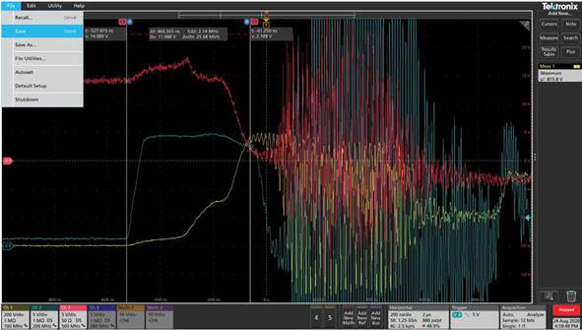
Test Waveform_Abnormal
While the DC Link is 500V, the DESAT
Feature worked abnormal. And test waveform shown lots of oscillated on Vgs/Vds/Vdesat, which caused damage on SiC Gate.
Red: Vgs; Yellow: Vds; Blue: Vdesat

