Slide 1
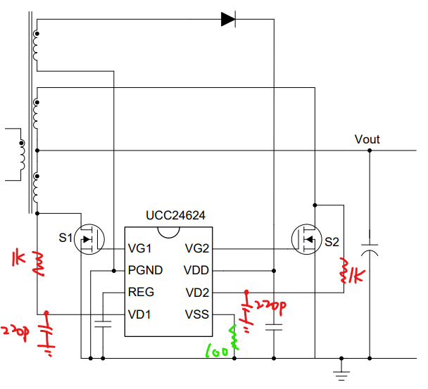
UCC24624 issue with Gate Driver
Application: UPS

Slide 2
Regarding the TI IC UCC24624, the customer encountered a phenomenon where the SR gate pin output signal randomly disappears during application testing (sometimes both gate drivers completely lose the gate output, or sometimes only one side gate output lose).
At the time, the output load current is about 30A. At this load level, there should definitely be SR gate output signals we think!
From customer current assessment, this issue seems to be caused by external noise interference. Customer have made several parameter adjustments in the attached schematic:
A 1k Ohm resistor is used as recommended by the datasheet, and additionally, a 220pF filter capacitor was added. This did improve the situation, but it did not completely resolve the issue.
For the resistor from VSS to ground (R offset), does it help suppress noise in addition to adjusting the turn-off threshold? (We are unsure if this resistor value still needs to be adjusted.)
We would like your suggestions on what other circuit parameters can be adjusted, or which specific nodes/waveforms you recommend checking for confirmation.

