Slide 1
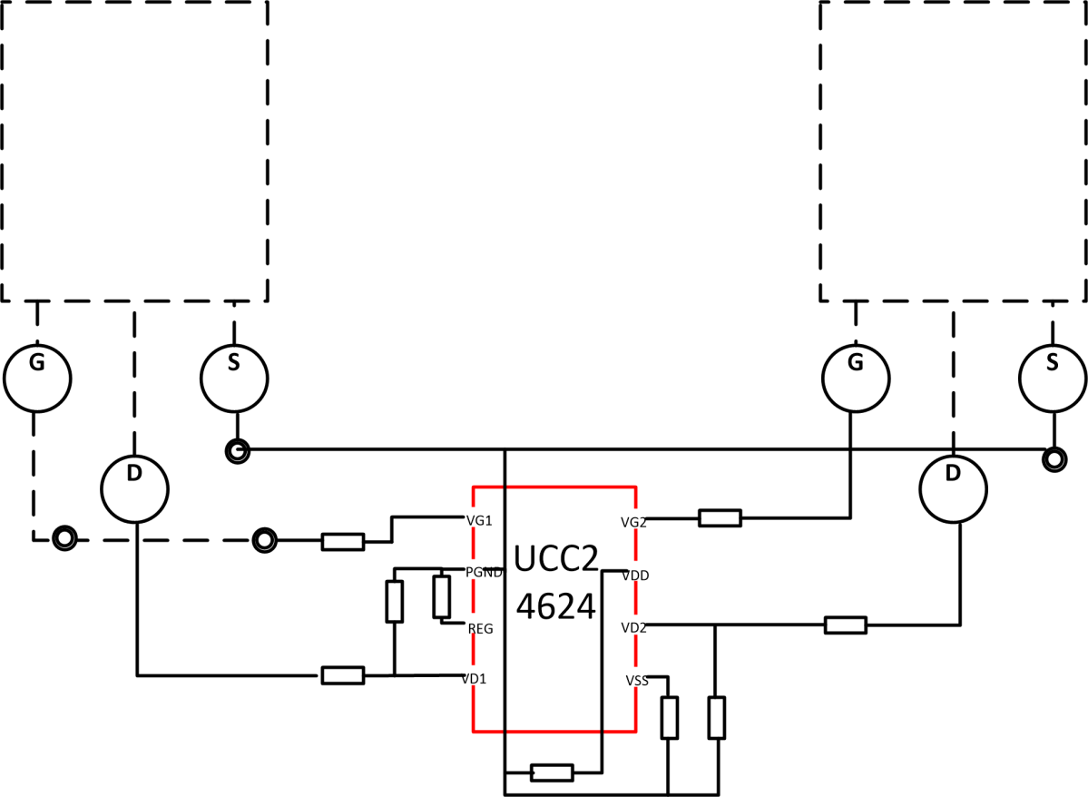
Single layer layout recommendation with UCC24624
Short circuit Gate to Source at here.
No, the wire is jumper
Since this is Single Layer board, we do not have bottom layer or dotted line.
No, the wire is jumper
VDD node cannot draw out to VDD power supply due to single layer. How can we draw out ?
Also use jumper
Dotted line is TOP side
Solid line is bottem side
VIA, the wire between VIA is jumper
1

