Slide 1
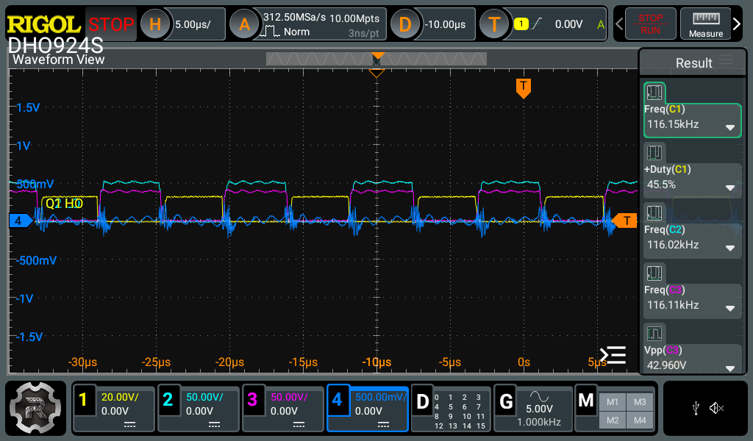
FQP8N60C
CH1 High side Gate
CH2 Low side Gate
CH3 HS
CH4 ISNS

Slide 2
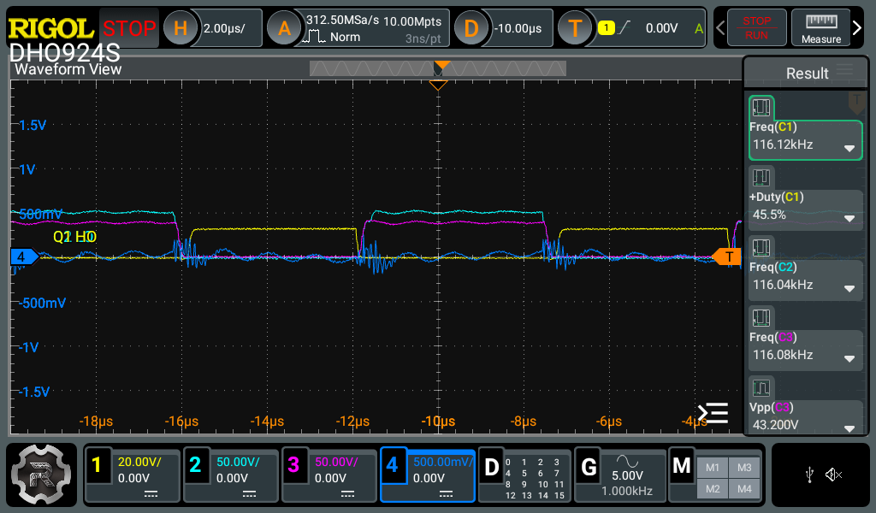
FQP8N60C
CH1 High side Gate
CH2 Low side Gate
CH3 HS
CH4 ISNS

Slide 3
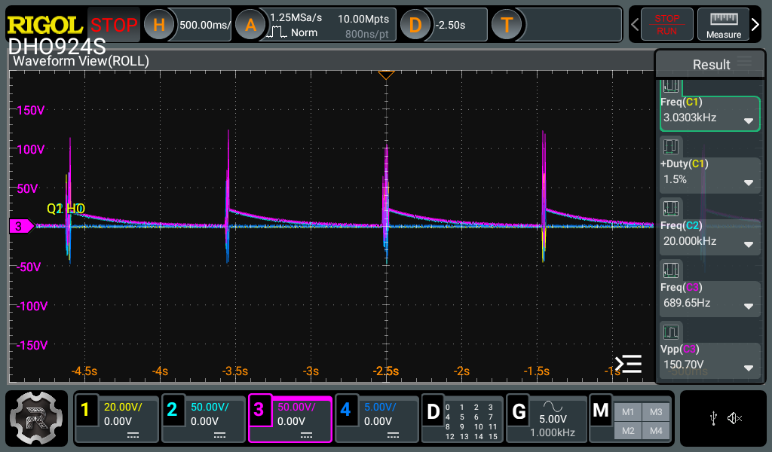
IPA60R170CFD7XKSA1
CH1 High side Gate
CH2 Low side Gate
CH3 HS
CH4 ISNS

Slide 4
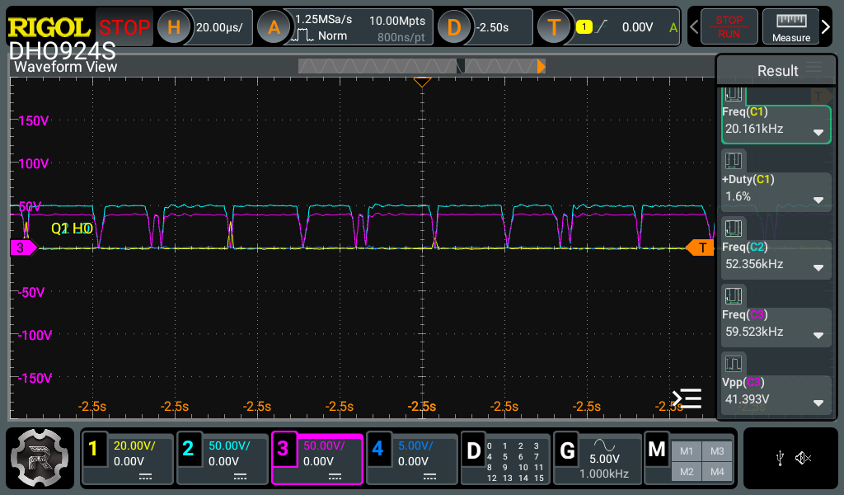
IPA60R170CFD7XKSA1
CH1 High side Gate
CH2 Low side Gate
CH3 HS
CH4 ISNS

