Slide 1
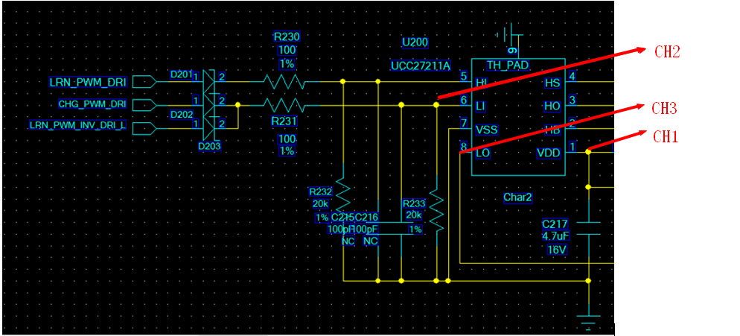
UCC27211A issue
1,SCH

Slide 2
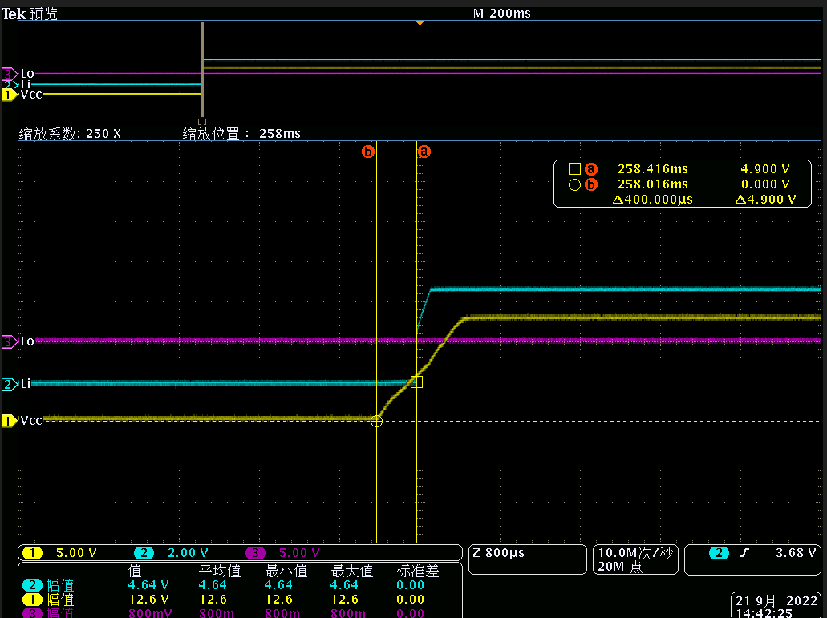
UCC27211A issue
2,Waveform: test on the Pin（VDD，Li，Lo）
You can see Lo is Low while Li is high, VDD voltage is valid, that is the issue we meet.

Slide 3
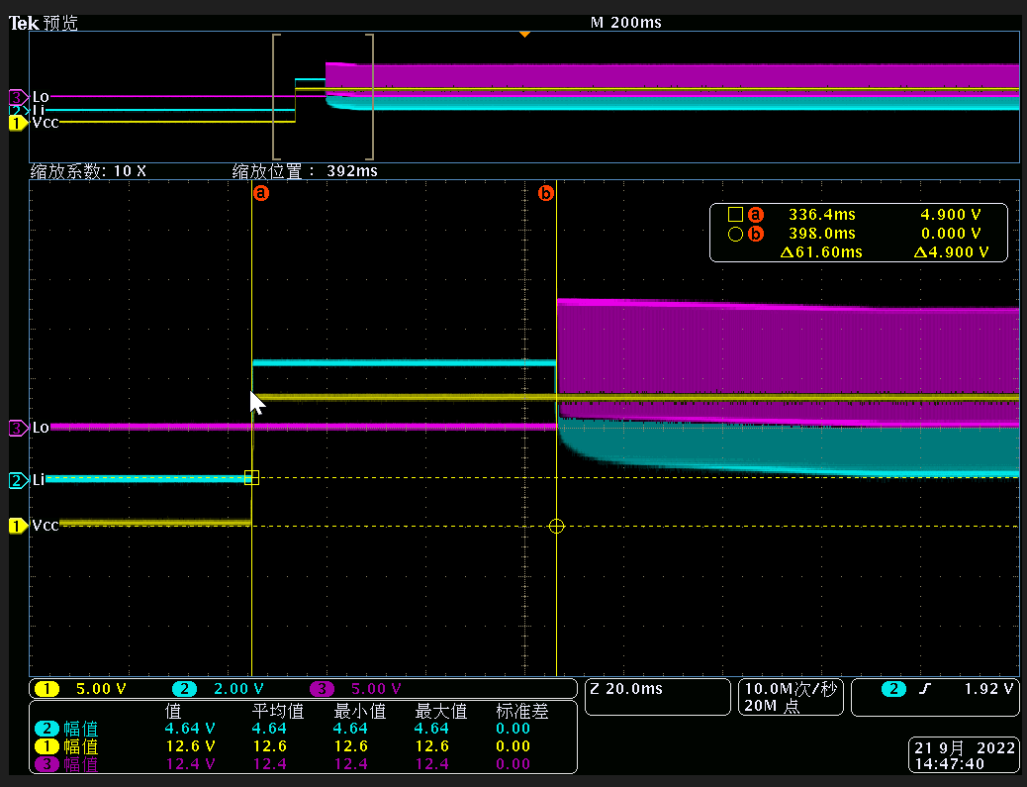
UCC27211A issue
2,Waveform: test on the Pin（VDD，Li，Lo）
You can see: if we input PWM signal, the Lo will return to normal(have PWM output)
Zoom in the PWM signal, pls check next slide.

Slide 4
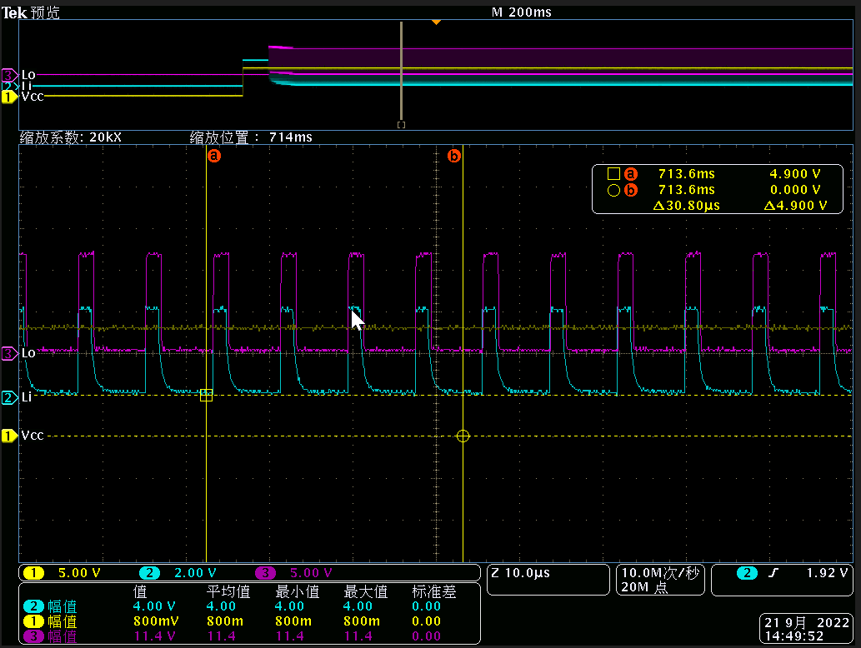
UCC27211A issue
2,Waveform: test on the Pin（VDD，Li，Lo）
Zoom in the PWM signal, Li and Lo signal is correct.

