Slide 1
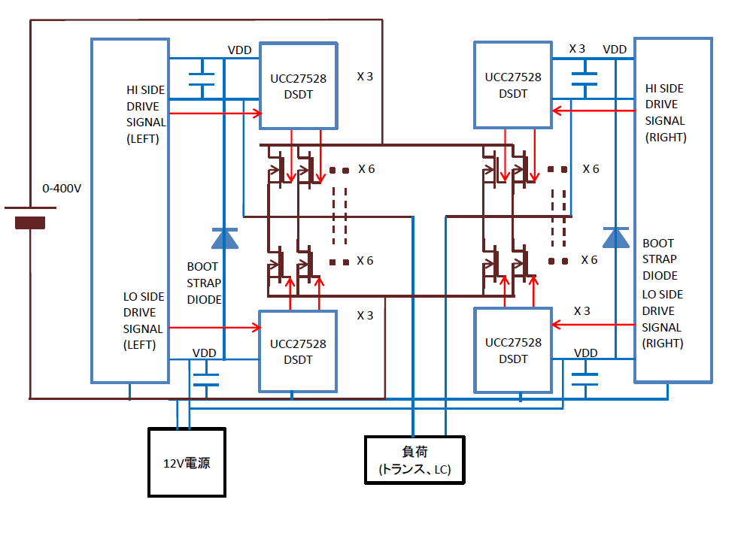
GND
GND
12V
supply
LOAD

