Slide 1
PFC - UCC28056ADBVR

Slide 2
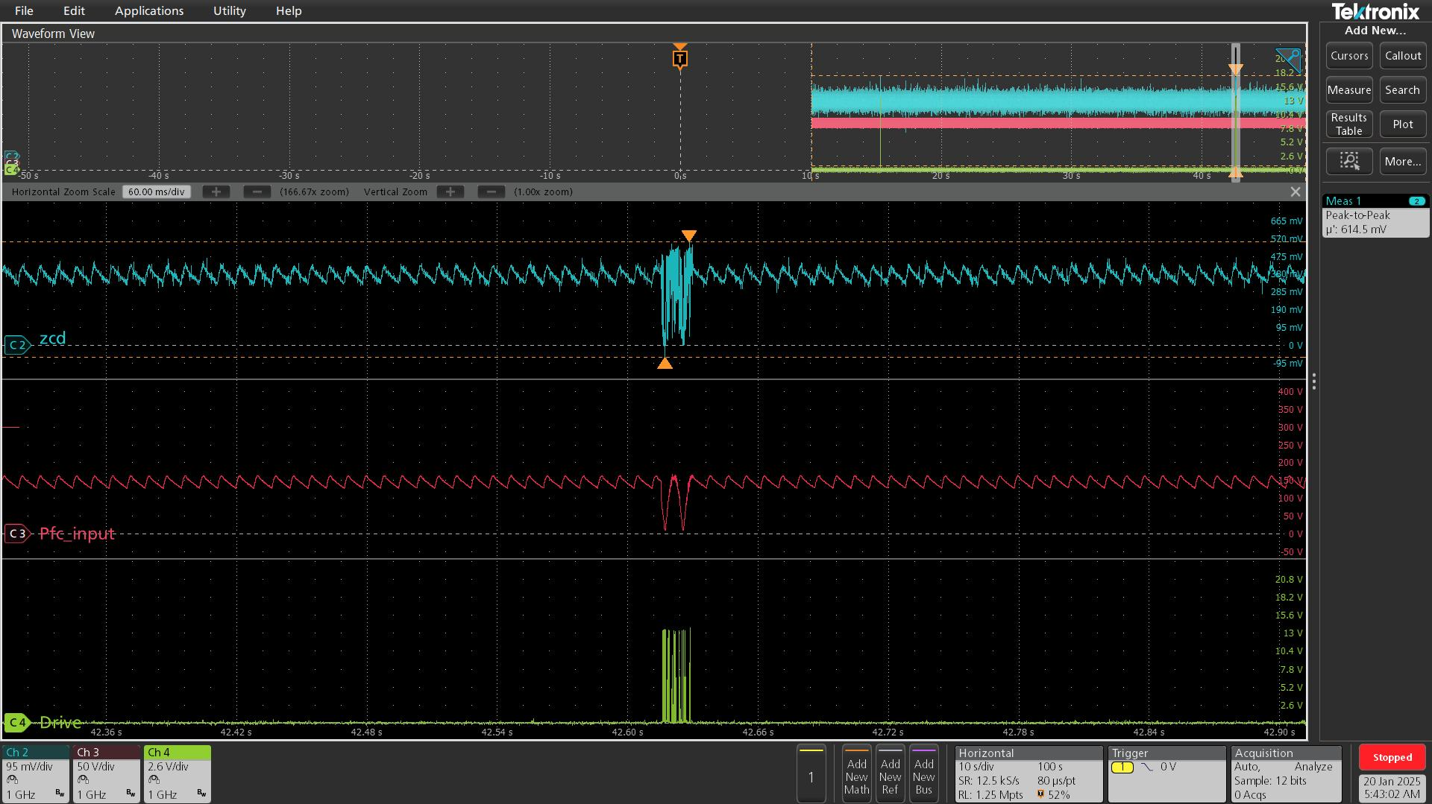
ZCD , PFC INPUT & DRIVE PIN

Slide 3
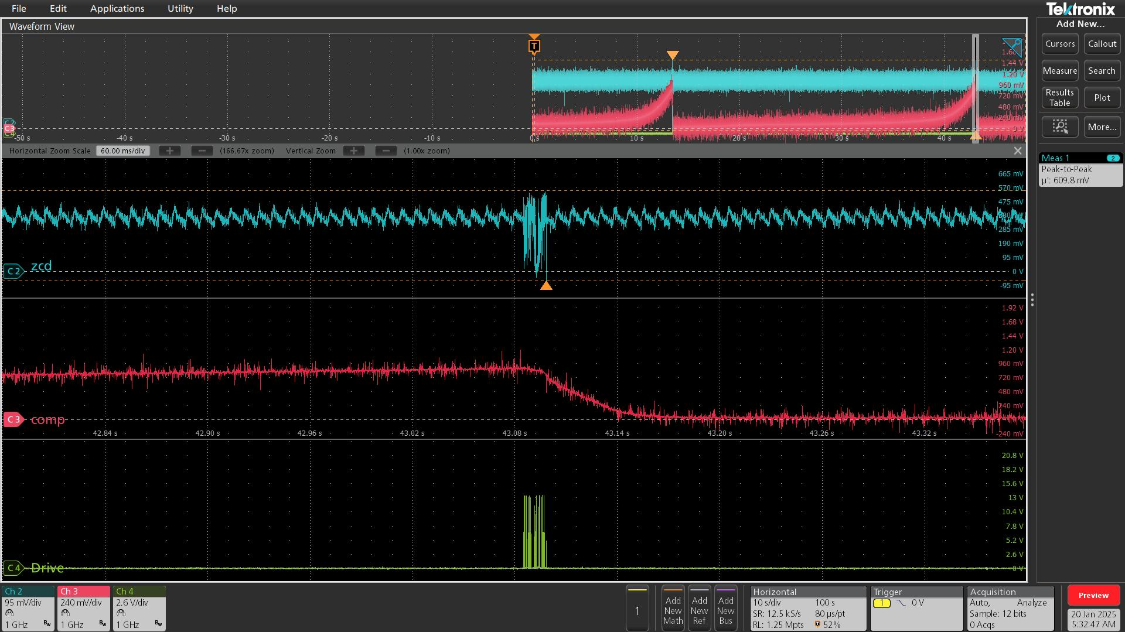
ZCD, COMP &DRIVE PIN

Slide 4
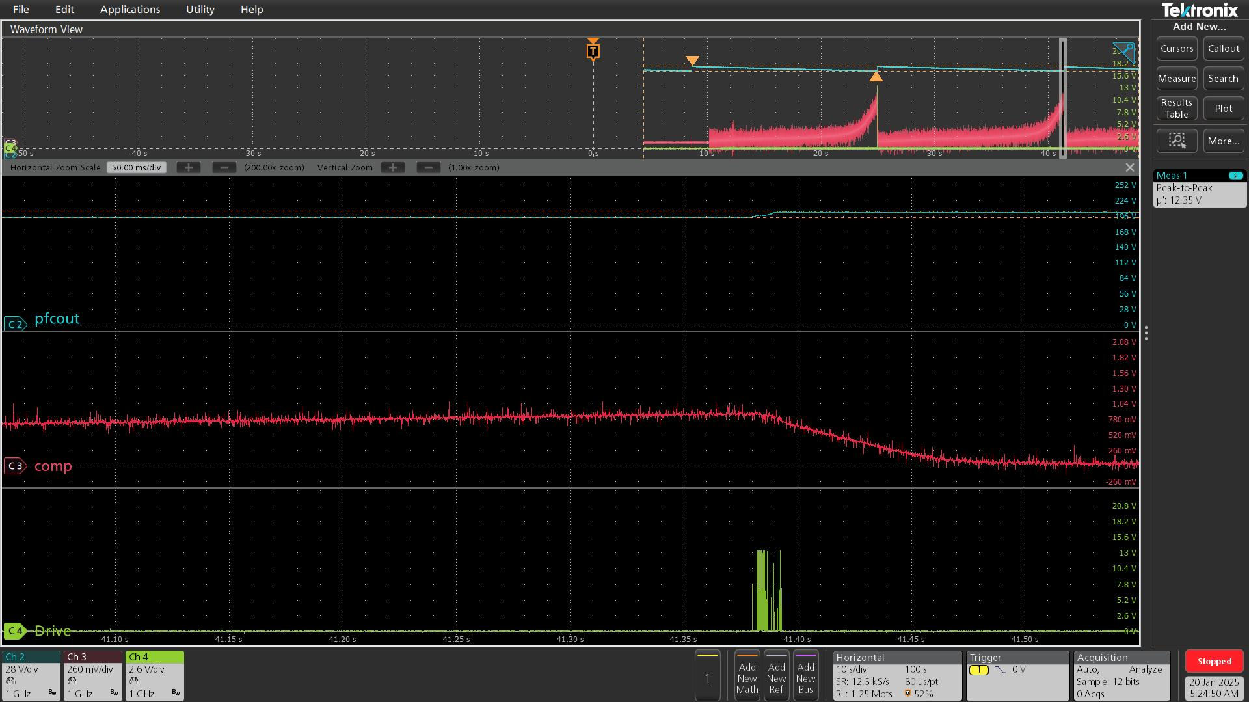
PFC_OUT , COMP &DRIVE

Slide 5
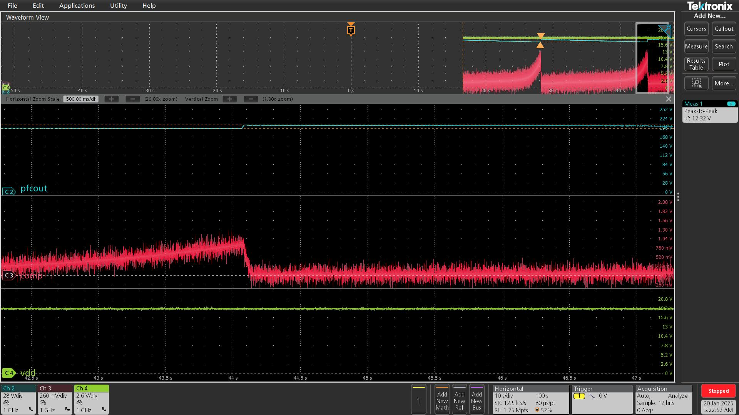
PFC_OUT, COMP &VDD

