Slide 1
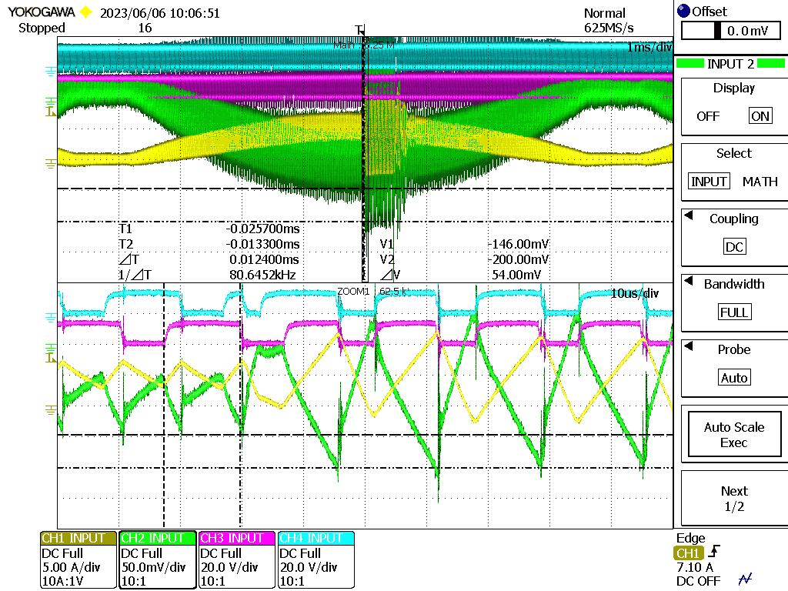
UCC28065 AC100V Pout 550W Pin 583W Pf 0.9928
CH1 PFC Current at detect resistor
CH2 CS IC 10pin
CH3 FET Gate Drive （Gate DRV2）
CH4 FET Gate Drive （Gate DRV1）
Forced turn off for OC operation
CS terminal peak: -146mV
2 drive operate in same phase.
CS terminal peak: -200mV
=>
Immediately turns off both
gate-drive outputs
Measured Ton: 12.4us < calculated Ton max at AC100V
Interleave operation 180degree Phase shift
CS terminal peak: -146mV

