Slide 1
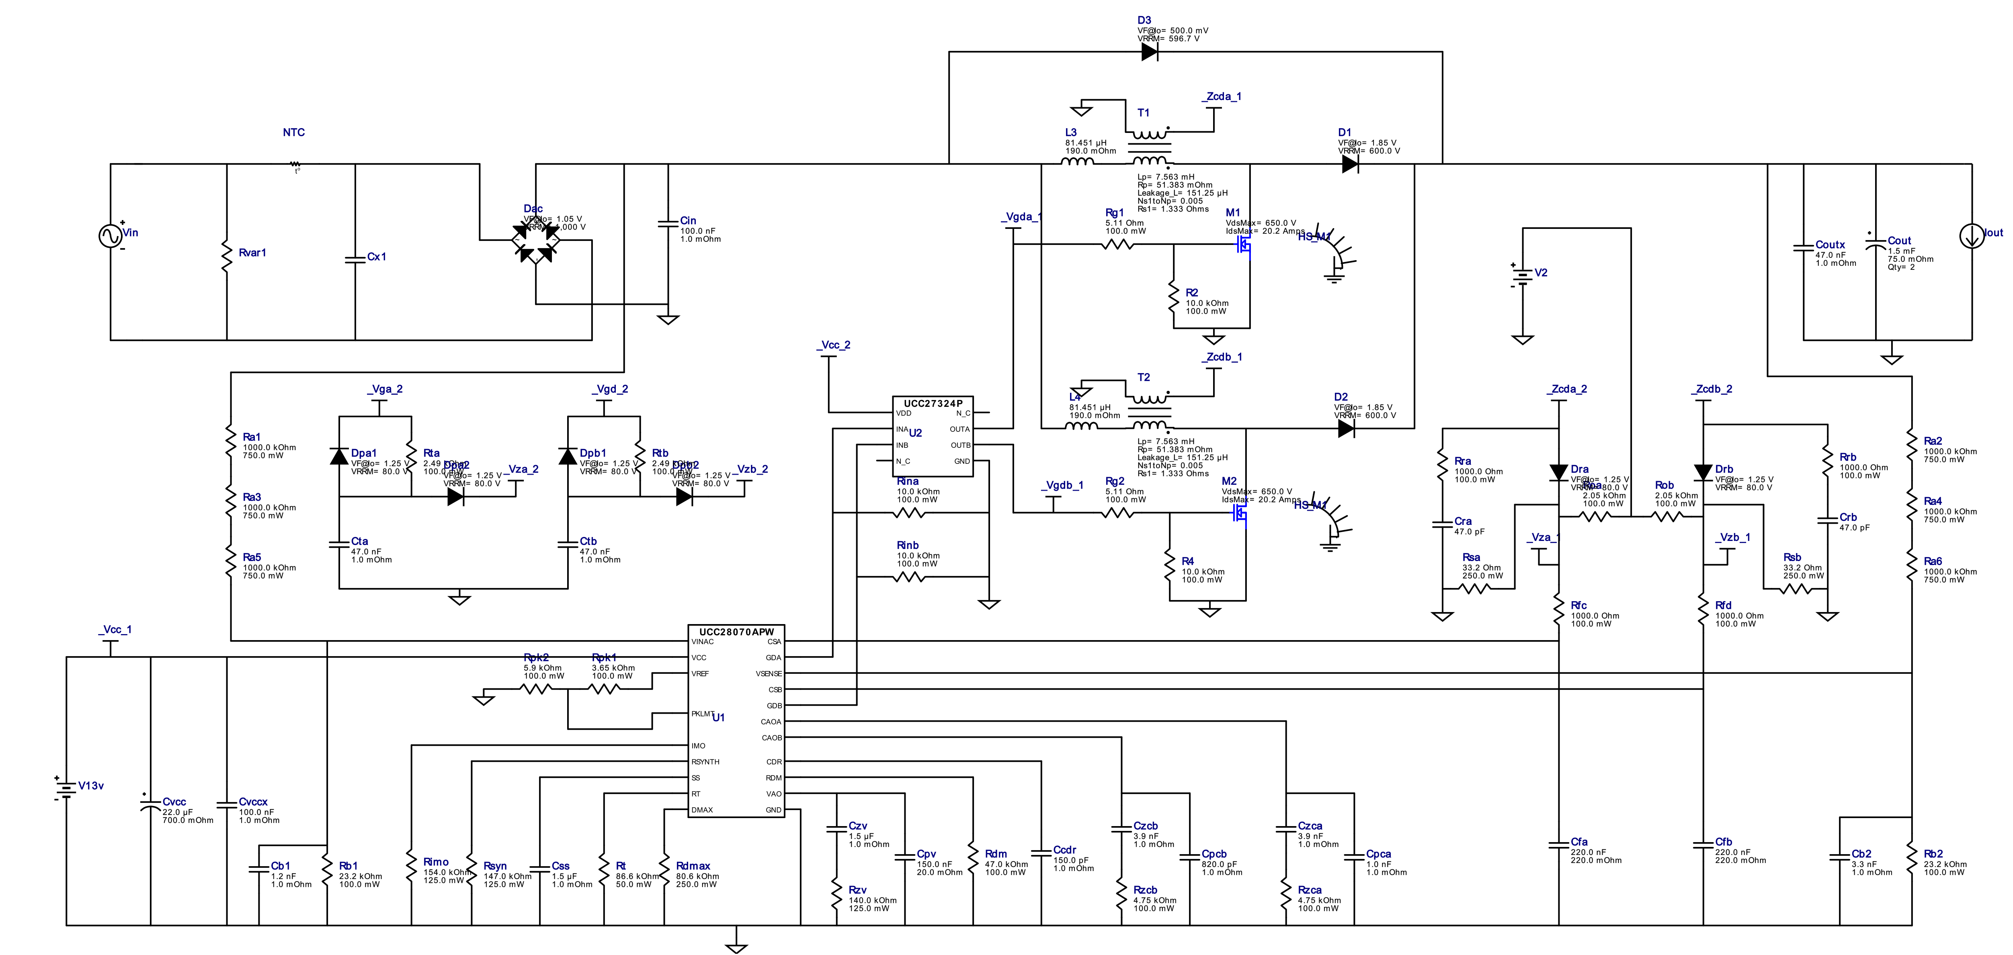
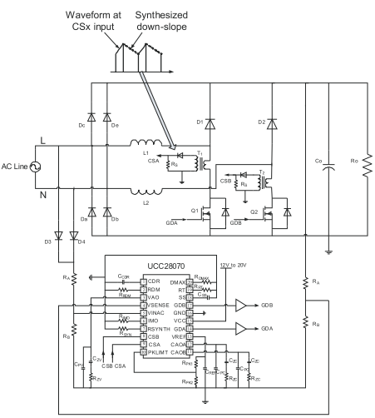
UCC28070 Normal circuit configuration
UCC28070 Semi-bridgeless circuit configuration
In a normal circuit configuration, how should the input capacitor (film capacitor of about 0.1 to 1.0uF) inserted for high frequency noise return be used when it becomes a semi-bridgeless circuit configuration?
Is the X capacitor also used?
In that case, when comparing the input filter configuration between the normal specification and the semi-bridgeless specification, is it necessary to strengthen the filter in the semi-bridgeless circuit?

