Slide 1
UCC28070 Operating at 400Hz
John Griffin
Nov 2015

Slide 2
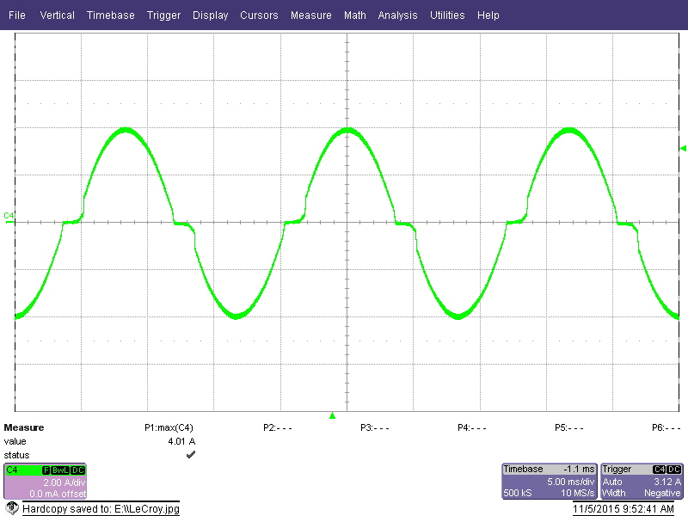
Line Current
115Vac 60Hz
300W 0.993pF

Slide 3
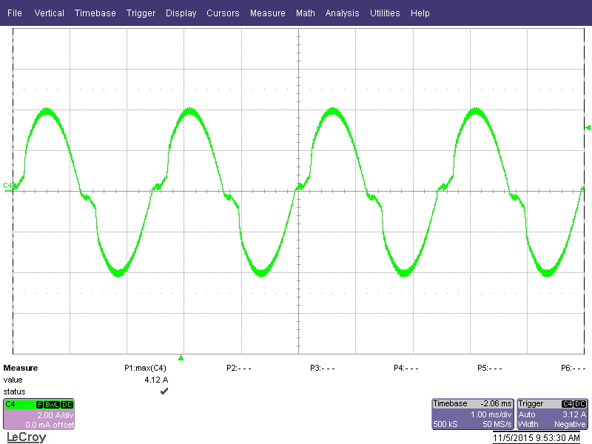
Line Current
115Vac 400Hz
300W 0.990pF

Slide 4
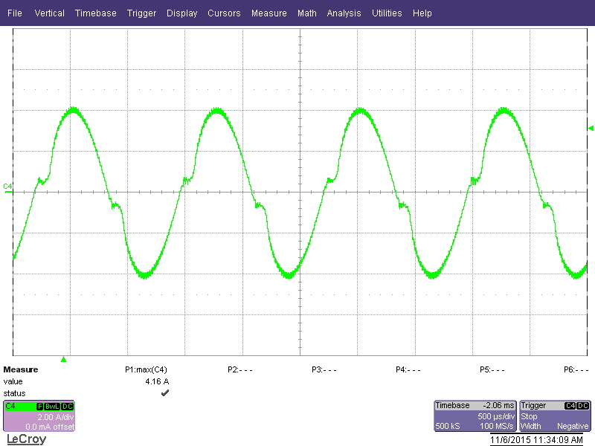
Line Current
115Vac 800Hz
300W 0.991pF

Slide 5
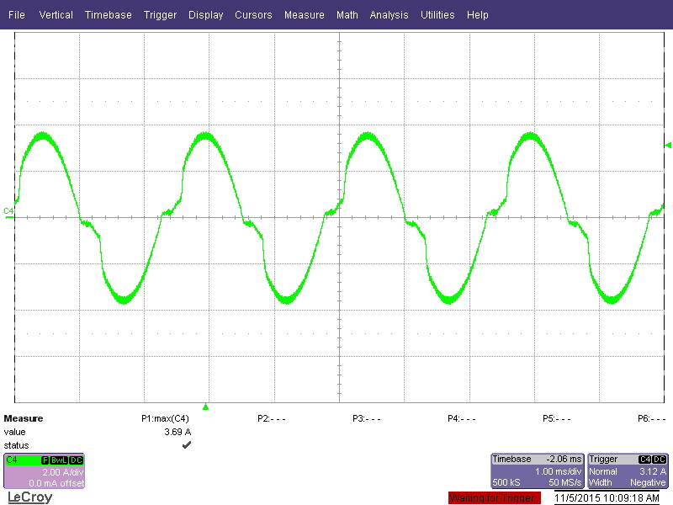
Line Current
115Vac 400Hz
50W 0.95pF

Slide 6
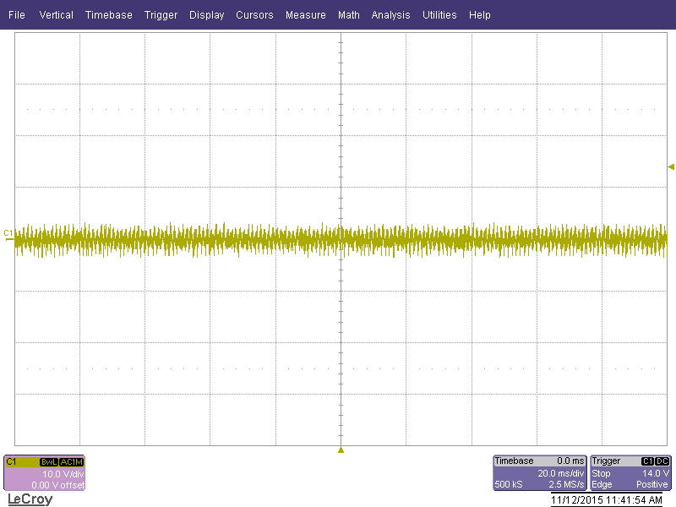
Full Load Ripple

