Slide 1
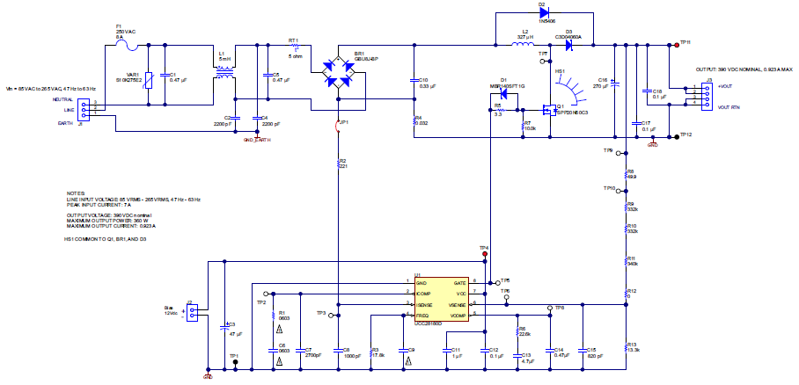
UCC28180EVM-573 Schematic
33k(fsw=65kHz)

Slide 2
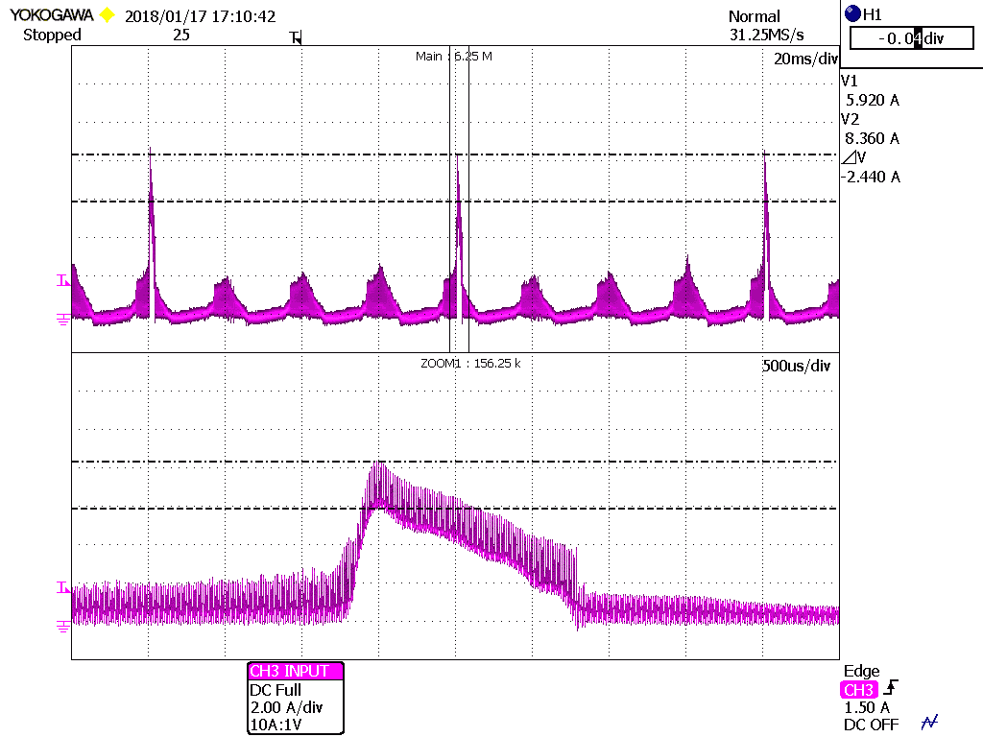
Waveform
Ch3: Input current
Vin=AC240V
Vout=390V
Iout=200mA
fsw=65kHz
This phenomenon is not occurred at AC100V input voltage.
Rush current is occurred at top of AC line input voltage
Zoom

