Slide 1
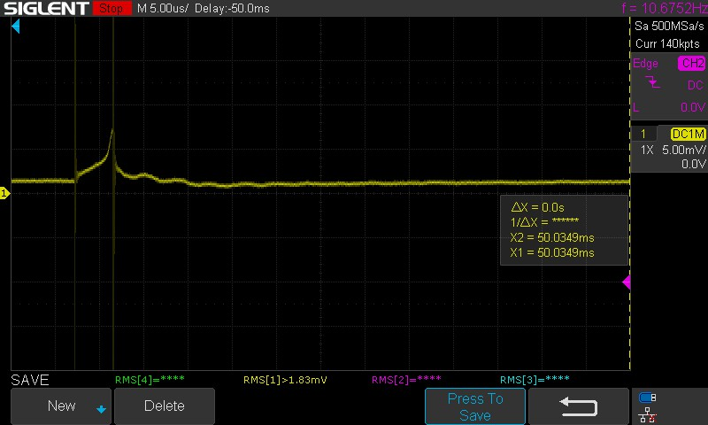
UCC28712 ASSY . Inptu 250V, load 1.5W only
Vcs
Clear sign of magnetics going into saturation

