Slide 1
UCC28740 Feedback Loop Compensation Design

Slide 2
Flyback Regulator Schematic Diagram
using UCC28740 with Opto-coupled Feedback
TL431

Slide 3
UCC28740 Control Law
for Output Voltage Regulation
Multiple control regions modify switching frequency and inductor current amplitude to achieve high efficiency over wide output power range.
Control region 3
(AM)
Control region 4
(FM)
Control-loop gain factors change when operation moves from one region to another.
Control region 1
(FM)
Control region 2
(FM)

Slide 4
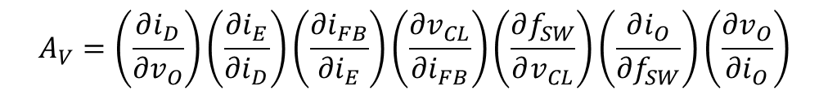
Voltage Feedback Loop Block Diagram
in FM Regions of Control Law
V_{IN}
G_{Pn}
I_{OUT} + i_{O}
Z_{L}(s)
V_{OUT} + v_{O}
V_{CSn}
f_{SW}
n = 1, 2, or 4, depending on FM region of operation
v_{O}
K_{FMn}
v_{CL}
G_{FB2}
i_{FB}
G_{FB1}
i_{E}
G_{OPTO}(s)
i_{D}
G₄₃₁(s)
Control-Loop Gain: A_{V} = G₄₃₁(s) · G_{OPTO}(S) · G_{FB1} · G_{FB2} · K_{FMn} · G_{Pn} · Z_{L}(s)
$$A_{V}=\left(\frac{∂i_{D}}{∂v_{O}}\right)\left(\frac{∂i_{E}}{∂i_{D}}\right)\left(\frac{∂i_{FB}}{∂i_{E}}\right)\left(\frac{∂v_{CL}}{∂i_{FB}}\right)\left(\frac{∂f_{SW}}{∂v_{CL}}\right)\left(\frac{∂i_{O}}{∂f_{SW}}\right)\left(\frac{∂v_{O}}{∂i_{O}}\right)$$
Notes:
In the FM regions of the Control Law, V_{CL} changes the switching frequency f_{SW} while the primary peak current-sense threshold voltage V_{CSn} stays constant. In the UCC28740, V_{CS4} = V_{CSMAX} = 0.780 V in region 4, and V_{CS1} = V_{CS2} = V_{CSMIN} = 0.195 V in regions 1 and 2.

Slide 5
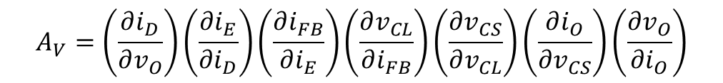
Voltage Feedback Loop Block Diagram
in AM Region of Control Law
V_{IN}
G_{P3}
I_{OUT} + i_{O}
Z_{L}(s)
V_{OUT} + v_{O}
F_{AM}
v_{CS}
v_{O}
K_{AM}
v_{CL}
G_{FB2}
i_{FB}
G_{FB1}
i_{E}
G_{OPTO}(s)
i_{D}
G₄₃₁(s)
Control-Loop Gain: A_{V} = G₄₃₁(s) · G_{OPTO}(S) · G_{FB1} · G_{FB2} · K_{AM3} · G_{P3} · Z_{L}(s)
$$A_{V}=\left(\frac{∂i_{D}}{∂v_{O}}\right)\left(\frac{∂i_{E}}{∂i_{D}}\right)\left(\frac{∂i_{FB}}{∂i_{E}}\right)\left(\frac{∂v_{CL}}{∂i_{FB}}\right)\left(\frac{∂v_{CS}}{∂v_{CL}}\right)\left(\frac{∂i_{O}}{∂v_{CS}}\right)\left(\frac{∂v_{O}}{∂i_{O}}\right)$$
Notes:
In the AM region of the Control Law, V_{CL} changes the primary peak current-sense threshold voltage V_{CS} while the switching frequency f_{SW} stays constant. In the UCC28740, V_{CS} varies between V_{CSMIN} and V_{CSMAX} with fixed f_{Sw} = F_{AM} = 32 kHz in region 3.

Slide 6


Gain Blocks Defined – G₄₃₁(s)
Output voltage sense to opto-coupler diode current gain:
i_{D}
$$Z_{FB}=\frac{1}{sC_{Z}}$$
TL431
$$G_{431}\left(s\right)=\left(\frac{∂i_{D}}{∂v_{O}}\right)≅\left[\frac{1}{R_{TL}}\left(\frac{1+sC_{Z}R_{FB1}}{sC_{Z}R_{FB1}}\right)\right]$$
Notes:
This gain is a simplified expression, provided the product of g_{M}R_{TL} is a large number, which makes several complicating terms “disappear” from the equation. g_{M} is the transconductance of the TL431 device at frequencies below its intrinsic gain roll-off pole.

Slide 7
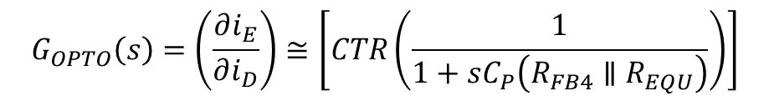


Gain Blocks Defined – G_{OPTO}(s)
Opto-coupler diode current to emitter current gain:
i_{E}
i_{D}
TL431
$$G_{OPTO}\left(s\right)=\left(\frac{∂i_{E}}{∂i_{D}}\right)≅\left[CTR\left(\frac{1}{1+sC_{P}\left(R_{FB4}∥R_{EQU}\right)}\right)\right]$$
$$C_{P}=C_{OPTO}+C_{CE}$$
$$C_{FB3}≫C_{P}$$
C_{CE} is external capacitance added across opto-coupler, if necessary
Notes:
R_{EQU} and V_{EQU} are the dynamic resistance and offset voltage of the current mirror at the FB input. For I_{FB} < 4 µA (near full-load), R_{EQU} ≈ 40 kΩ and V_{EQU} ≈ 0.44 V, while for 4 µA < I_{FB} < 25 µA (lower load to no-load), R_{EQU} ≈ 14 kΩ and V_{EQU} ≈ 0.54 V.
This gain is shown as an approximate relationship, valid for certain assumptions:
1. CTR (current transfer ratio) is “constant” for a given DC operating point, and loop crossover frequency is lower than intrinsic opto-coupler pole,
2. C_{FB3} is at least 10 x C_{P}.

Slide 8

Gain Blocks Defined – G_{FB1}
Opto-coupler emitter current to FB-pin current gain:
i_{E}
i_{FB}
TL431
$$G_{FB1}=\left(\frac{∂i_{FB}}{∂i_{E}}\right)=\left[\frac{R_{FB4}}{R_{FB4}+R_{EQU}}\right]$$
Notes:
This gain is merely a current split between R_{FB4} and the equivalent dynamic mirror resistance R_{EQU}.

Slide 9

Gain Blocks Defined – G_{FB2}
FB-pin current to Control-Law voltage gain:
i_{FB}
i_{FB}
$$G_{FB2}=\left(\frac{∂v_{CL}}{∂i_{FB}}\right)=\left[\frac{480kΩ}{−2.5}\right]$$
Notes:
Note the negative sign for this stage, which indicates that as I_{FB} goes up (increases positively) , V_{CL} goes down (increases negatively).

Slide 10
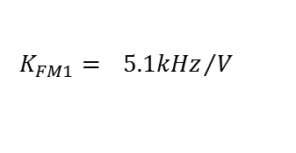
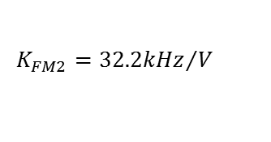
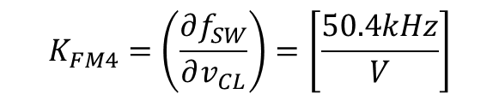
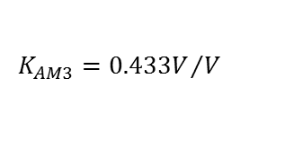
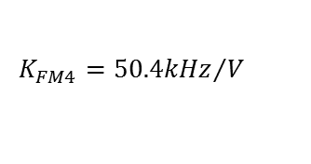
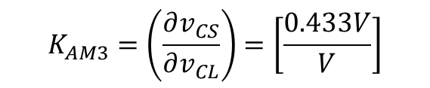
Gain Blocks Defined – K_{FMn}, K_{AM3}
Control-Law voltage to power stage modulation (FM or AM) gain:
$$K_{FM4}={50.4kHz}/V$$
$$K_{AM3}={0.433V}/V$$
$$K_{FM2}={32.2kHz}/V$$
$$K_{FM1}={ 5.1kHz}/V$$
$$K_{FM4}=\left(\frac{∂f_{SW}}{∂v_{CL}}\right)=\left[\frac{50.4kHz}{V}\right]$$
$$K_{AM3}=\left(\frac{∂v_{CS}}{∂v_{CL}}\right)=\left[\frac{0.433V}{V}\right]$$

Slide 11
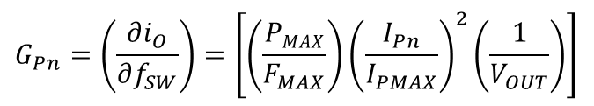
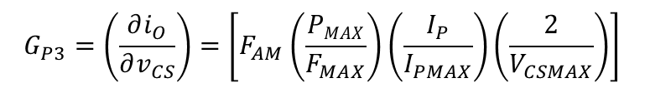
Gain Blocks Defined – G_{Pn}, G_{P3}
Power stage modulation (FM or AM) to average current gain:
TL431
$$G_{Pn}=\left(\frac{∂i_{O}}{∂f_{SW}}\right)=\left[\left(\frac{PMAX}{F_{MAX}}\right){\left(\frac{I_{Pn}}{I_{PMAX}}\right)}^{2}\left(\frac{1}{V_{OUT}}\right)\right]$$
$$G_{P3}=\left(\frac{∂i_{O}}{∂v_{CS}}\right)=\left[F_{AM}\left(\frac{PMAX}{F_{MAX}}\right)\left(\frac{I_{P}}{I_{PMAX}}\right)\left(\frac{2}{V_{CSMAX}}\right)\right]$$
I_{Pn} = I_{PMAX} for n = 4; = I_{PMAX}/4 for n = 1, 2
I_{P} = Primary peak current at specific load condition
F_{AM} = AM region switching frequency

Slide 12

Gain Blocks Defined – Z_{L}(s)
Output current to output voltage gain:
Output impedance, Z_{L}(s), comprises output capacitance in parallel with load resistance.
TL431
Factor of ½ is due to differentiation.
R_{L} = V_{OUT}/I_{OUT} at specific condition of interest.
$$Z_{L}\left(s\right)=\left(\frac{∂v_{O}}{∂i_{O}}\right)=\left[\frac{R_{L}}{2}\left(\frac{1}{1+sC_{OUT}\frac{R_{L}}{2}}\right)\right]$$

Slide 13
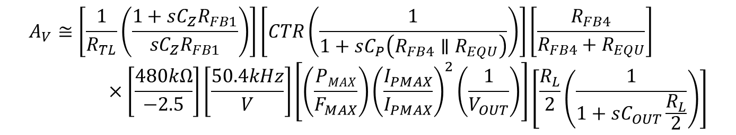
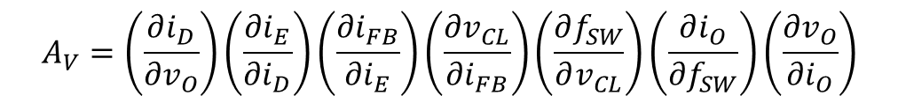
Full Loop-gain Equation
Control-Loop Gain: A_{V} = G₄₃₁(s) · G_{OPTO}(S) · G_{FB1} · G_{FB2} · K_{FMn} · G_{Pn} · Z_{L}(s)
$$A_{V}=\left(\frac{∂i_{D}}{∂v_{O}}\right)\left(\frac{∂i_{E}}{∂i_{D}}\right)\left(\frac{∂i_{FB}}{∂i_{E}}\right)\left(\frac{∂v_{CL}}{∂i_{FB}}\right)\left(\frac{∂f_{SW}}{∂v_{CL}}\right)\left(\frac{∂i_{O}}{∂f_{SW}}\right)\left(\frac{∂v_{O}}{∂i_{O}}\right)$$
$$A_{V}≅\left[\frac{1}{R_{TL}}\left(\frac{1+sC_{Z}R_{FB1}}{sC_{Z}R_{FB1}}\right)\right]\left[CTR\left(\frac{1}{1+sC_{P}\left(R_{FB4}∥R_{EQU}\right)}\right)\right]\left[\frac{R_{FB4}}{R_{FB4}+R_{EQU}}\right]×\left[\frac{480kΩ}{−2.5}\right]\left[\frac{50.4kHz}{V}\right]\left[\left(\frac{PMAX}{F_{MAX}}\right){\left(\frac{I_{PMAX}}{I_{PMAX}}\right)}^{2}\left(\frac{1}{V_{OUT}}\right)\right]\left[\frac{R_{L}}{2}\left(\frac{1}{1+sC_{OUT}\frac{R_{L}}{2}}\right)\right]$$

Slide 14
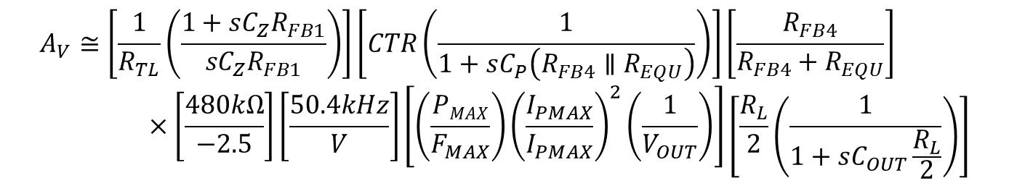
Design Considerations
$$A_{V}≅\left[\frac{1}{R_{TL}}\left(\frac{1+sC_{Z}R_{FB1}}{sC_{Z}R_{FB1}}\right)\right]\left[CTR\left(\frac{1}{1+sC_{P}\left(R_{FB4}∥R_{EQU}\right)}\right)\right]\left[\frac{R_{FB4}}{R_{FB4}+R_{EQU}}\right]×\left[\frac{480kΩ}{−2.5}\right]\left[\frac{50.4kHz}{V}\right]\left[\left(\frac{PMAX}{F_{MAX}}\right){\left(\frac{I_{PMAX}}{I_{PMAX}}\right)}^{2}\left(\frac{1}{V_{OUT}}\right)\right]\left[\frac{R_{L}}{2}\left(\frac{1}{1+sC_{OUT}\frac{R_{L}}{2}}\right)\right]$$
Limited flexibility of choice for several component values:
  R_{EQU} = device parameter, inflexible value
  P_{MAX}, F_{MAX}, and C_{OUT} are determined during DC design
  R_{TL} and R_{FB4} have narrow variability after nominal DC design consideration
  CTR has limited choice of rankings
  C_{P} can only be made larger (using external C_{CE}), not smaller
R_{FB1} and C_{Z} have wider range of values to set compensation zero

Slide 15
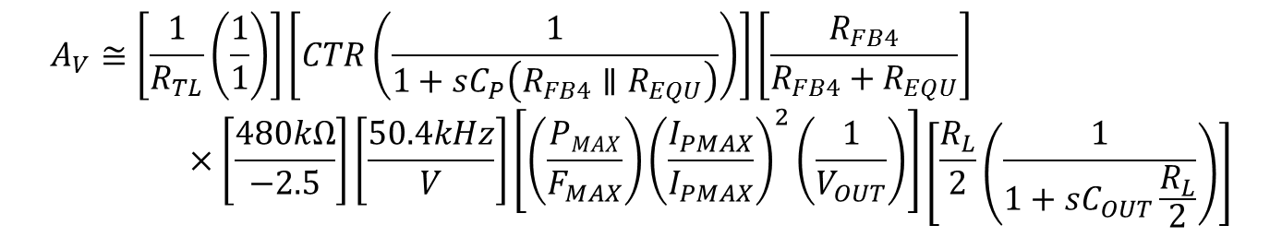
Design Considerations
Generate Bode-plot gain and phase of A_{V} at full-load condition with C_{Z} = 0.
From plot, determine the frequency (f_{Z}) where placing a zero in the response would cause the response to cross 0dB with at least 45° phase margin.
Calculate C_{Z} = 1/(2πf_{Z}R_{FB1})
If necessary, adjust C_{P} with C_{CE} such that the loop cross-over frequency < 3 kHz.
Iterate and fine-tune loop compensation during prototype evaluation.
$$A_{V}≅\left[\frac{1}{R_{TL}}\left(\frac{1}{1}\right)\right]\left[CTR\left(\frac{1}{1+sC_{P}\left(R_{FB4}∥R_{EQU}\right)}\right)\right]\left[\frac{R_{FB4}}{R_{FB4}+R_{EQU}}\right]×\left[\frac{480kΩ}{−2.5}\right]\left[\frac{50.4kHz}{V}\right]\left[\left(\frac{PMAX}{F_{MAX}}\right){\left(\frac{I_{PMAX}}{I_{PMAX}}\right)}^{2}\left(\frac{1}{V_{OUT}}\right)\right]\left[\frac{R_{L}}{2}\left(\frac{1}{1+sC_{OUT}\frac{R_{L}}{2}}\right)\right]$$

Slide 16
Simplifying Assumptions
TL431, CTR: The gain of these components do have high-frequency roll-off characteristics (pole) but are considered constant provided the loop crossover frequency is significantly lower than their respective pole frequencies.
R_{EQU} is linearized from a piece-wise linear approximation of the V_{FB}/I_{FB} curve.
The ESR-zero frequency of C_{OUT} is far above the loop crossover frequency.
C_{FB3} is more than 10 times larger than C_{P} which causes its effect on compensation to be negligible.
The product g_{M}R_{TL} > 10000, which causes several terms to become negligible (g_{M} = transconductance of TL431).

