Slide 1
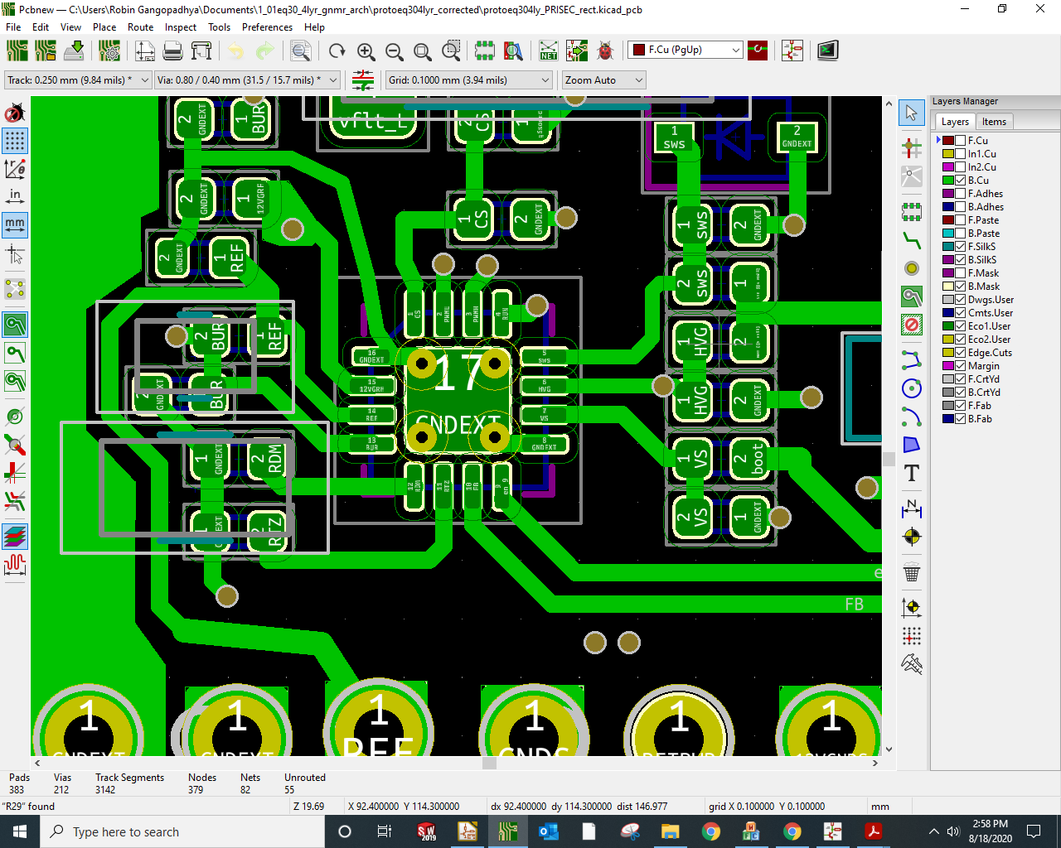
Routing around
UCC28780

