Slide 1
ULN2003A IC Troubleshooting
Design Challenge & Testing Analysis
Technical Investigation Report

Slide 2
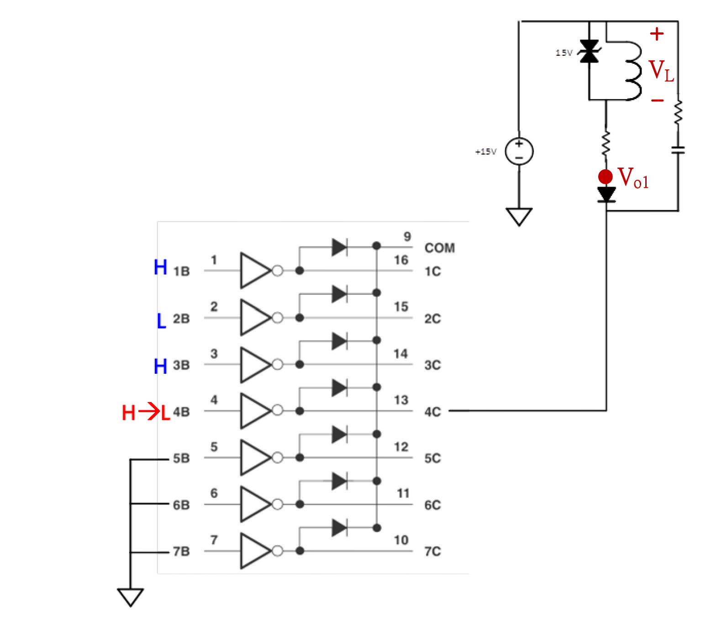
Issue #1: Output Voltage Anomaly
Circuit Description:
PIN1=HIGH, PIN2=LOW, PIN3=HIGH
PIN4 transitions from HIGH to LOW
VL generates -15V due to current is charged, Vo1 reaches ~30V relative to PIN8
Result: PIN8 and PIN9 short-circuit

Slide 3
Why Does 30V at IC Output
Cause PIN8 and PIN9 Short?
Investigation Focus:
Understanding Darlington transistor failure mechanism

Slide 4
Testing Configuration
Input pin in floating state (not grounded)
Test voltage applied at output(For example pin 16): 30V
Observation: Darlington circuit damage occurs/NG
Damage modes: Diode open(Output connected to Pin9) or output – to - ground is shorted
In datasheet, it specified the output max. Voltage is 50V, however when in above test mode with 30V, the output can be damaged?

Slide 5
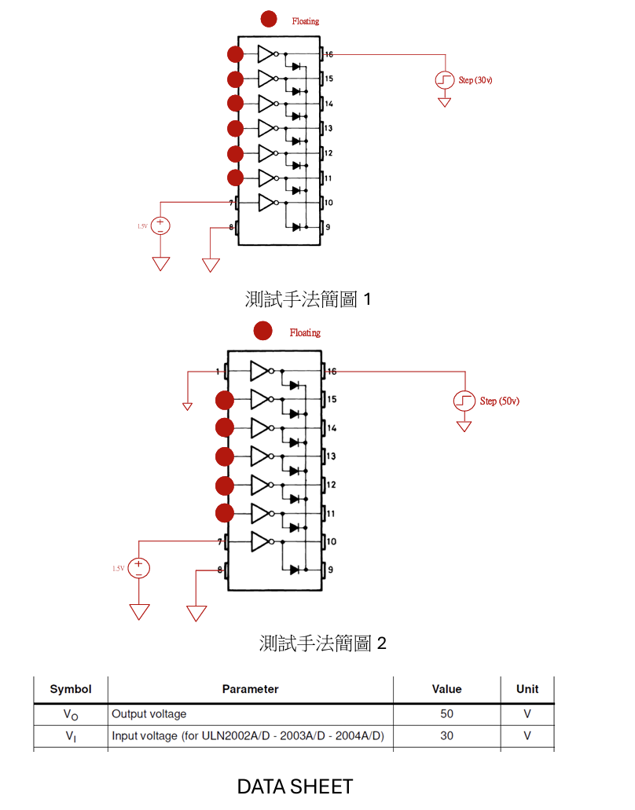
NG
GOOD

