Slide 1
USB-TypeC_Charging operation confirmation results

Slide 2
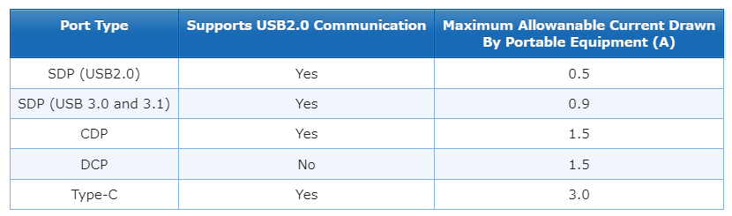
[confirmation]
D+/D- terminal voltage value and output current when detecting Type-C and BC1.2 (SDP, DCP)
BC1.2 specifies the following three types of power feeding ports(USB ports Type):
－SDP：Standard Downstream Port
－CDP：Charging Downstream Port
－DCP：Dedicated Charging Port
※ Excludes CDP with ports that support USB2.0 communication

Slide 3
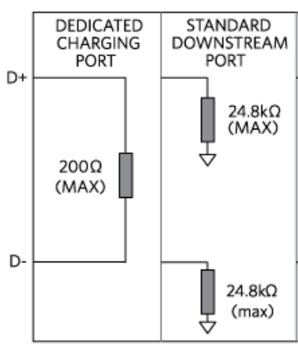
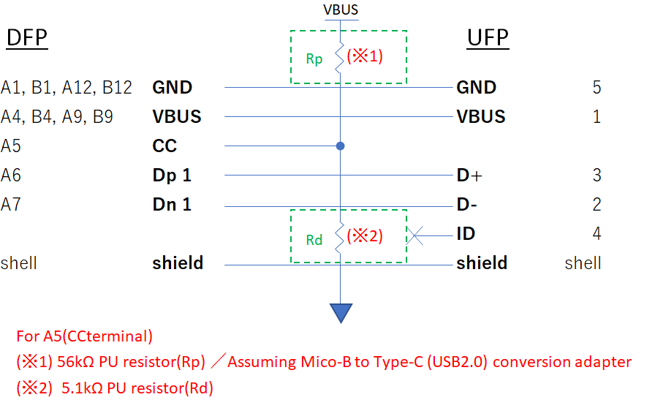
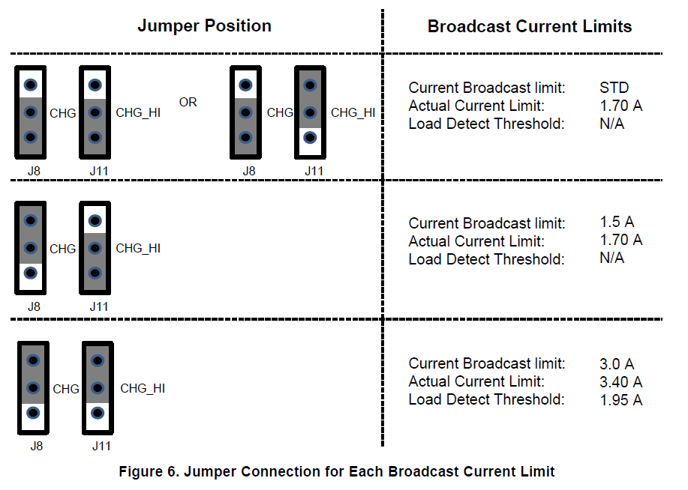
[Measurement condition]
・BC1.2 (reference:Fig1)
DCP: Short D+ and D-
SDP: 15kΩ PD resistor each for D+ and D-
・Type-C (reference:Fig2)
CC:Implement Rp or Rd
※Connect a load resistor to the Type-C receptacle (between VBUS and GND)
or without load resistance
Fig1
Fig2
[Target board]
TPS25810EVM
※ Main IC is TPS25810 and TPS2514A
※J15：short (Connect with TPS2514A)

Slide 4
Charging Current
no
VBUS
Detect
Data
Contact
Detect
Primary
Detection
Secondary
Detection
yes
yes
(※1)(※2)
(※3)
(※4)
SDP or CDP/DCP
SDP
CDP or DCP
CDP
USB2.0:0.5A
USB3.*:0.9mA
(※1) Wait 300-900ms after "attach" and move to Primary Detection
DCP
1.5A
(※2) Determine whether BC1.2 is supported
3A
(※3) Determine whether SDP or CDP/DCP
ACA Detection
Type-C
(※4) Determine whether CDP or DCP
(※5)
D+/D- =OPEN
(※5) Only determined for portable devices with Micro-AB sockets

Slide 5
[Confirmation details]
Measurement condition
with load resistance (Connect 1Ω/20W products in series and check current when load resistance is 2Ω)
Purpose
D+/D- terminal voltage value and output current when detecting Type-C and BC1.2 (SDP, DCP)
Question matters
(1) Type-C and USB port type (BC1.2): When checking the waveforms of D+ and D- when using DCP,
it was found that they were at the same voltage level.
I would like to know if the behavior is correct at the same voltage level and how to control the current.
(Type-CとUSB port type(BC1.2)：DCPの時のD+、D-の波形を確認すると同じ電圧レベルであることが分かった。
同一電圧レベルで挙動としては合っているのか、電流をどのように制御いるのかをご教授頂きたい。)
(2) Confirmed current measurement of Type-C and USB port type (BC1.2)/DCP, SDP using cement resistance (load resistance).
As a result, the current value did not change regardless of the state.
I would like to know how to control the current and how to measure the current when using the USB port type (BC1.2).
(Type-C及び、USB port type(BC1.2)／DCP,SDPの電流測定をセメント抵抗(負荷抵抗)を使用して確認をした。
結果としては、状態によらず電流値は変わらなかった。
電流制御方法及び、USB port type(BC1.2)の時の電流測定方法をご教授頂きたい。)

Slide 6
Differences depending on the conversion adapter to be connected
CC terminal is connected to GND via resistor Rd (5.1 kΩ ± 5%) (Fig1)
CC terminal is connected via Rd and Rp in Fig1 and Fig2 (Fig2)
※When the CC terminal is connected to VBUS through the resistor Rp (56 kΩ ± 5%),
Vout>=5[V] (actual value: 2[V]), so the output condition is not satisfied.
Therefore, it is excluded from the measurement conditions.
5V(INPUT)
5V(INPUT)
Fig1. Rd=5.1k for CC1
Fig2. Rd=5.1k,Rp=56k for CC1

Slide 7
Differences by USB port type
Check behavior when charging ports are different
⇒ As a result, the voltage level was the same when D+/D- = OPEN and when D+ and D- were shorted.
Fig3-1. CHG=H、CHG_HI=H、Rd=5.1k、D+／D-=OPEN (Type-C)
Fig4-1. CHG=H、CHG_HI=H、Rd=5.1k、 Short D+ and D- (DCP)
Fig5-1. CHG=H、CHG_HI=H、Rd=5.1k、15kΩ PD resistor each for D+ and D- (SDP)

Slide 8
Fig3-1. CHG=H、CHG_HI=H、Rd=5.1k、D+／D-=OPEN (Type-C)
Fig4-1. CHG=H、CHG_HI=H、Rd=5.1k、 Short D+ and D- (DCP)
Fig5-1. CHG=H、CHG_HI=H、Rd=5.1k、15kΩ PD resistor each for D+ and D- (SDP)

Slide 9
[Appendix]
Excerpt from Universal Serial Bus
Type-C Cable and Connector Specification

Slide 10
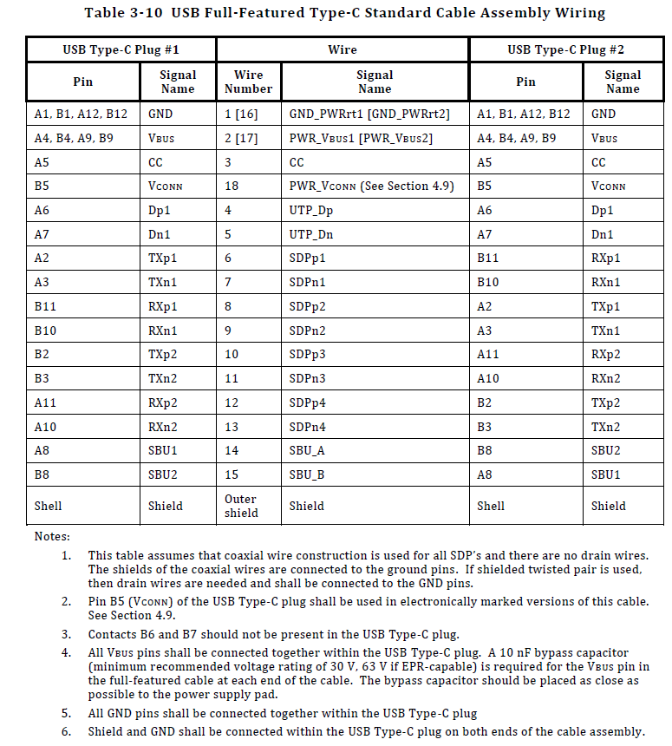
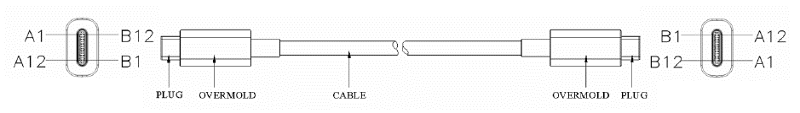
Type-C to Type-C

Slide 11
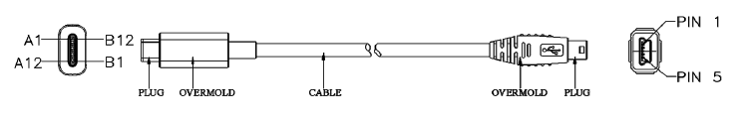
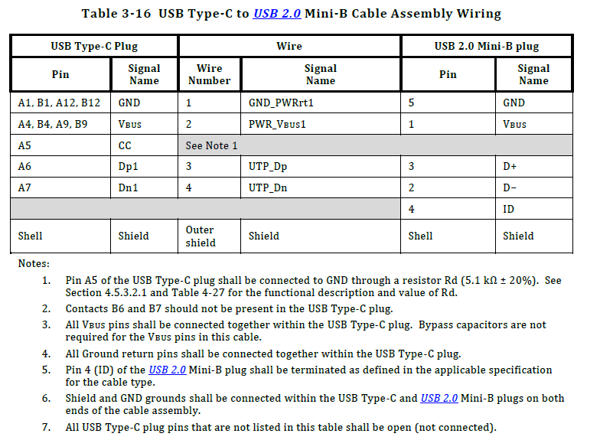
Type-C to Mini-B Cable (USB2.0)

Slide 12
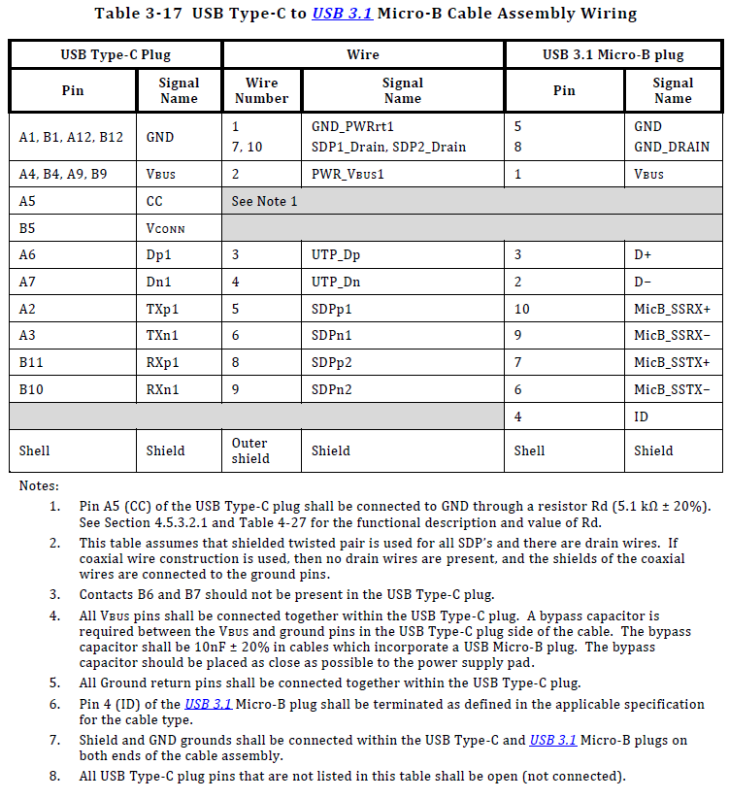
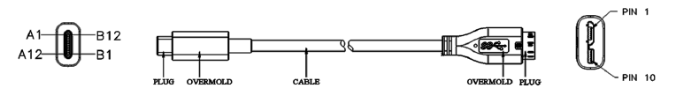
Type-C to Mico-B Cable (USB3.1)

Slide 13
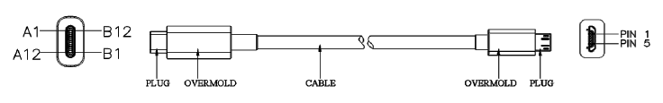
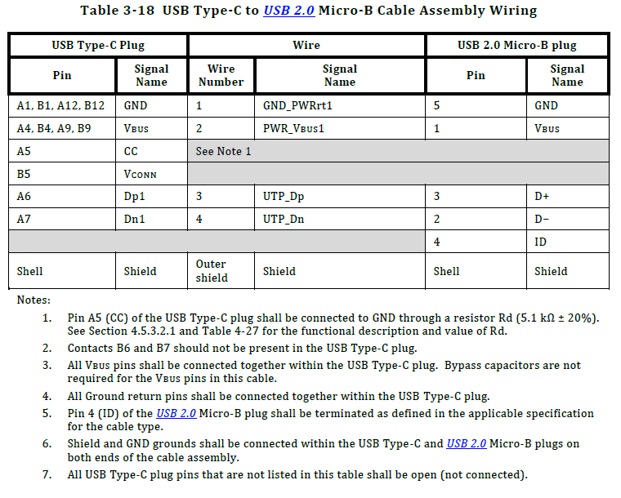
Type-C to Mico-B Cable (USB2.0)

Slide 14
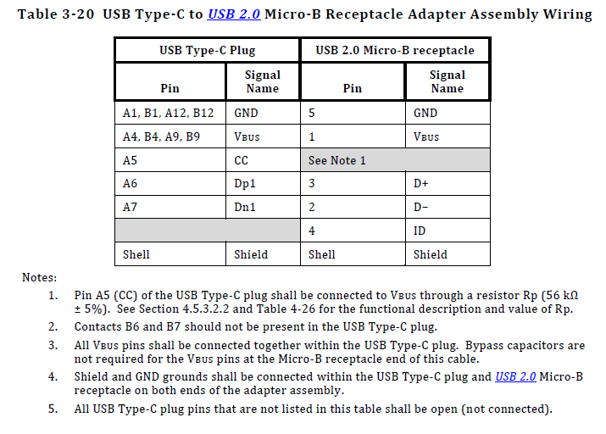
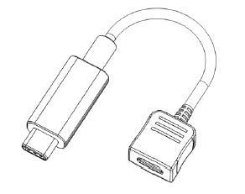
Mico-B to Type-C (USB2.0)_Conversion Adapter

