Slide 1
External UVLO Ideas
Rev C
8/5/2025

Slide 2
Common Themes
See spreadsheet files in zip file for design help.
  Yellow are inputs
The divider current (Ion) should be large enough to swamp out any input current into the EN pin.
Check Ion, the voltage at the EN input and at the PGOOD pin, at maximum input voltage, to ensure compliance with data sheet Abs. Max requirements.
If possible, simulate with actual regulator models under the specific application conditions.
If possible, test with EVM.
Refer to document in appendix

Slide 3
Common Themes (cont.)
V_{OFF} = Input voltage to turn off regulator
V_{ON} = Input voltage to turn on regulator
V_{ENH} = EN input rising threshold voltage
V_{ENL} = EN input falling threshold voltage
I_{ON} = Current in EN divider
V_{REF} = Zener diode voltage or reference diode voltage
I_{HYST} = Internal EN hysteresis current. Current flows out of EN pin when device turns on. No current with device off.

Slide 4
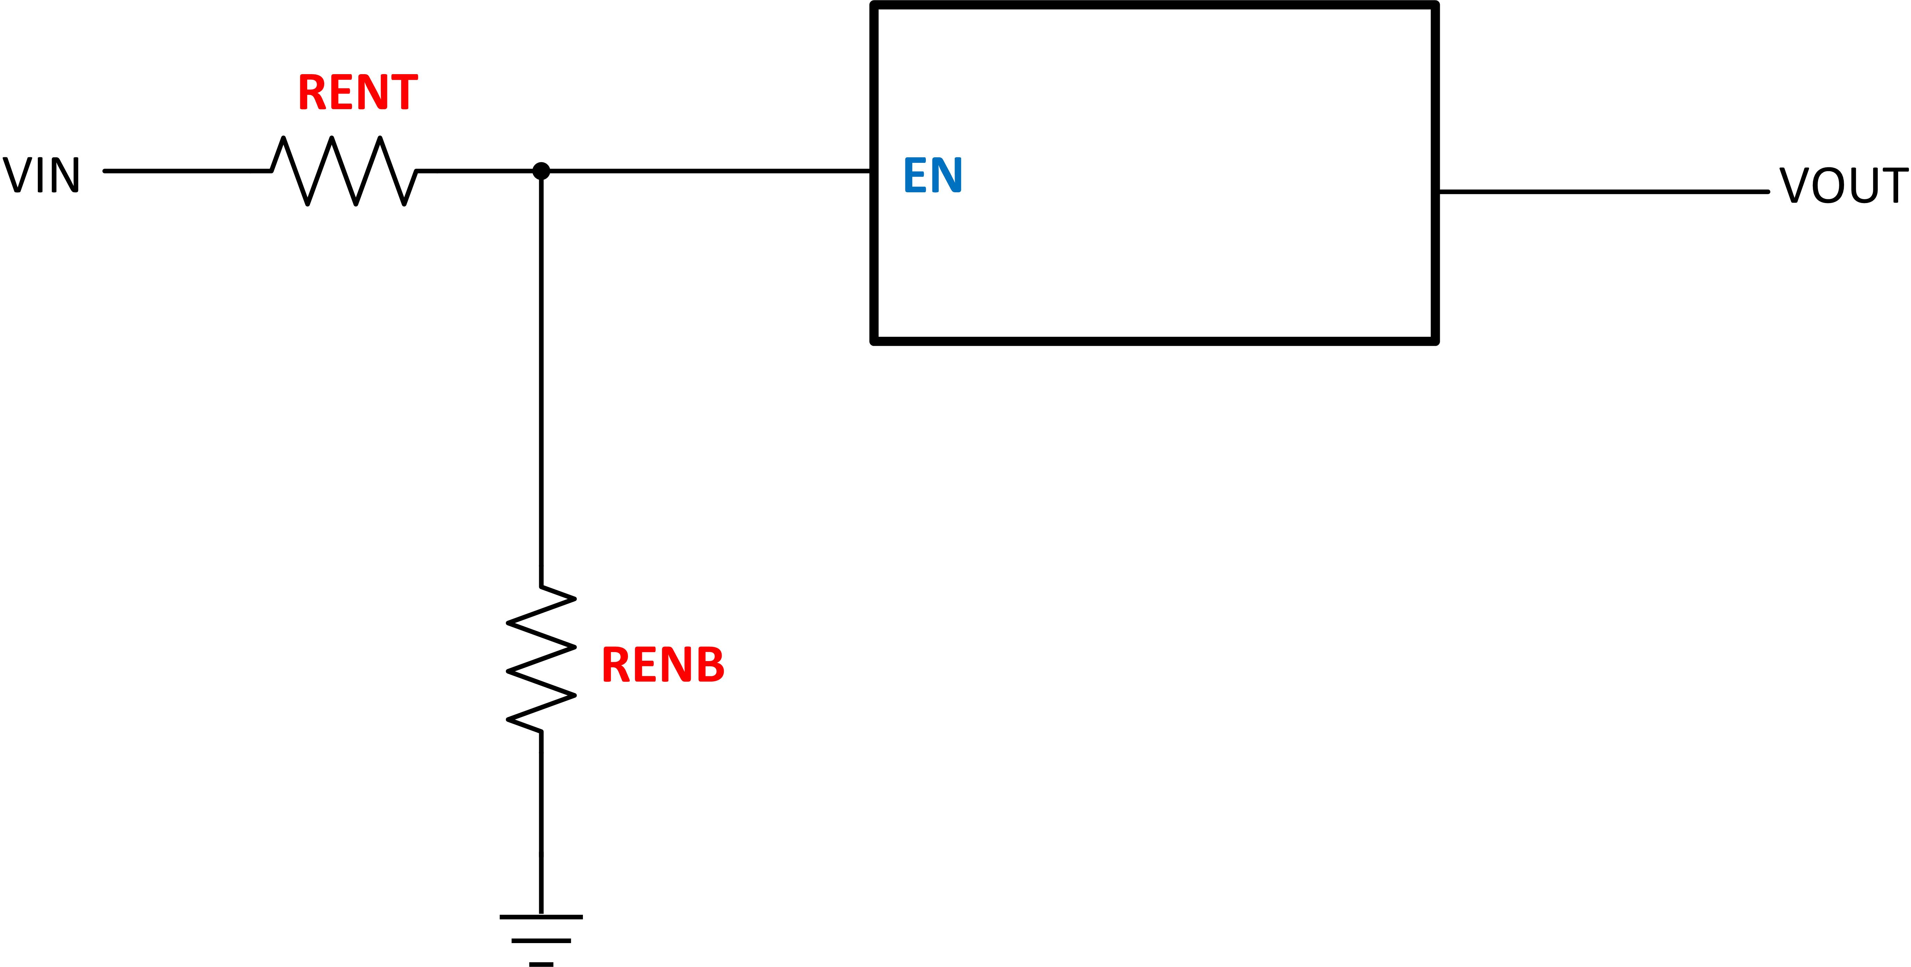
UVLO w/ Internal EN
V_{ON} and I_{ON} are designable
V_{OFF} (and hysteresis) fixed by internal EN hysteresis
Should choose device with precision EN thresholds and hysteresis
See calc tool for equations and design or relevant data sheet

Slide 5
UVLO w/ Internal EN Hysteresis Current
V_{ON} and V_{OFF} are designable
Should choose device with precision EN thresholds and hysteresis current
I_{HYST} flows out of EN when device is on; no current when device is off
See calc tool for equations and design or relevant data sheet

Slide 6
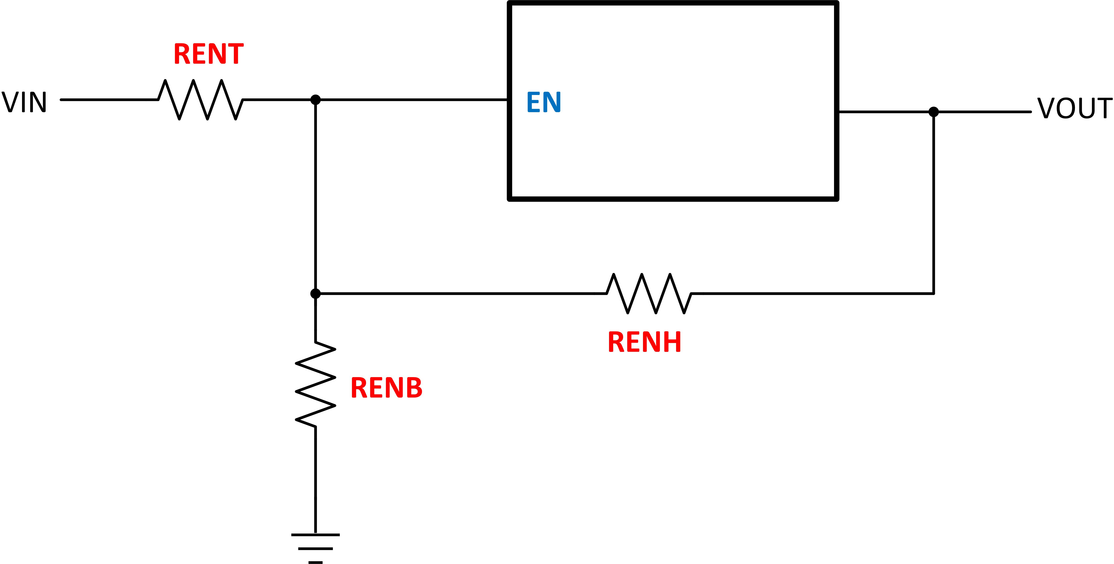
UVLO w/ VOUT for Hysteresis
Used with devices that don't (or do) have EN hysteresis but application needs more hysteresis
V_{ON}, V_{OFF}, and Ion are designable
May not give good “snap” action due to slow change of output voltage during start-up and shut-down.
See calc tool for equations and design

Slide 7
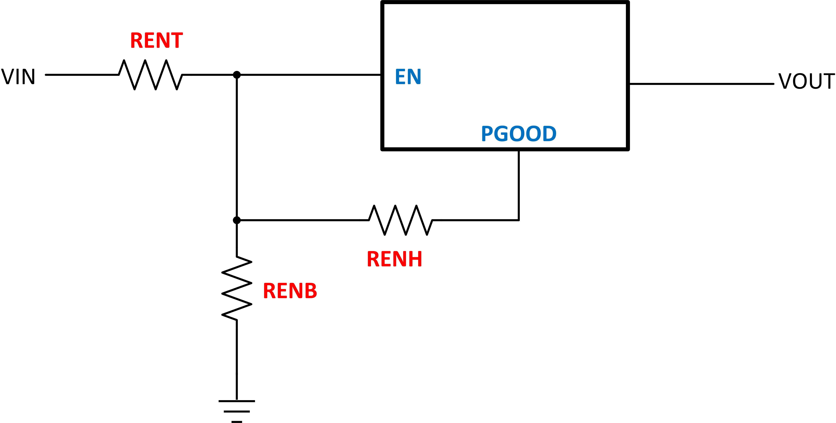
UVLO w/ PGOOD for Hysteresis
Used with devices that don't (or do) have EN hysteresis but application needs more hysteresis
Von, Voff, and Ion are designable
May give better “snap” action due to fast response of PGOOD during start-up and shut-down.
See calc tool for equations and design

Slide 8
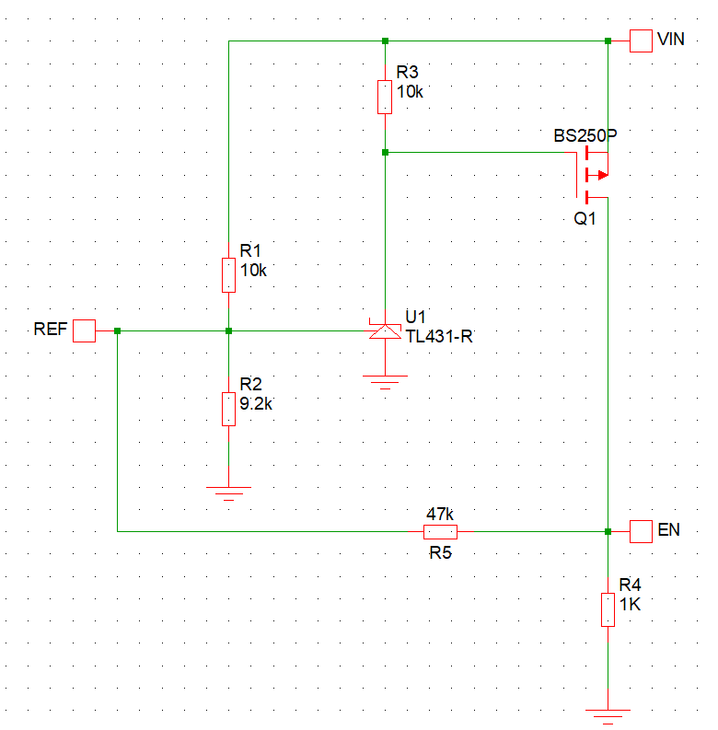
UVLO w/ Discreate Components
Used with regulators that do not have precision EN thresholds or the hysteresis is not selectable
Von, Voff are designable
Use generic '431 shunt regulator as comparator
  See attached App note
LM3411 may be another option
  See data sheet
Not as accurate as separate reference and comparator

Slide 9
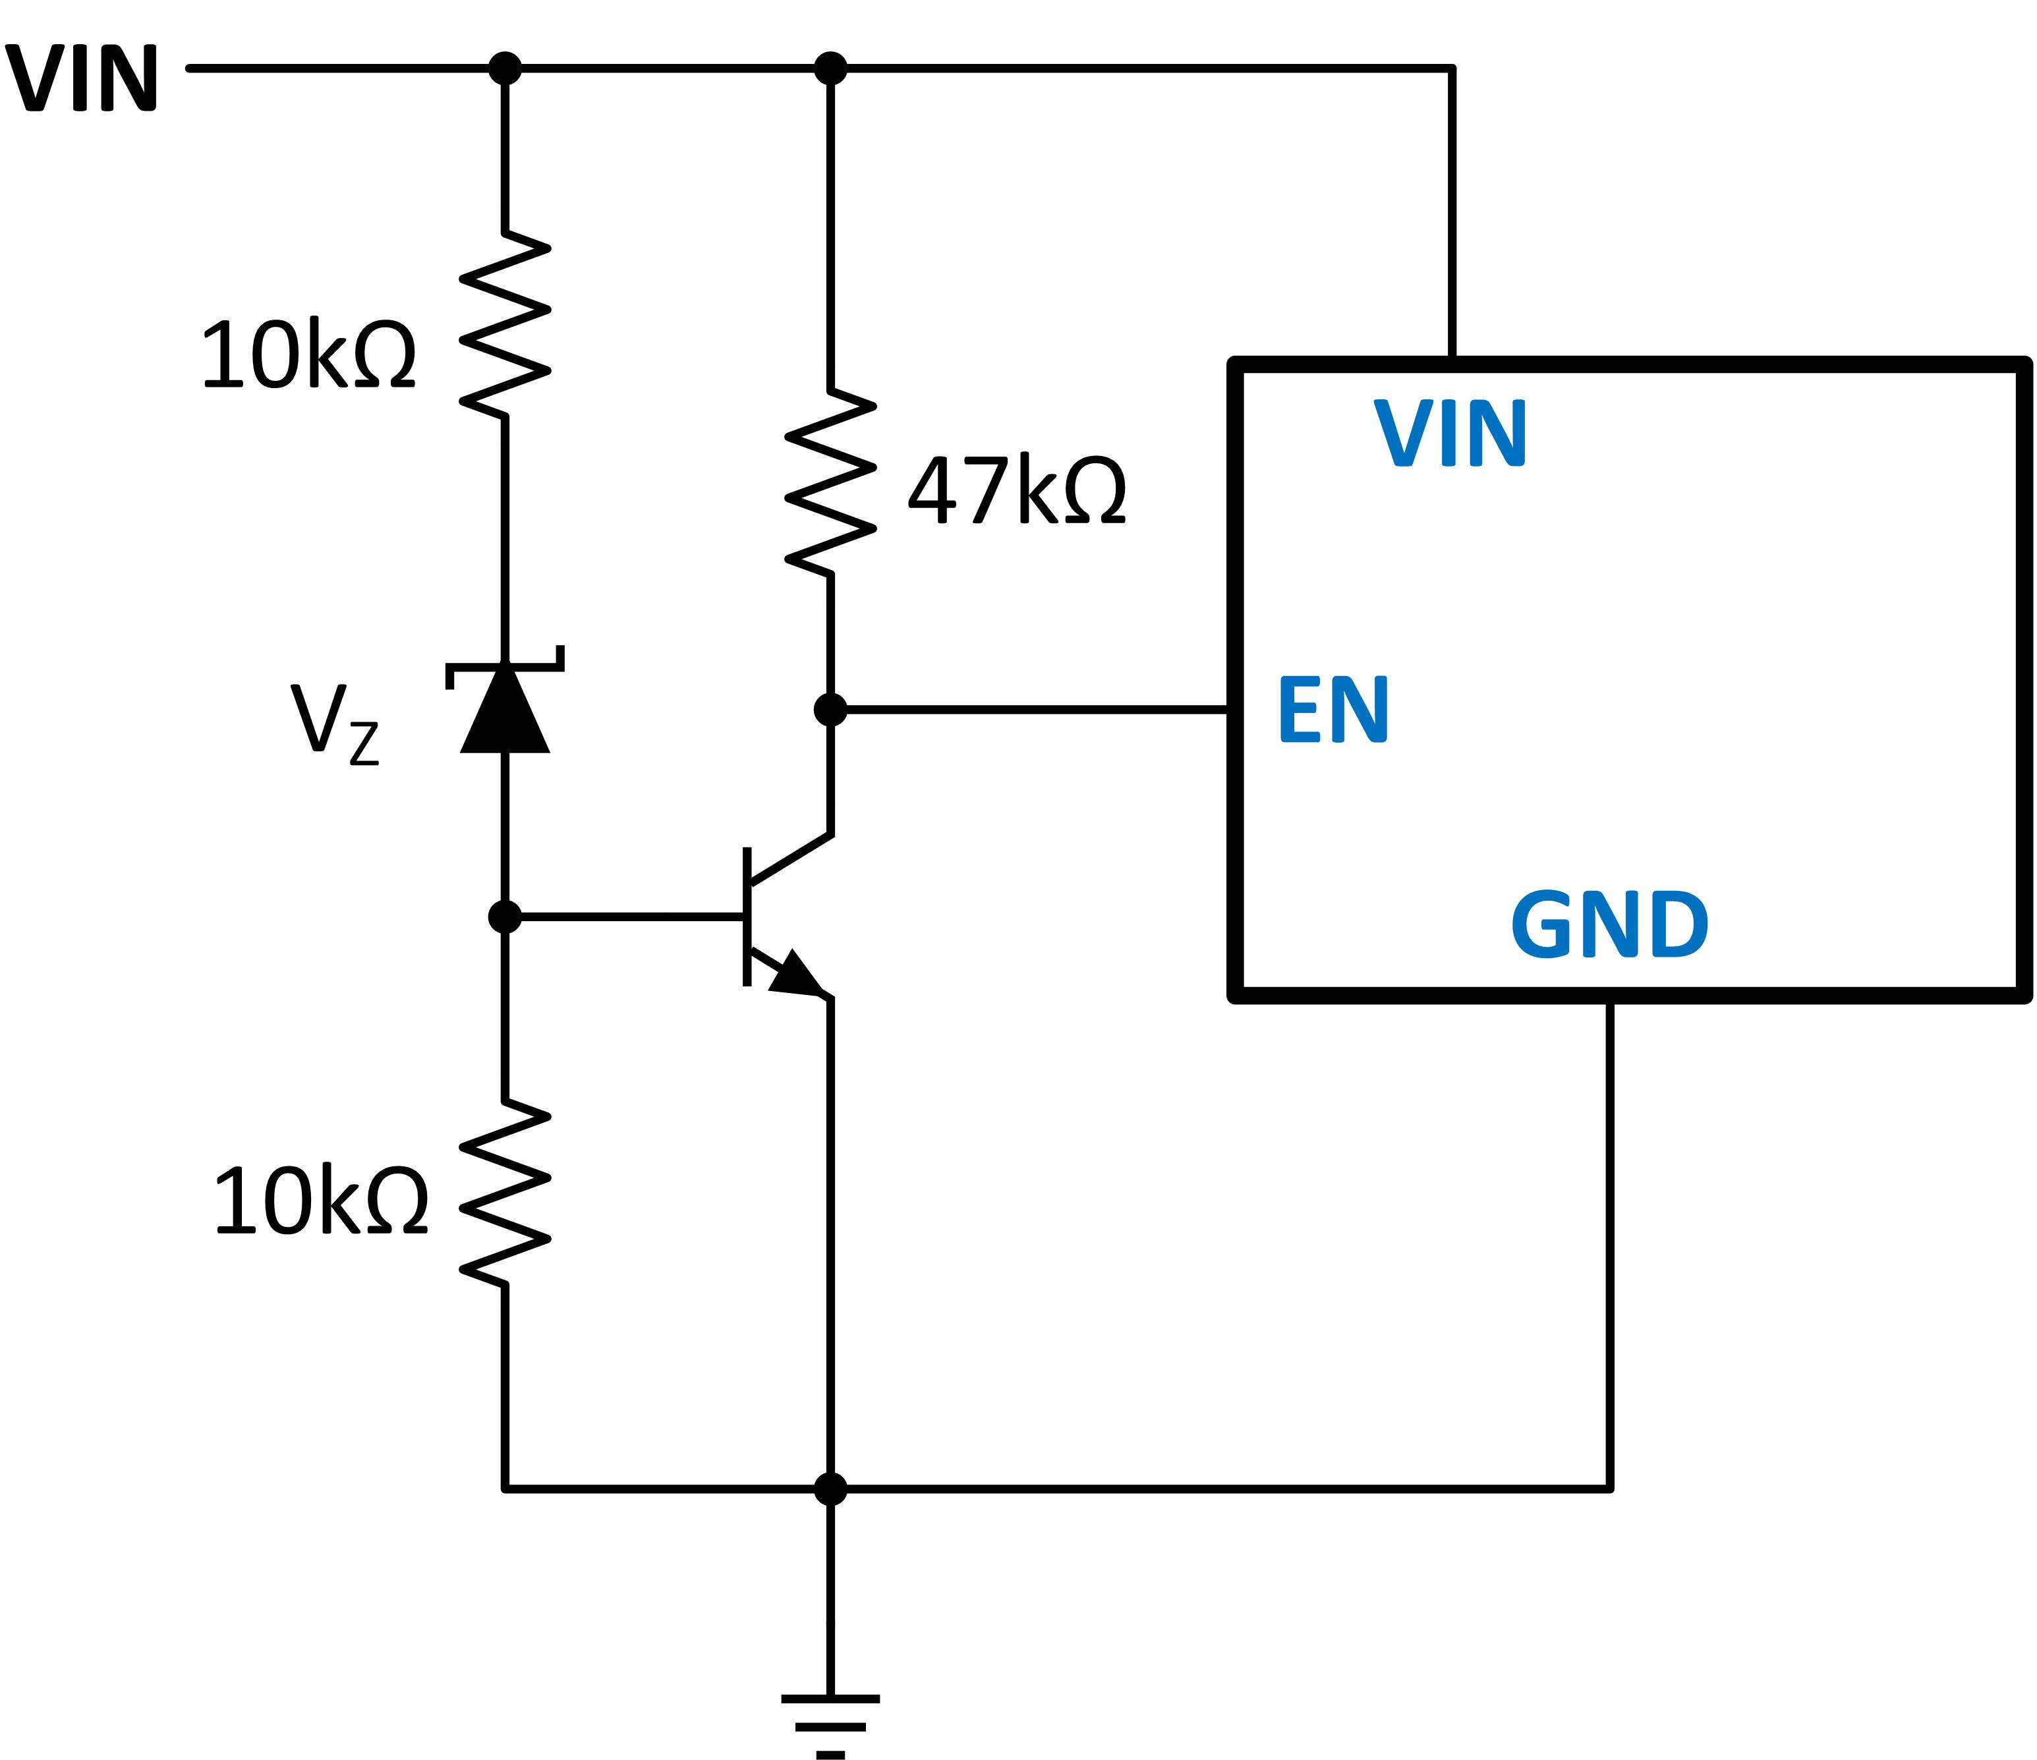
UVLO for Devices with Negative Logic EN
Used with devices that have EN=Low for “ON” and EN=High for “OFF”; like Antique Gen.
Very little hysteresis
Von is set by ~V_{Z}+V_{BE}
Values in schematic are only examples; customer needs to work out design based on application requirements.

Slide 10
UVLO for IBB Applications
Without external UVLO the shutdown is very messy
  Device enters drop-out and/or current limit while in boost mode
  Very high input currents
  Device shuts down when |V_{OUT}| ≈ internal UVLO
    Vin very low at this point; supplying loss
Start-up is normal at internal UVLO point
  V_{OUT} = 0V

Slide 11
Some Ideas
#1: Connect bottom of RENB to –VOUT
#2: Use Zener between VIN and EN
#3: Discreate PNP and xx431 reference
#4: Comparator with reference and level shifter

Slide 12
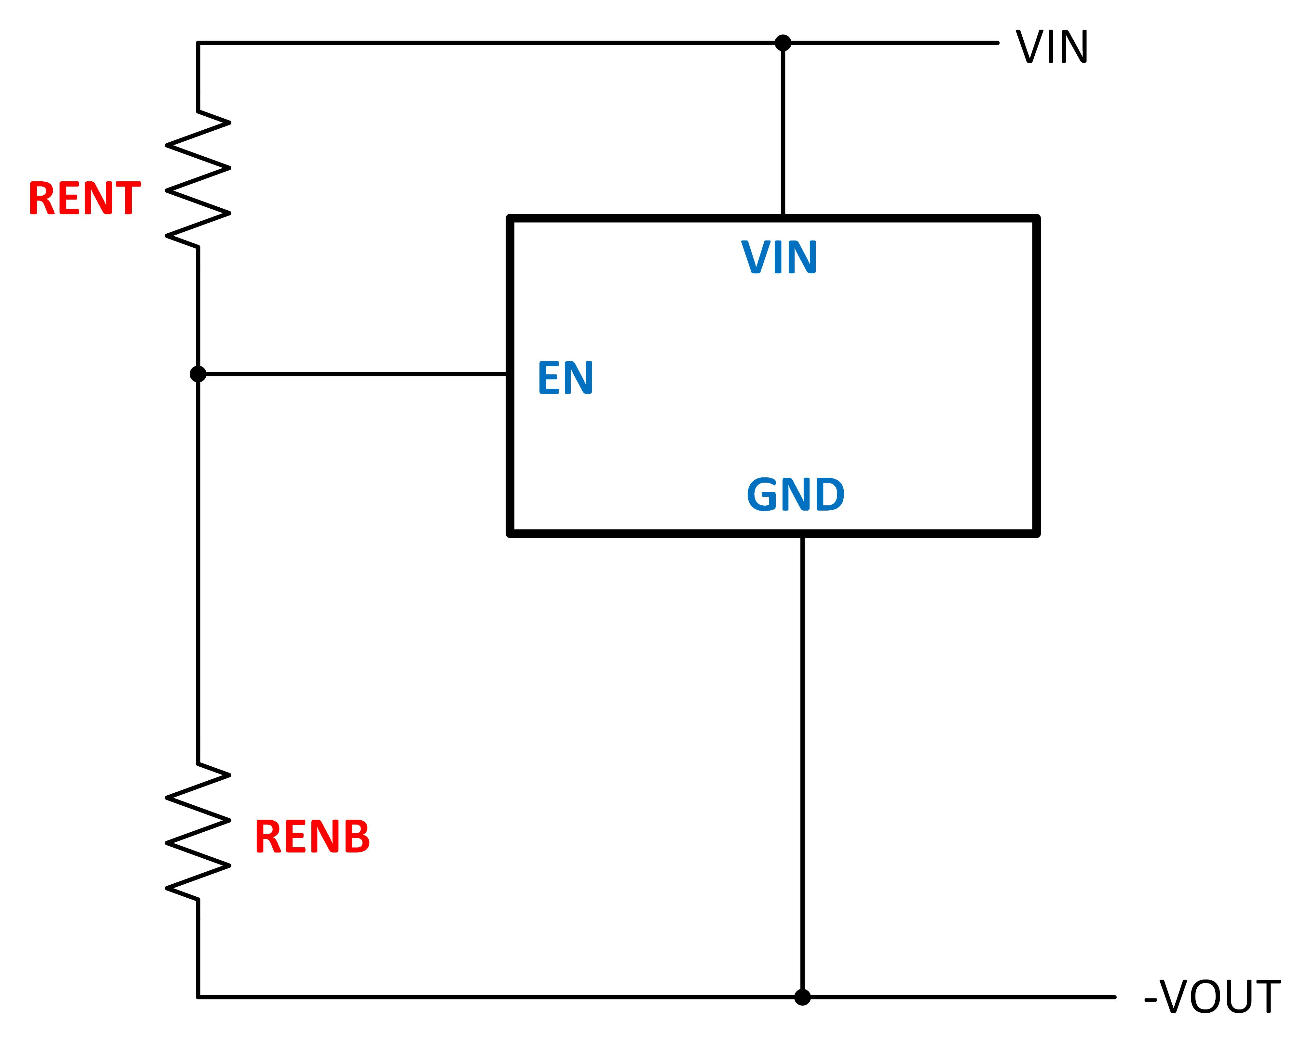
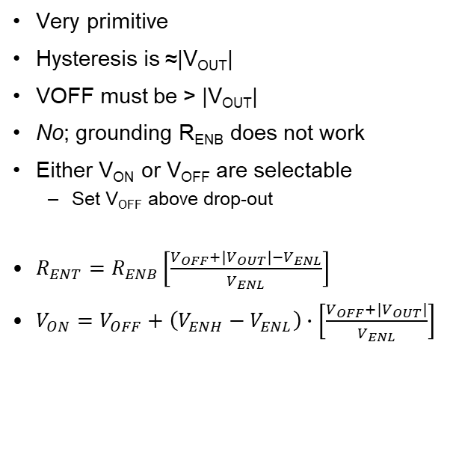
UVLO for IBB #1
Very primitive
Hysteresis is ≈|V_{OUT}|
VOFF must be > |V_{OUT}|
No; grounding R_{ENB} does not work
Either V_{ON} or V_{OFF} are selectable
  Set V_{OFF} above drop-out
$R_{ENT}=R_{ENB}\left[\frac{V_{OFF}+\left|V_{OUT}\right|−V_{ENL}}{V_{ENL}}\right]$
$V_{ON}=V_{OFF}+\left(V_{ENH}−V_{ENL}\right)∙\left[\frac{V_{OFF}+|V_{OUT}|}{V_{ENL}}\right]$

Slide 13
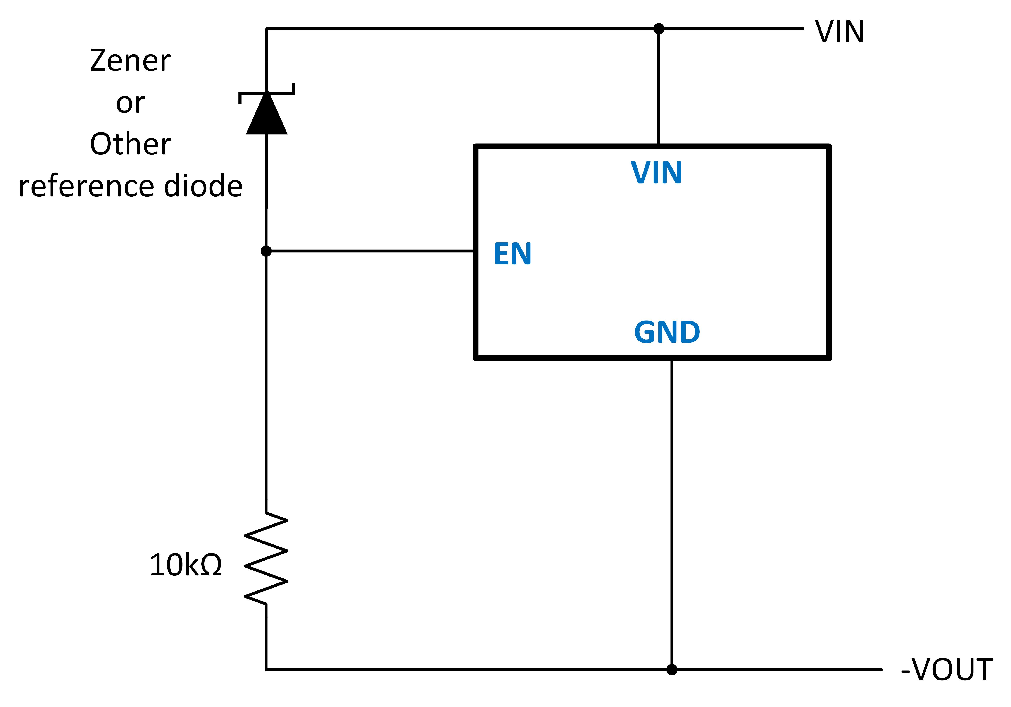
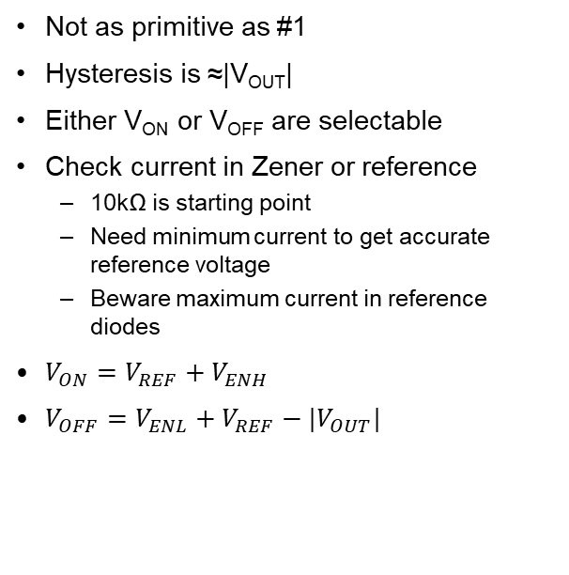
UVLO for IBB #2
Not as primitive as #1
Hysteresis is ≈|V_{OUT}|
Either V_{ON} or V_{OFF} are selectable
Check current in Zener or reference
  10kΩ is starting point
  Need minimum current to get accurate reference voltage
  Beware maximum current in reference diodes
$V_{ON}=V_{REF}+V_{ENH}$
$V_{OFF}=V_{ENL}+V_{REF}−|V_{OUT}|$

Slide 14
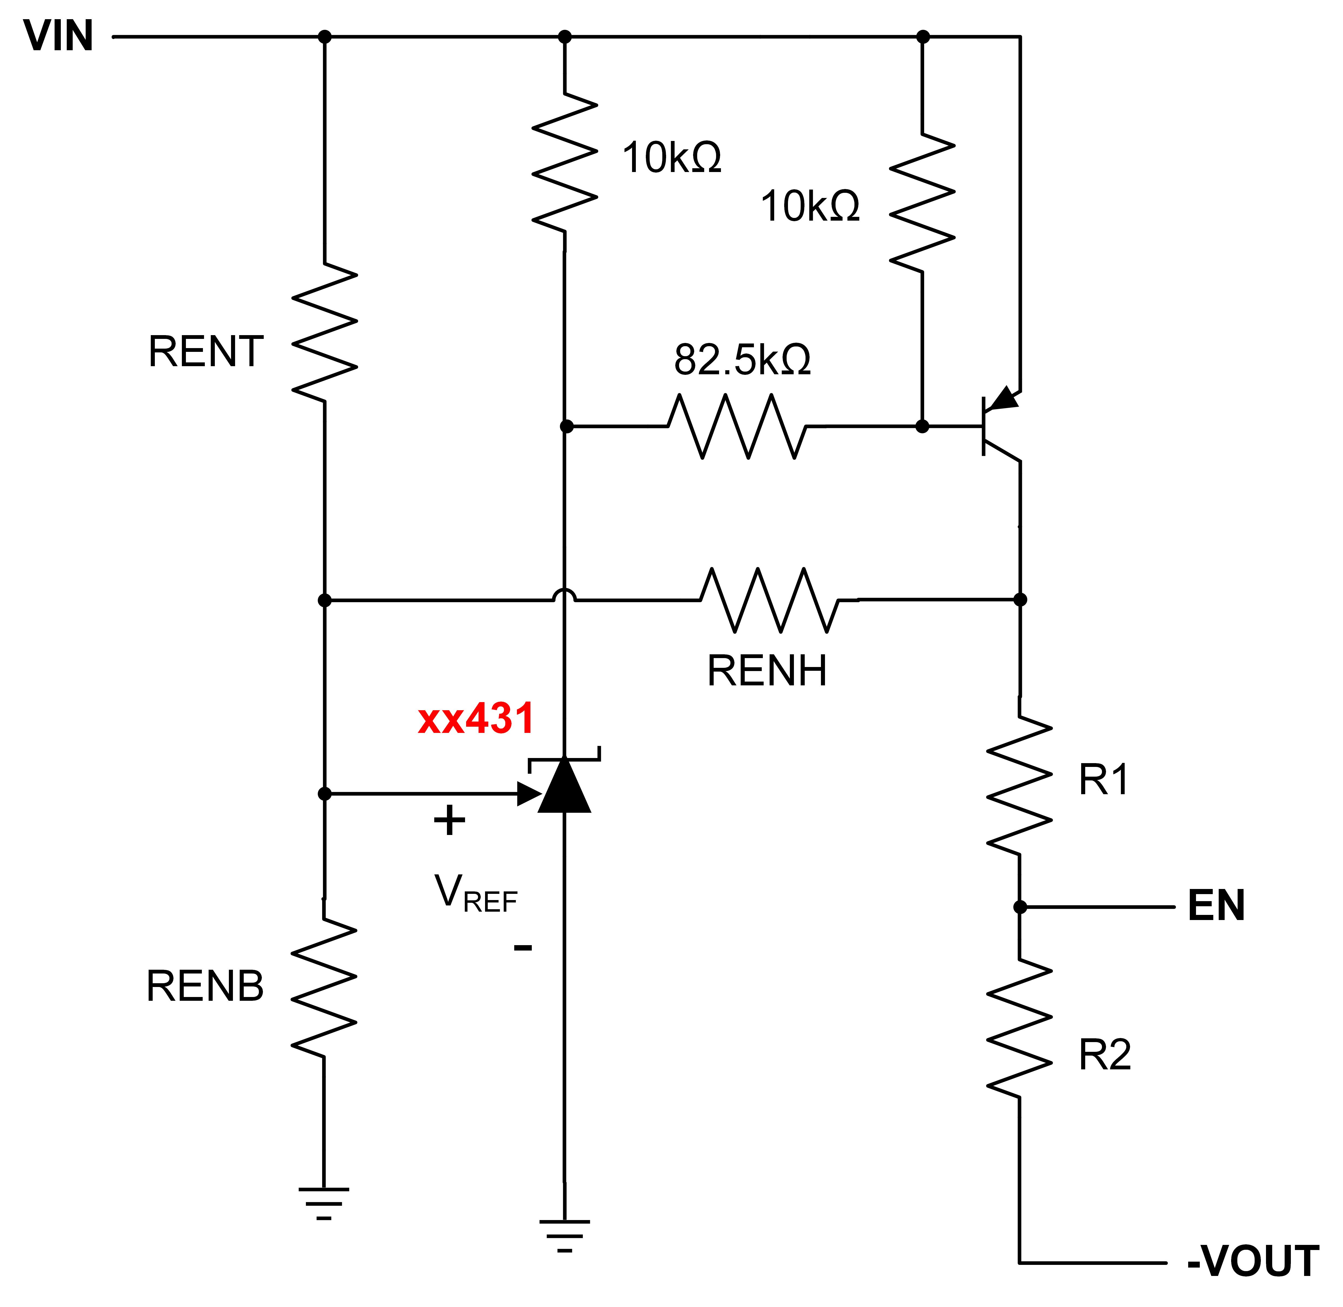
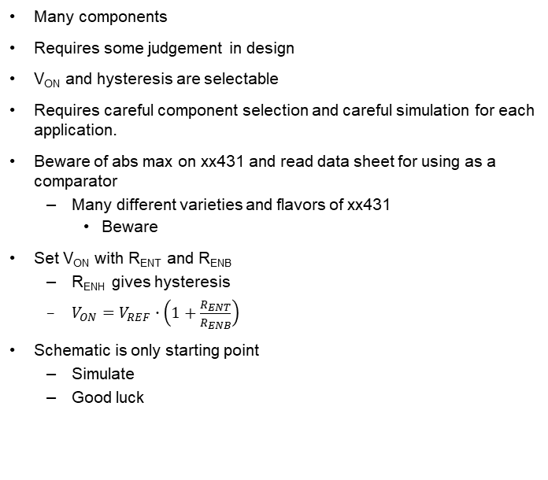
UVLO for IBB #3
Many components
Requires some judgement in design
V_{ON} and hysteresis are selectable
Requires careful component selection and careful simulation for each application.
Beware of abs max on xx431 and read data sheet for using as a comparator
  Many different varieties and flavors of xx431
    Beware
Set V_{ON} with R_{ENT} and R_{ENB}
  R_{ENH} gives hysteresis
  $V_{ON}=V_{REF}∙\left(1+\frac{R_{ENT}}{R_{ENB}}\right)$
Schematic is only starting point
  Simulate
  Good luck

Slide 15
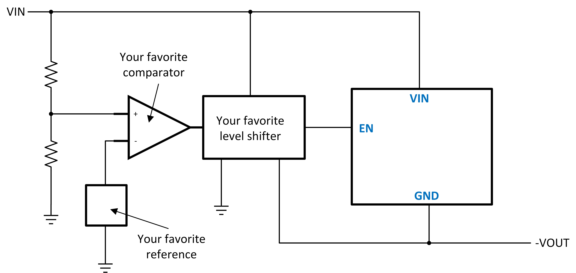
UVLO for IBB #4
Most accurate and designable
Many expensive components
Self explanatory
  Don’t forget the hysteresis

Slide 16
APPENDIX

Slide 17
Supervisor and Reset ICs

Slide 18
Important notice and disclaimer
TI PROVIDES TECHNICAL AND RELIABILITY DATA (INCLUDING DATASHEETS), DESIGN RESOURCES (INCLUDING REFERENCE DESIGNS), APPLICATION OR OTHER DESIGN ADVICE, WEB TOOLS, SAFETY INFORMATION, AND OTHER RESOURCES “AS IS” AND WITH ALL FAULTS, AND DISCLAIMS ALL WARRANTIES, EXPRESS AND IMPLIED, INCLUDING WITHOUT LIMITATION ANY IMPLIED WARRANTIES OF MERCHANTABILITY, FITNESS FOR A PARTICULAR PURPOSE OR NON-INFRINGEMENT OF THIRD PARTY INTELLECTUAL PROPERTY RIGHTS.
These resources are intended for skilled developers designing with TI products. You are solely responsible for (1) selecting the appropriate TI products for your application, (2) designing, validating and testing your application, and (3) ensuring your application meets applicable standards, and any other safety, security, or other requirements.
These resources are subject to change without notice. TI grants you permission to use these resources only for development of an application that uses the TI products described in the resource. Other reproduction and display of these resources is prohibited. No license is granted to any other TI intellectual property right or to any third party intellectual property right. TI disclaims responsibility for, and you will fully indemnify TI and its representatives against, any claims, damages, costs, losses, and liabilities arising out of your use of these resources.
TI’s products are provided subject to TI’s Terms of Sale or other applicable terms available either on ti.com or provided in conjunction with such TI products. TI’s provision of these resources does not expand or otherwise alter TI’s applicable warranties or warranty disclaimers for TI products.

