Slide 1
Vin=12V, Vout=5V
Question List:
1. What condition is necessary for VCC power on?
2. We set the timing between Vin and EN to the same. And then restart many times to check VCC, but VCC behaves differently. Can you explain?
3. We only provide VIN=12V (EN=0V) but VCC rises to 1.18V. Is this normal?

Slide 2
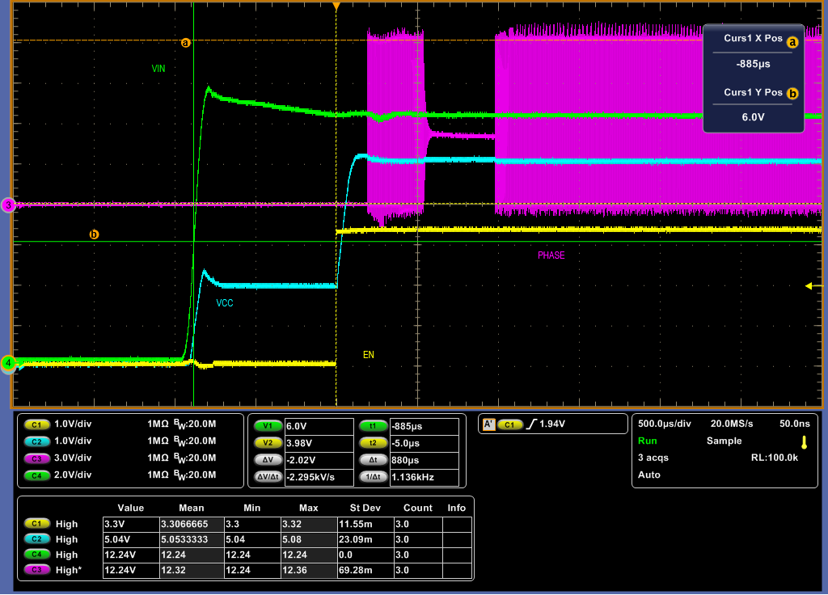
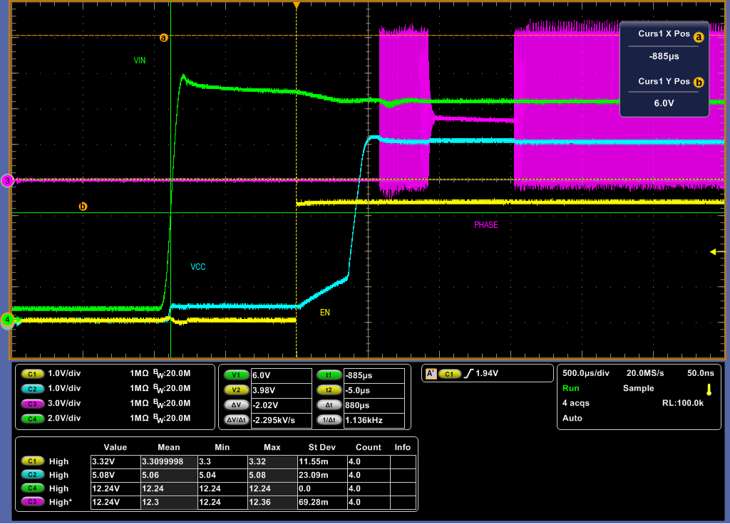
Question 2

Slide 3
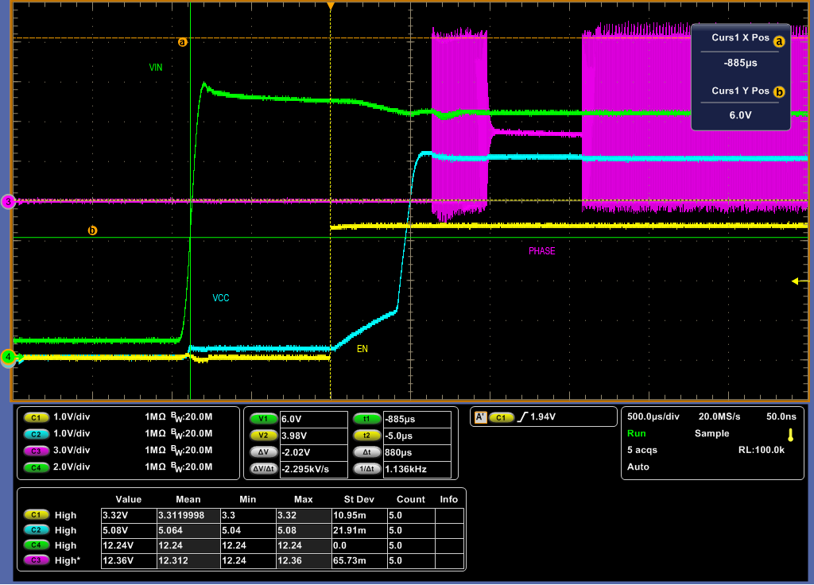

Question 2

Slide 4
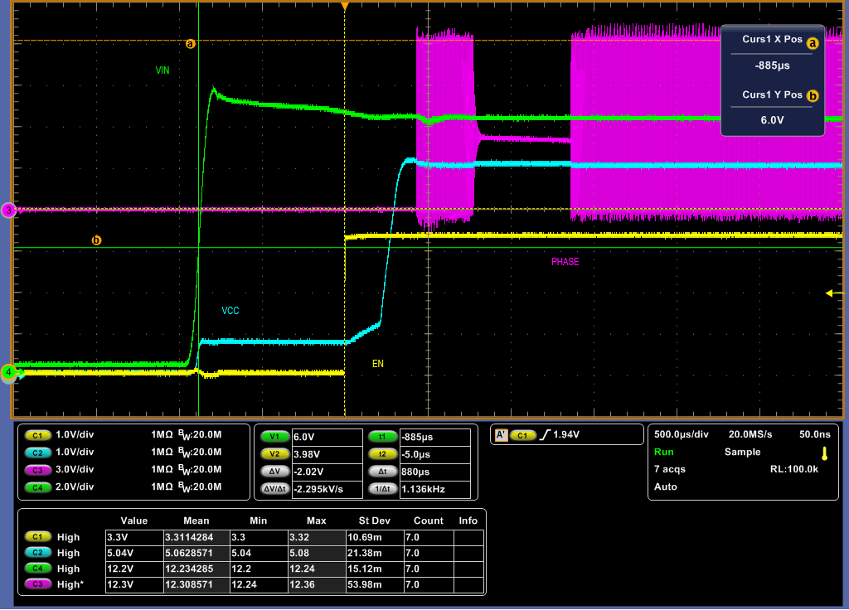
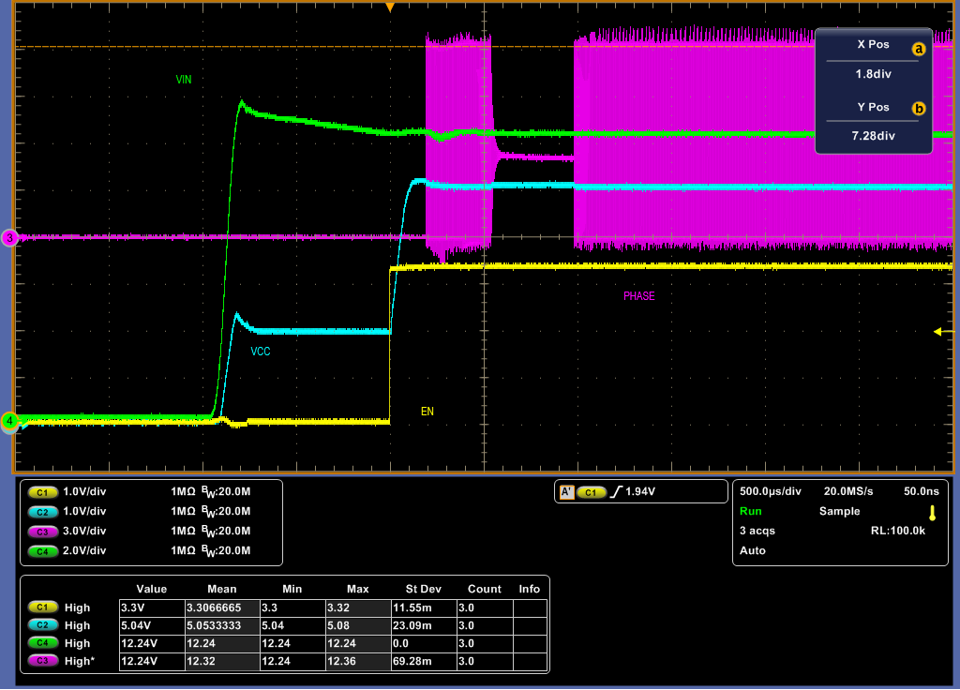
Question 2

Slide 5
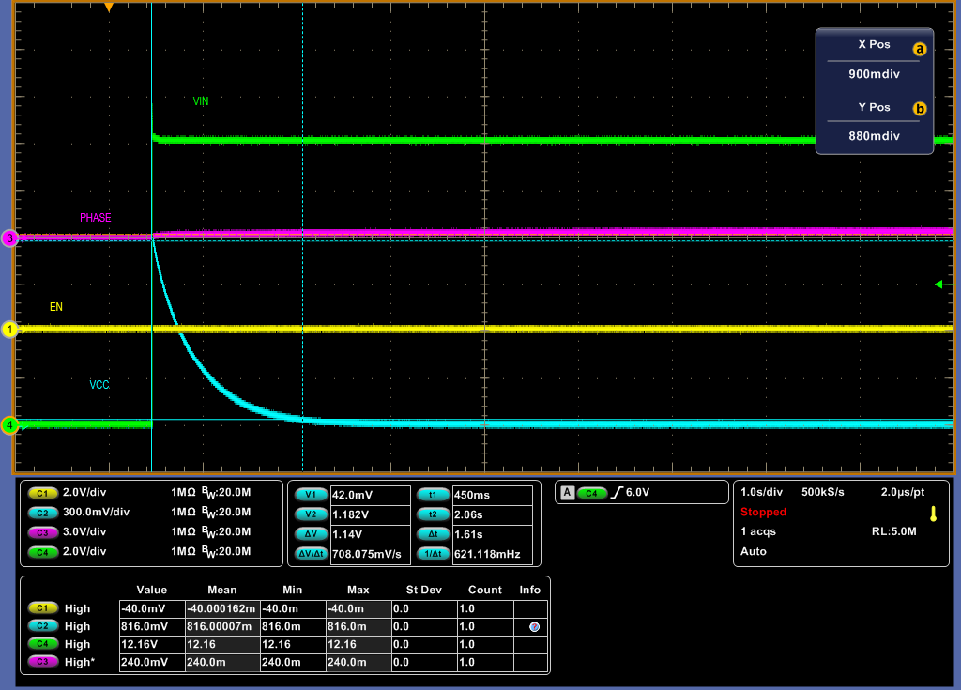
Question 3

