Slide 1
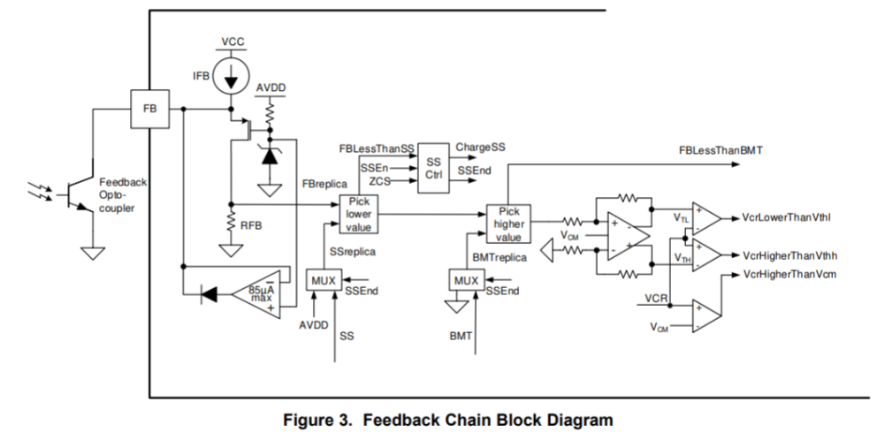
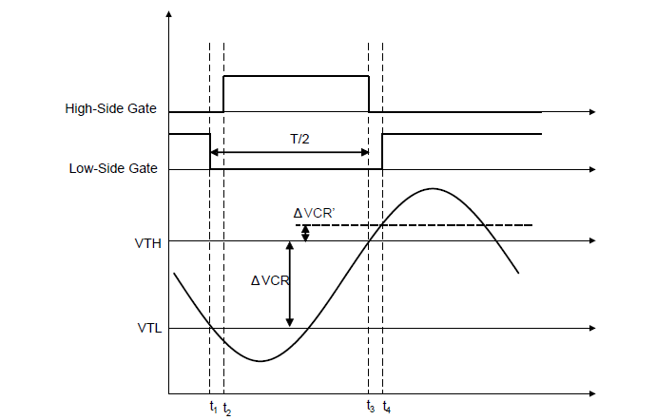





VFB = IFB*RFB Sets Drive High and Low Turn Off
$$I_{RFB}=IFB −I_{C}$$
$$V_{RFB}=I_{RFB}×R_{FB}$$
clamp
I_{C}
$V_{RFB(max)}=6V$, Clamped Internally
$$V_{RFB}=VTH−VTL$$
I_{RFB}
$$V_{CM}=3V$$

