Slide 1
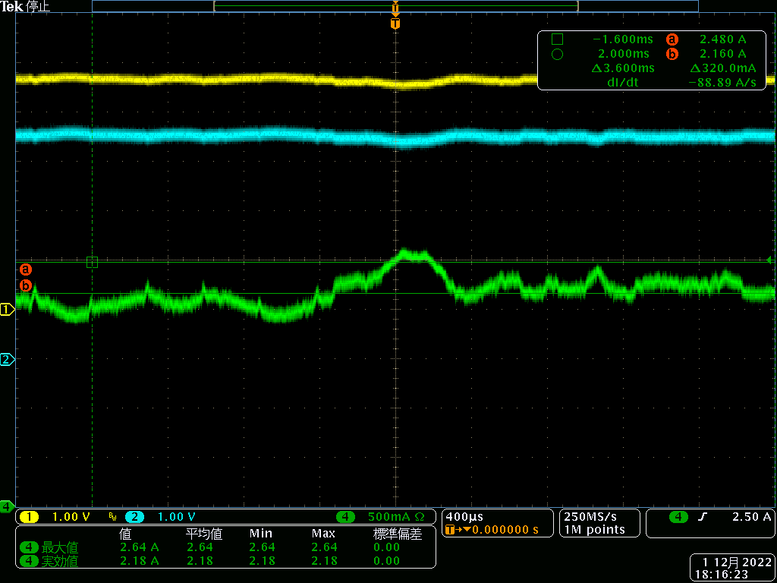
VIN, VOUT and Iin waveforms (400us scale)
Because the current limit time is less than 400~500us, will the eFUSE not current limit?
Vin
Vout
220us
Current limit Setting = 2.479A(typ.)
(RILIM = 59.3kohm)
Iin
(mobile phone CPU(SnapDragon) current)

