Slide 1
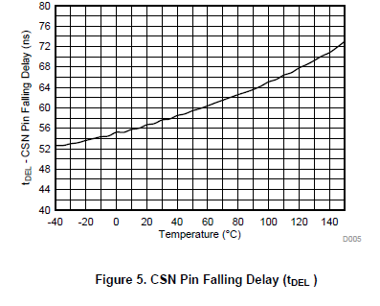
110ns
(worst case)
110-73 =37ns
Q1
We see tDEL=58ns(TYP),110ns(MAX) in the TPS92518 data sheet.
Our understanding is 110ns is worst case including chip(lot) variance.
So, at the point where Ta=150deg-C and typical chip, we see tDEL=73ns on Fig5.
Difference between chip(lot) should be 37ns.
So, we should think tDEL=58ns(TYP)+37ns=95ns as Ta=30deg-C in case chip variance?
Otherwise, this “ 37ns “ is much smaller in case Ta is lower?
Q2
If available, do you have minimum value of tDEL? (58ns(TYP)/110ns(MAX) ..and MIN??)

Slide 2
Analog dimming
(change PKTH)
shunt FET dimming
1A
200mA
1mA
shunt FET dimming
(PKTH is fixed)
1A
200mA
1mA
Q3
Do you suggest shunt FET dimming only, rather than analog dimming + shunt FET dimming
if TOFFMAX were well tuned, shunt FET Rdson was small and clamp diode is used carefully?
The reason why our question is, in case ILED=200mA, ILED has variance depends on
VLED( duty/switching frequency) due to tDEL influence, even same TOFF/PKTH .
.. Please kindly see attached PPT file page 4 …(A).
One idea is to monitor ILED externally and change PKTH by MCU, but
Customer says it isn’t easy to have accurate measurement .

Slide 3
Q4
Customer intend to use switching FET whose trr is 48ns ( attached data sheet ).
Would you please kindly give your opinion?
( Is its trr too slow? )
Q5
Even though in case same TOFF, same VLED, same Vin,
Switching frequency is changed depends on PKTH.
It became higher/lower depend duty also..
(please kindly see attached PPT page 4 (B) and (c))
Would you please give your comment about reason why?

Slide 4
VIN=55V
TPS92518EVM
LED
(VLED=12V typ or 36V type)
Monitor
SW, VLED, inductor current ( current probe)

Slide 5
Summary
VIN=55V, L=100uH /FET(ST) is TPS92518EVM default H/W
LED | TOFF | photo | PKTH | ILED (set) | ILED actual (tester reading) | Ipk Oscillo reading | ΔIpk-pk(mA) | Fsw (KHz) | Duty(%) | NOTE
36V | 30 | 1 | 162 | 1A | 1011 | 1096 | 180 | 825 | 70
 | 30 | 2 | 39 | 0.2A | 227 | 292 | 134 | 1065 | 61 | TON 0.57
 | 40 | 3 | 166 | 1A | 1014 | 1128 | 244 | 636 | 69
 | 40 | 4 | 39 | 0.2A | 200 | 296 | 200 | 787 | 61 | TON 0.77us
12V | 30 | 5 | 159 | 1A | 1010 | 1028 | 184 | 704 | 24.8
 | 30 | 6 | 39 | 0.2A | 266 | 344 | 185 | 685 | 21.6 | TON 0.3us
 | 40 | 7 | 166 | 1A | 1010 | 1128 | 220 | 545 | 24.8
 | 40 | 8 | 39 | 0.2A | 230(A) | 336 | 216 | 512 | 21.5 | TON 0.41us
(B)
(A)
(C)
(A)
Even same TOFF=40, PKTH=39, ILED(av.) is different.
It should be depends on TON . In case TON was small, ILED is 30mA bigger.
The reason is contribution by tDEL (58ns(TYP)) is big(TON is short)
Or small (TON is long)…. (Is it true??)
…. Graph1
(B) (C)
In case ILED is big ( approx. 1A), ILED is almost same: 1010mA.
However, switching frequency is changed depends on PKTH
and also depends on duty.: lower : (B) Higher (c) .
We don’t know the reason.
Graph1
TON(us)

Slide 6
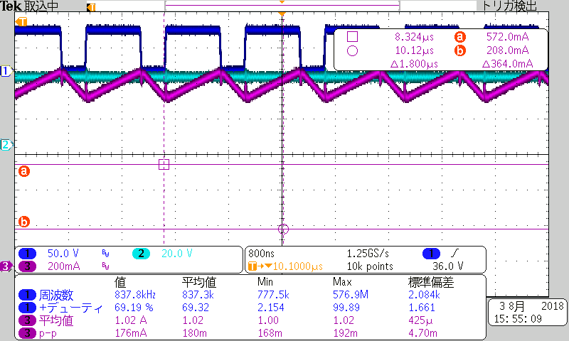
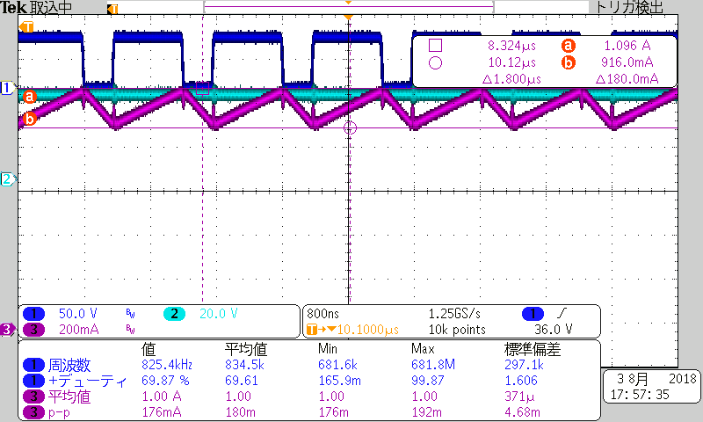
TOFF=30 PK=162
photo1
36V_VLED
SW
VLED
Inductor
current

Slide 7
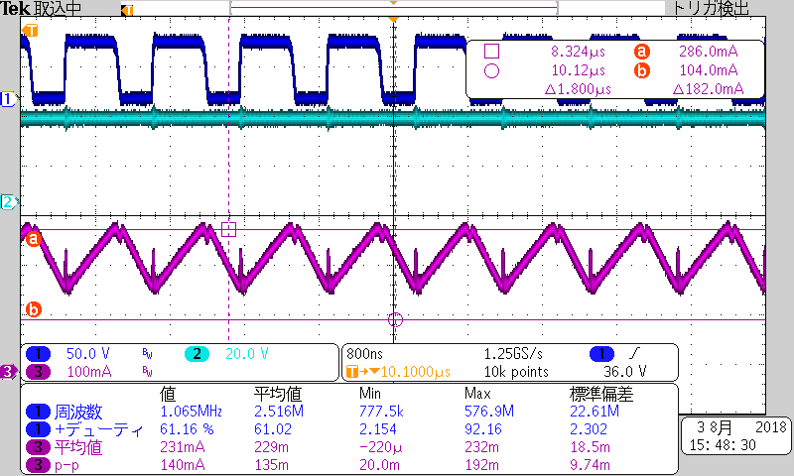
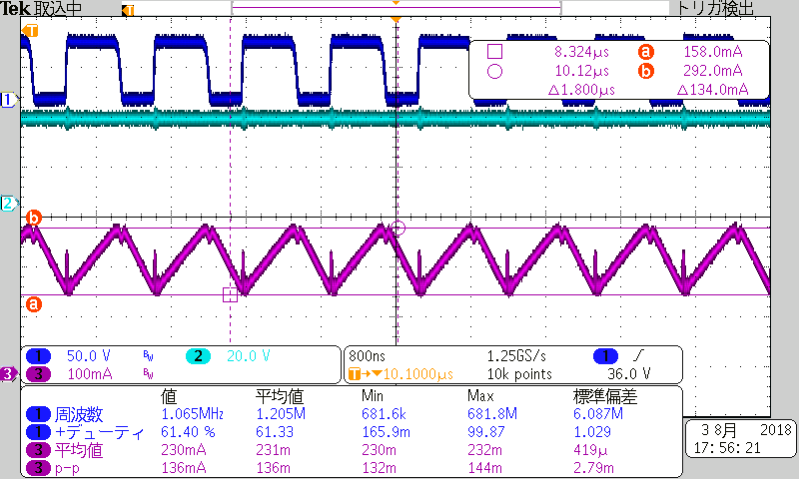
TOFF=30 PK=39
photo2
36V_VLED

Slide 8
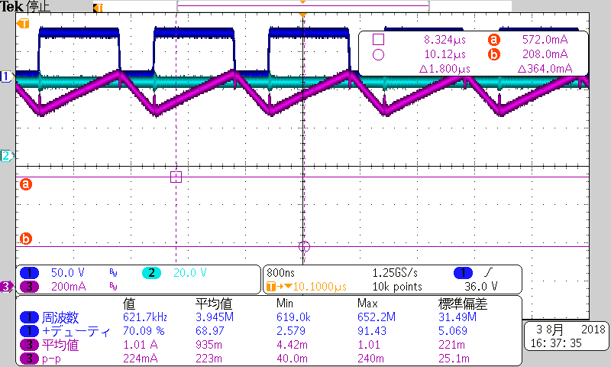
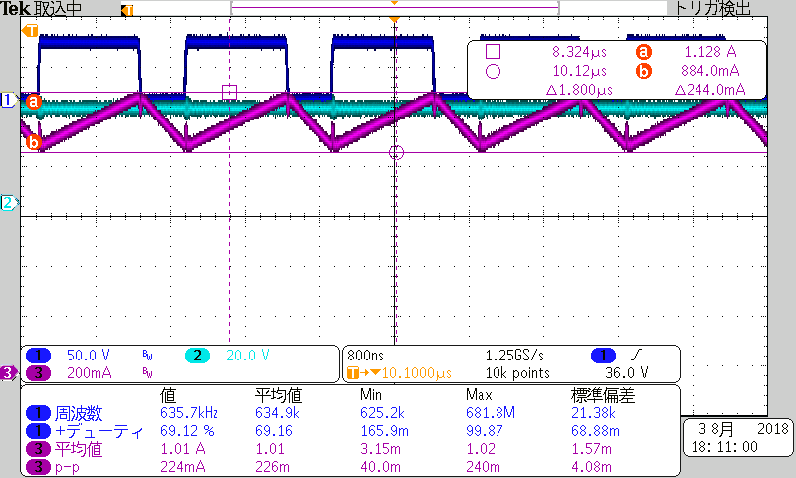
TOFF=40 PK=166
photo3
36V_VLED

Slide 9
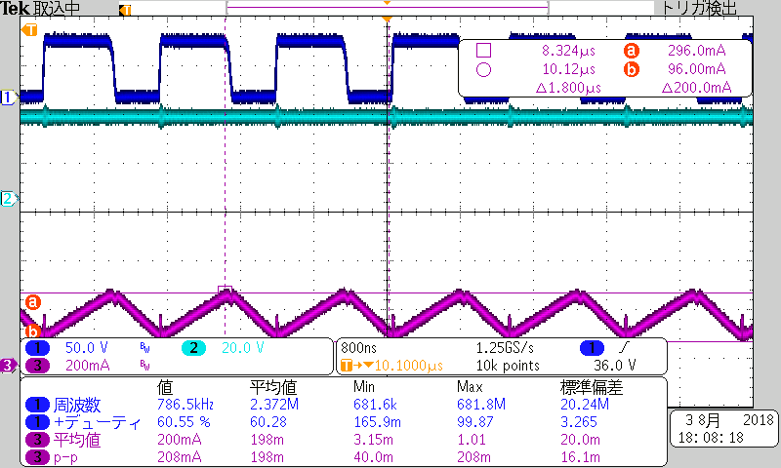
TOFF=40 PK=39
photo4
36V_VLED

Slide 10
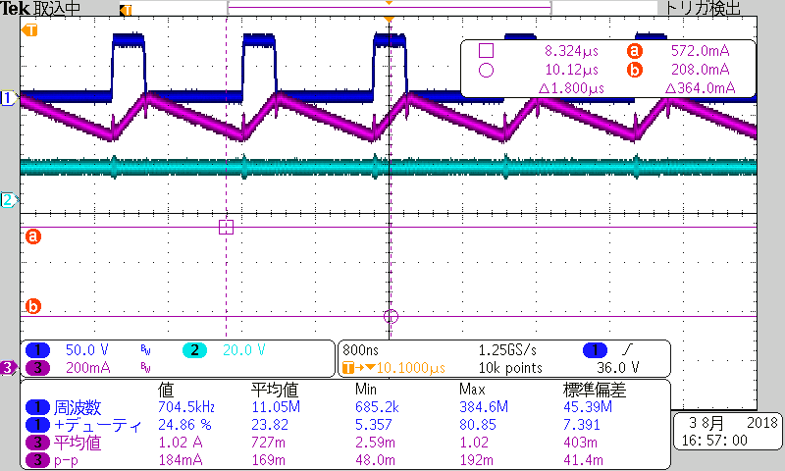
TOFF=30 PK=159
photo5
12V_VLED

Slide 11
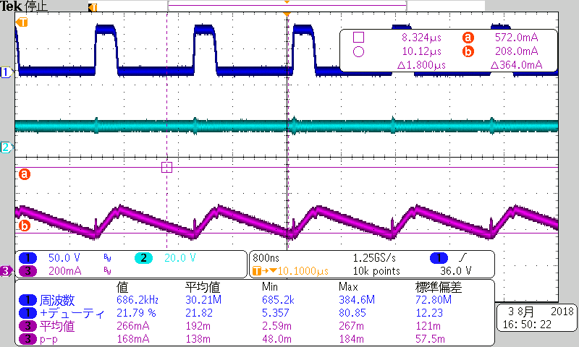
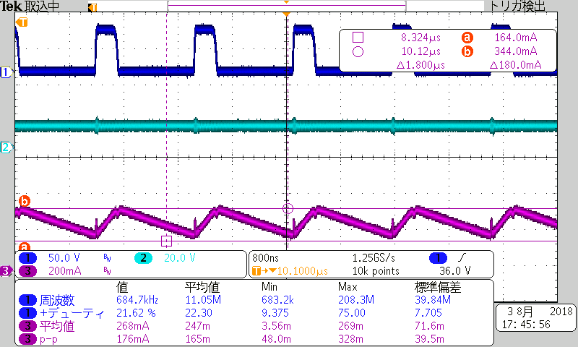
TOFF=30 PK=39
photo6
12V_VLED

Slide 12
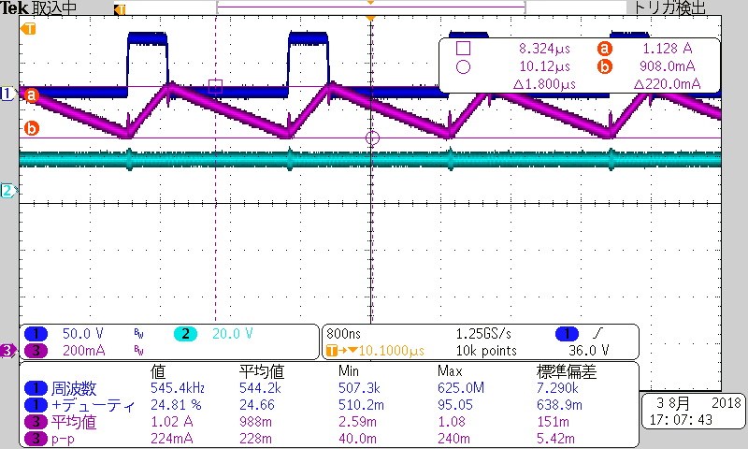
TOFF=40 PK=165
photo7
12V_VLED

Slide 13
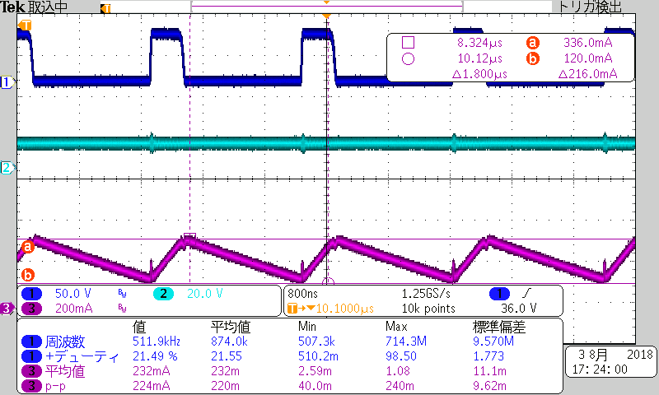
TOFF=40 PK=39
photo8
12V_VLED

