Slide 1
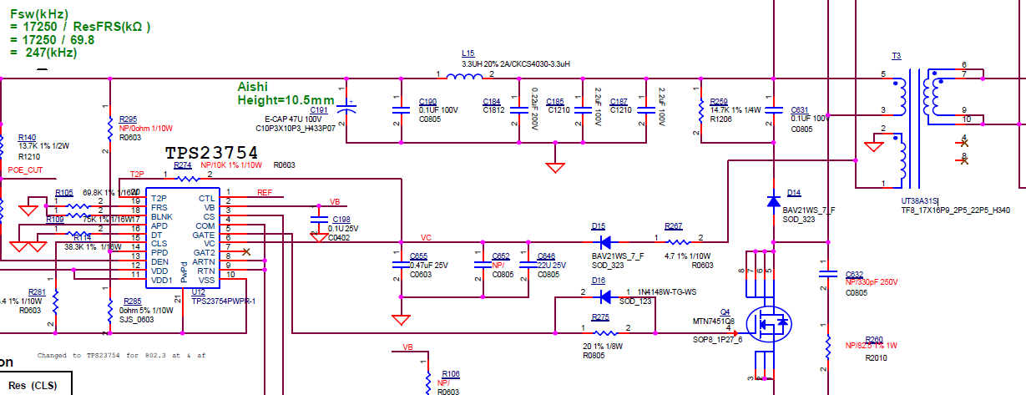
WAPAX09 TPS23754-1(TPS23754PWPR-1) 802.3at POE

Slide 2
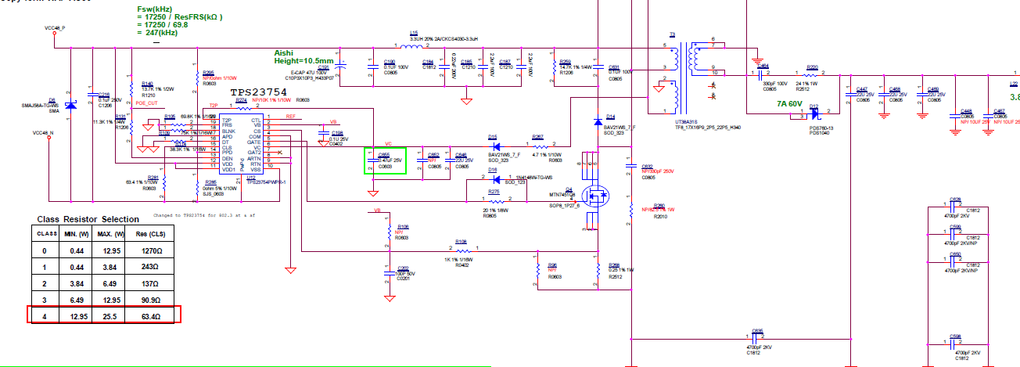
48V to 12V

