Slide 1
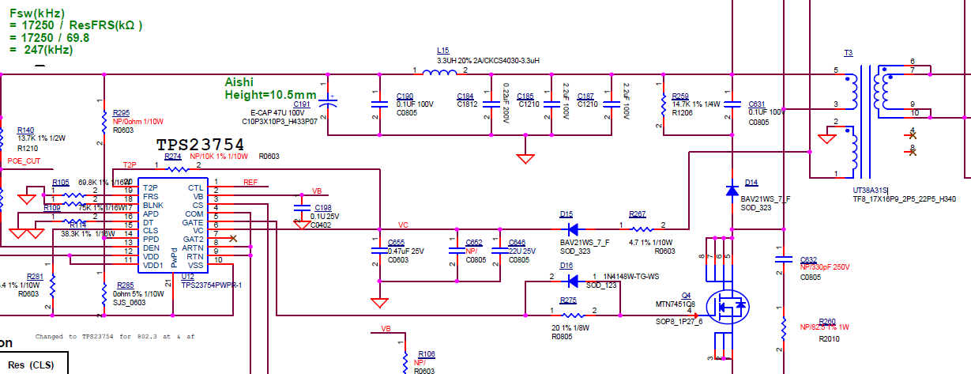
WAPAX09 TPS23754-1(TPS23754PWPR-1) 802.3at POE
22uF
We add an extra cap 22uF and parallel with C646 22uF

Slide 2
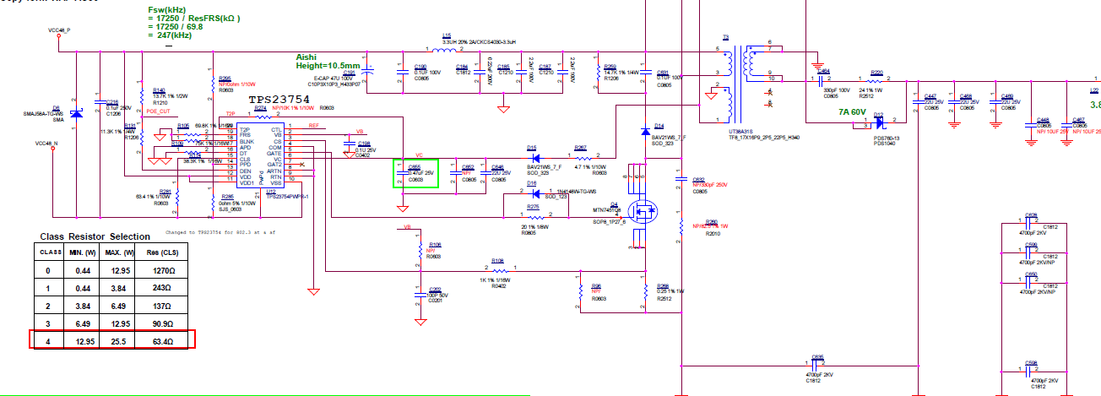
48V to 12V

Slide 3
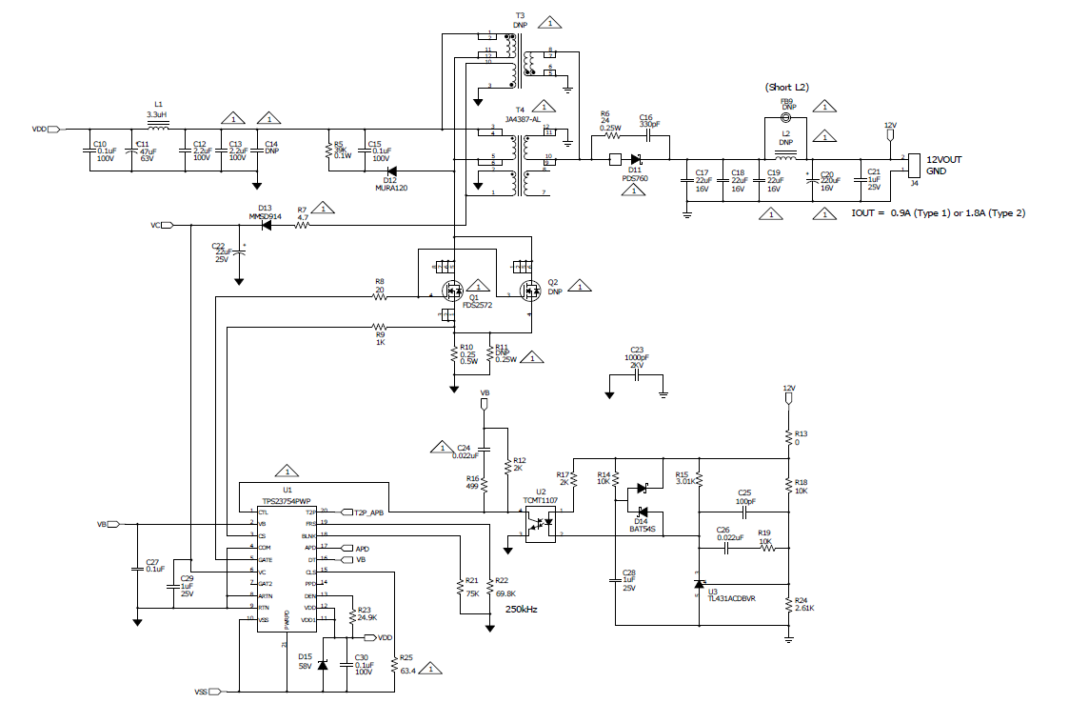
TI PMP6812 reference

