Slide 1
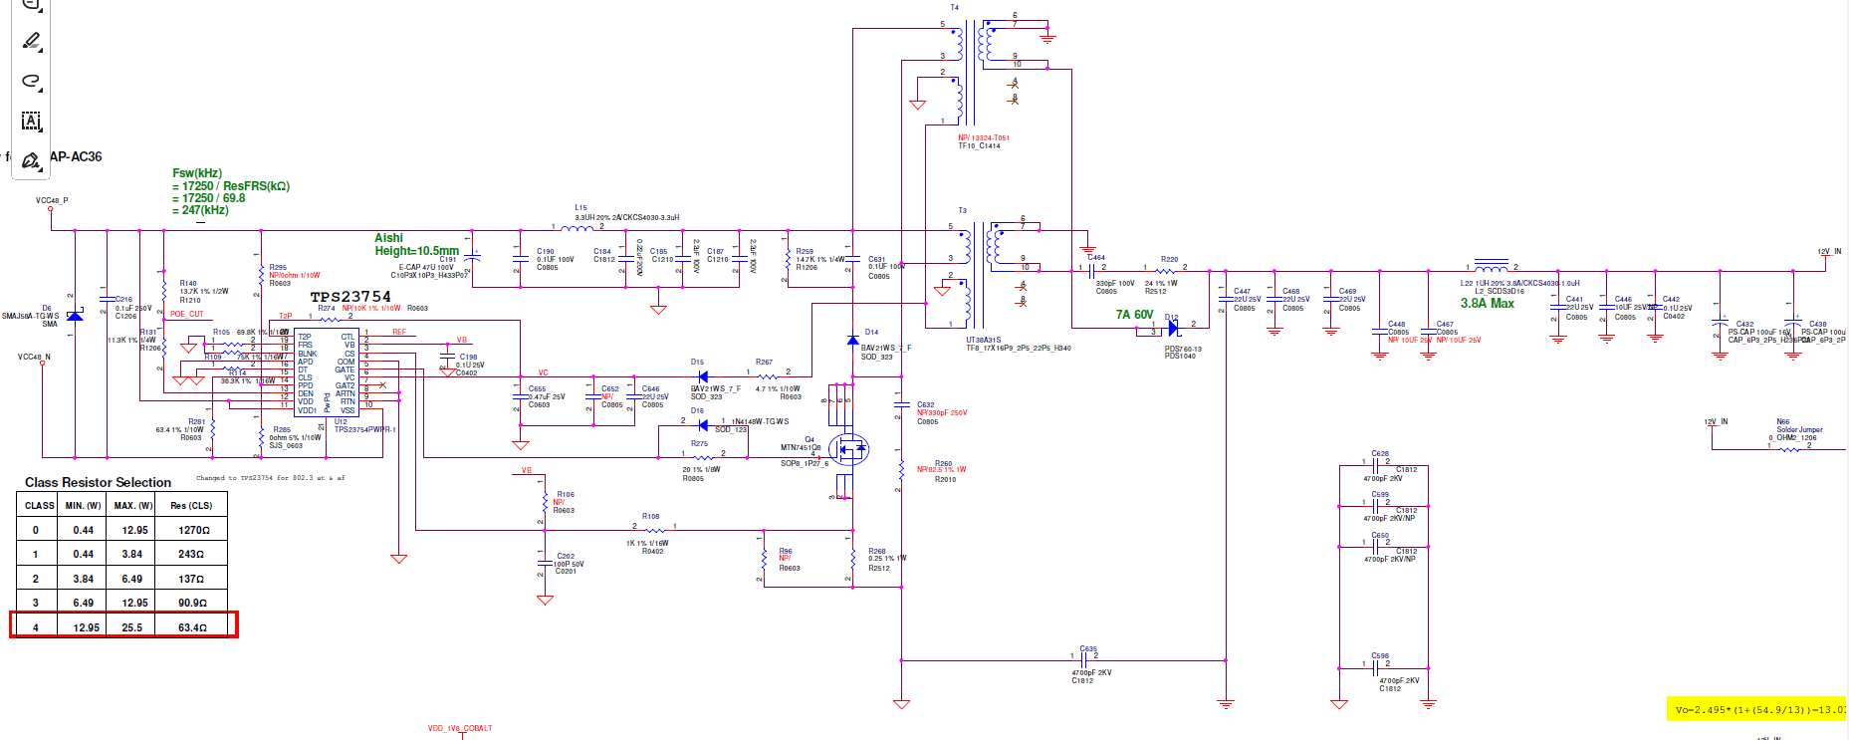
WAPAX09 TPS23754-1(TPS23754PWPR-1) 802.3at POE 48V to 12V Schematic
T3 Transformer
ALPHA P/N:
512993831000G
PWR X'MER UT38A31S SMD10
Vc voltage level
Cbias(Cvc) capacitor

