Slide 1
What effects LDO PSRR?
Kyle Van Renterghem
Apps & Validation Manager
Notes:
Title slide – Welcome
Welcome to our second APP Town Hall. Thank you for joining us, here in the room in Dallas or via WebEx. And for our teams in other timezones, who may view a recorded version later on, welcome to you, too!
I have three things I like for you to take away from this townhall:
Our performance year till date
Our progress

Slide 2
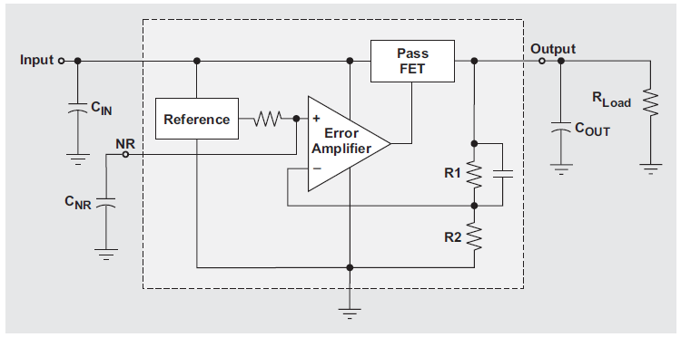

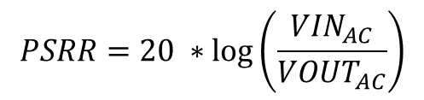
PSRR
PSRR (Power Supply Rejection Ratio) represents the ability of the LDO to filter input voltage changes. This is critical for low-noise applications.
$$PSRR=20 ∗\log\left(\frac{{VIN}_{AC}}{{VOUT}_{AC}}\right)$$
VIN_{AC}
VOUT_{AC}

Slide 3
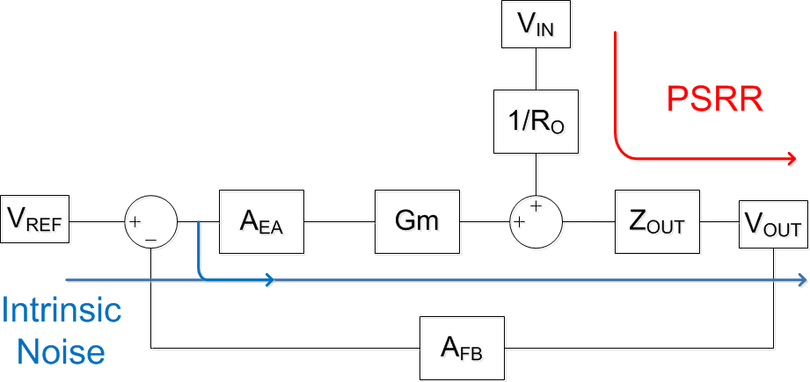
How PSRR/Noise Relate to the LDO AC Model
Total LDO output voltage noise is composed of Input noise that is coupled to the output, as well as intrinsic noise generated by the LDO.
  Power Supply Rejection Ratio (PSRR) measures how much noise from the input couples into the output through the pass device.
  Intrinsic noise is dominated by the noise of the internal reference and error amplifier.

Slide 4
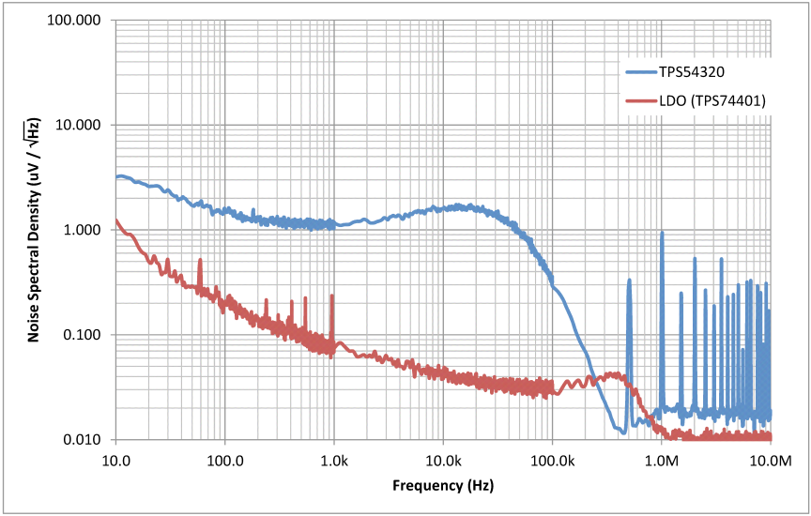
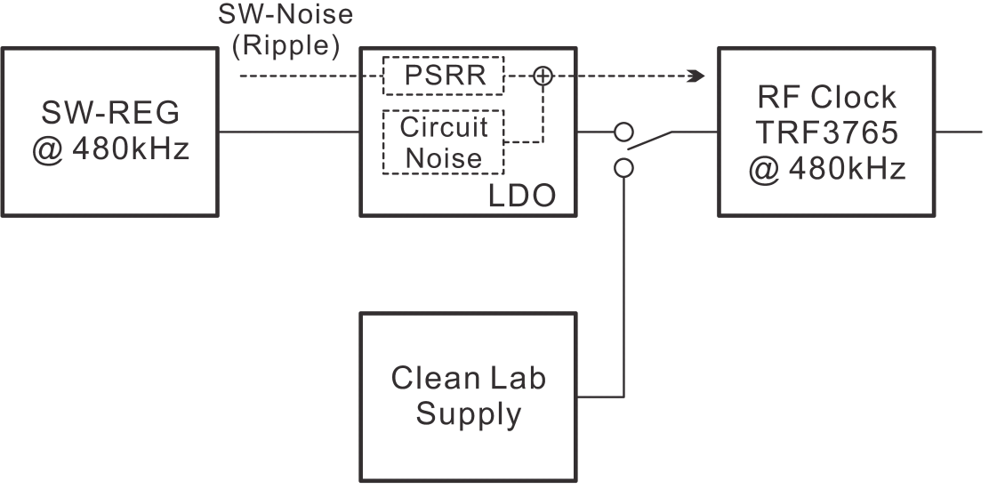
The Importance of LDO PSRR
DC/DC (switching) converters are necessary for efficiency, however they are very noisy
  most clock generators and clocking devices are very sensitive to power supply noise
  DC/DC converters are commonly followed by an LDO to clean the supply
DC/DC Noise
LDO Noise
Clock

Slide 5
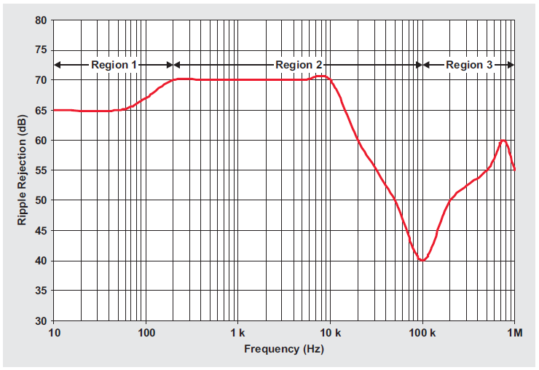
Typical PSRR Curve
Region 1 is determined by:
PSRR of the Reference and the effectiveness of the RC filter
Region 2 is determined by:
Open-Loop Gain of Error Amplifier
Region 3 is determined by:
Parasitic capacitance of the FET and the output capacitor (capacitive divider)
  The smaller the parasitic cap the less the Vin is AC coupled to Vout
  The larger Cout the more noise is shunted to GND

Slide 6
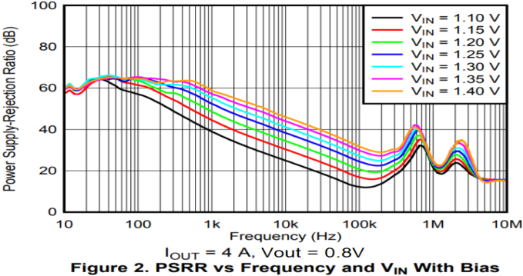
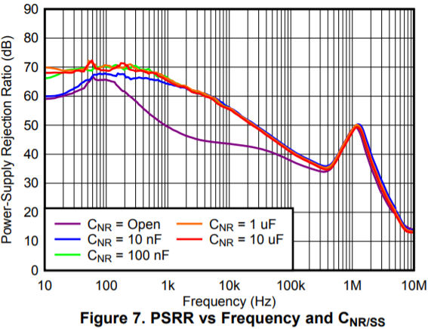
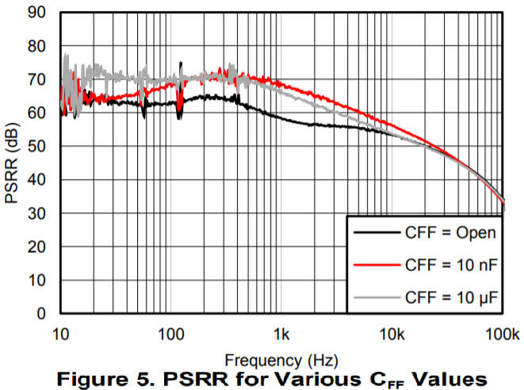
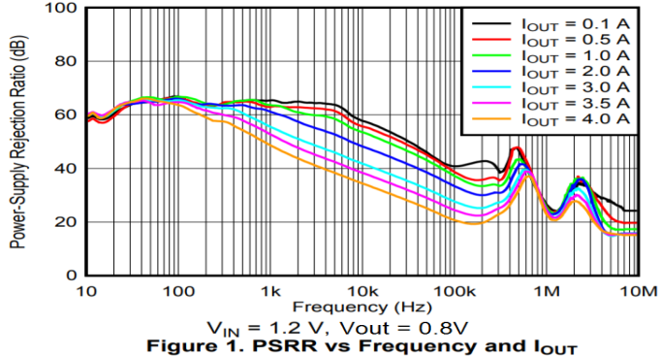
What Conditions Effect PSRR The Most
#1 thing that effects PSRR performance is the combo of Vin/Iout (Vdo)
The next thing that effects PSRR is the noise reduction capacitor
The final thing that effects PSRR is the feedforward capacitor

Slide 7
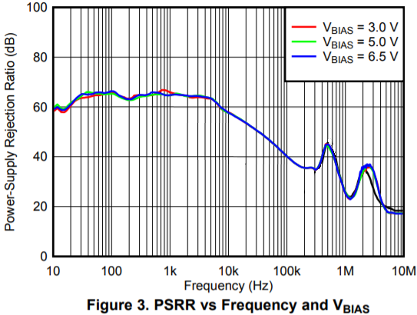
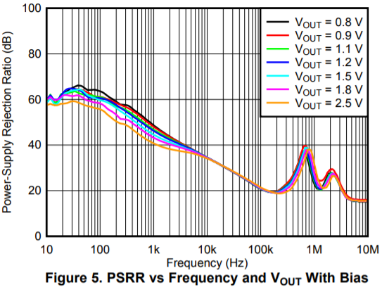
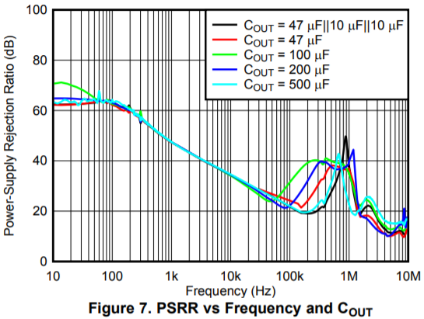
What Conditions Do Not Effect PSRR Much
Number one thing that has almost no effect on PSRR is Vbias>min
The next thing that only has a small effect on PSRR is Vout
And the final thing that has some effect (but only at high freq) is output capacitor

