Slide 1
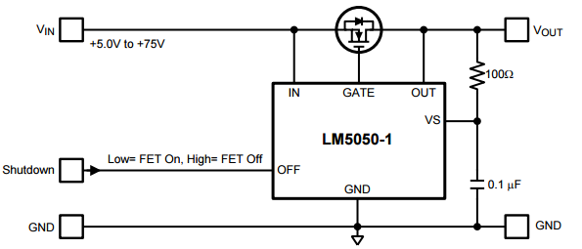
What is an ORing Controller?
Example of a Linear/Regulation ORing controller:
If IN – OUT > 22mV, increase GATE voltage
If IN – OUT < 22mV, decrease GATE voltage
If IN – OUT < -10mV, pull GATE to IN with strong pull down.
IF OFF is High, pull GATE to IN with strong pull down.

