Slide 1
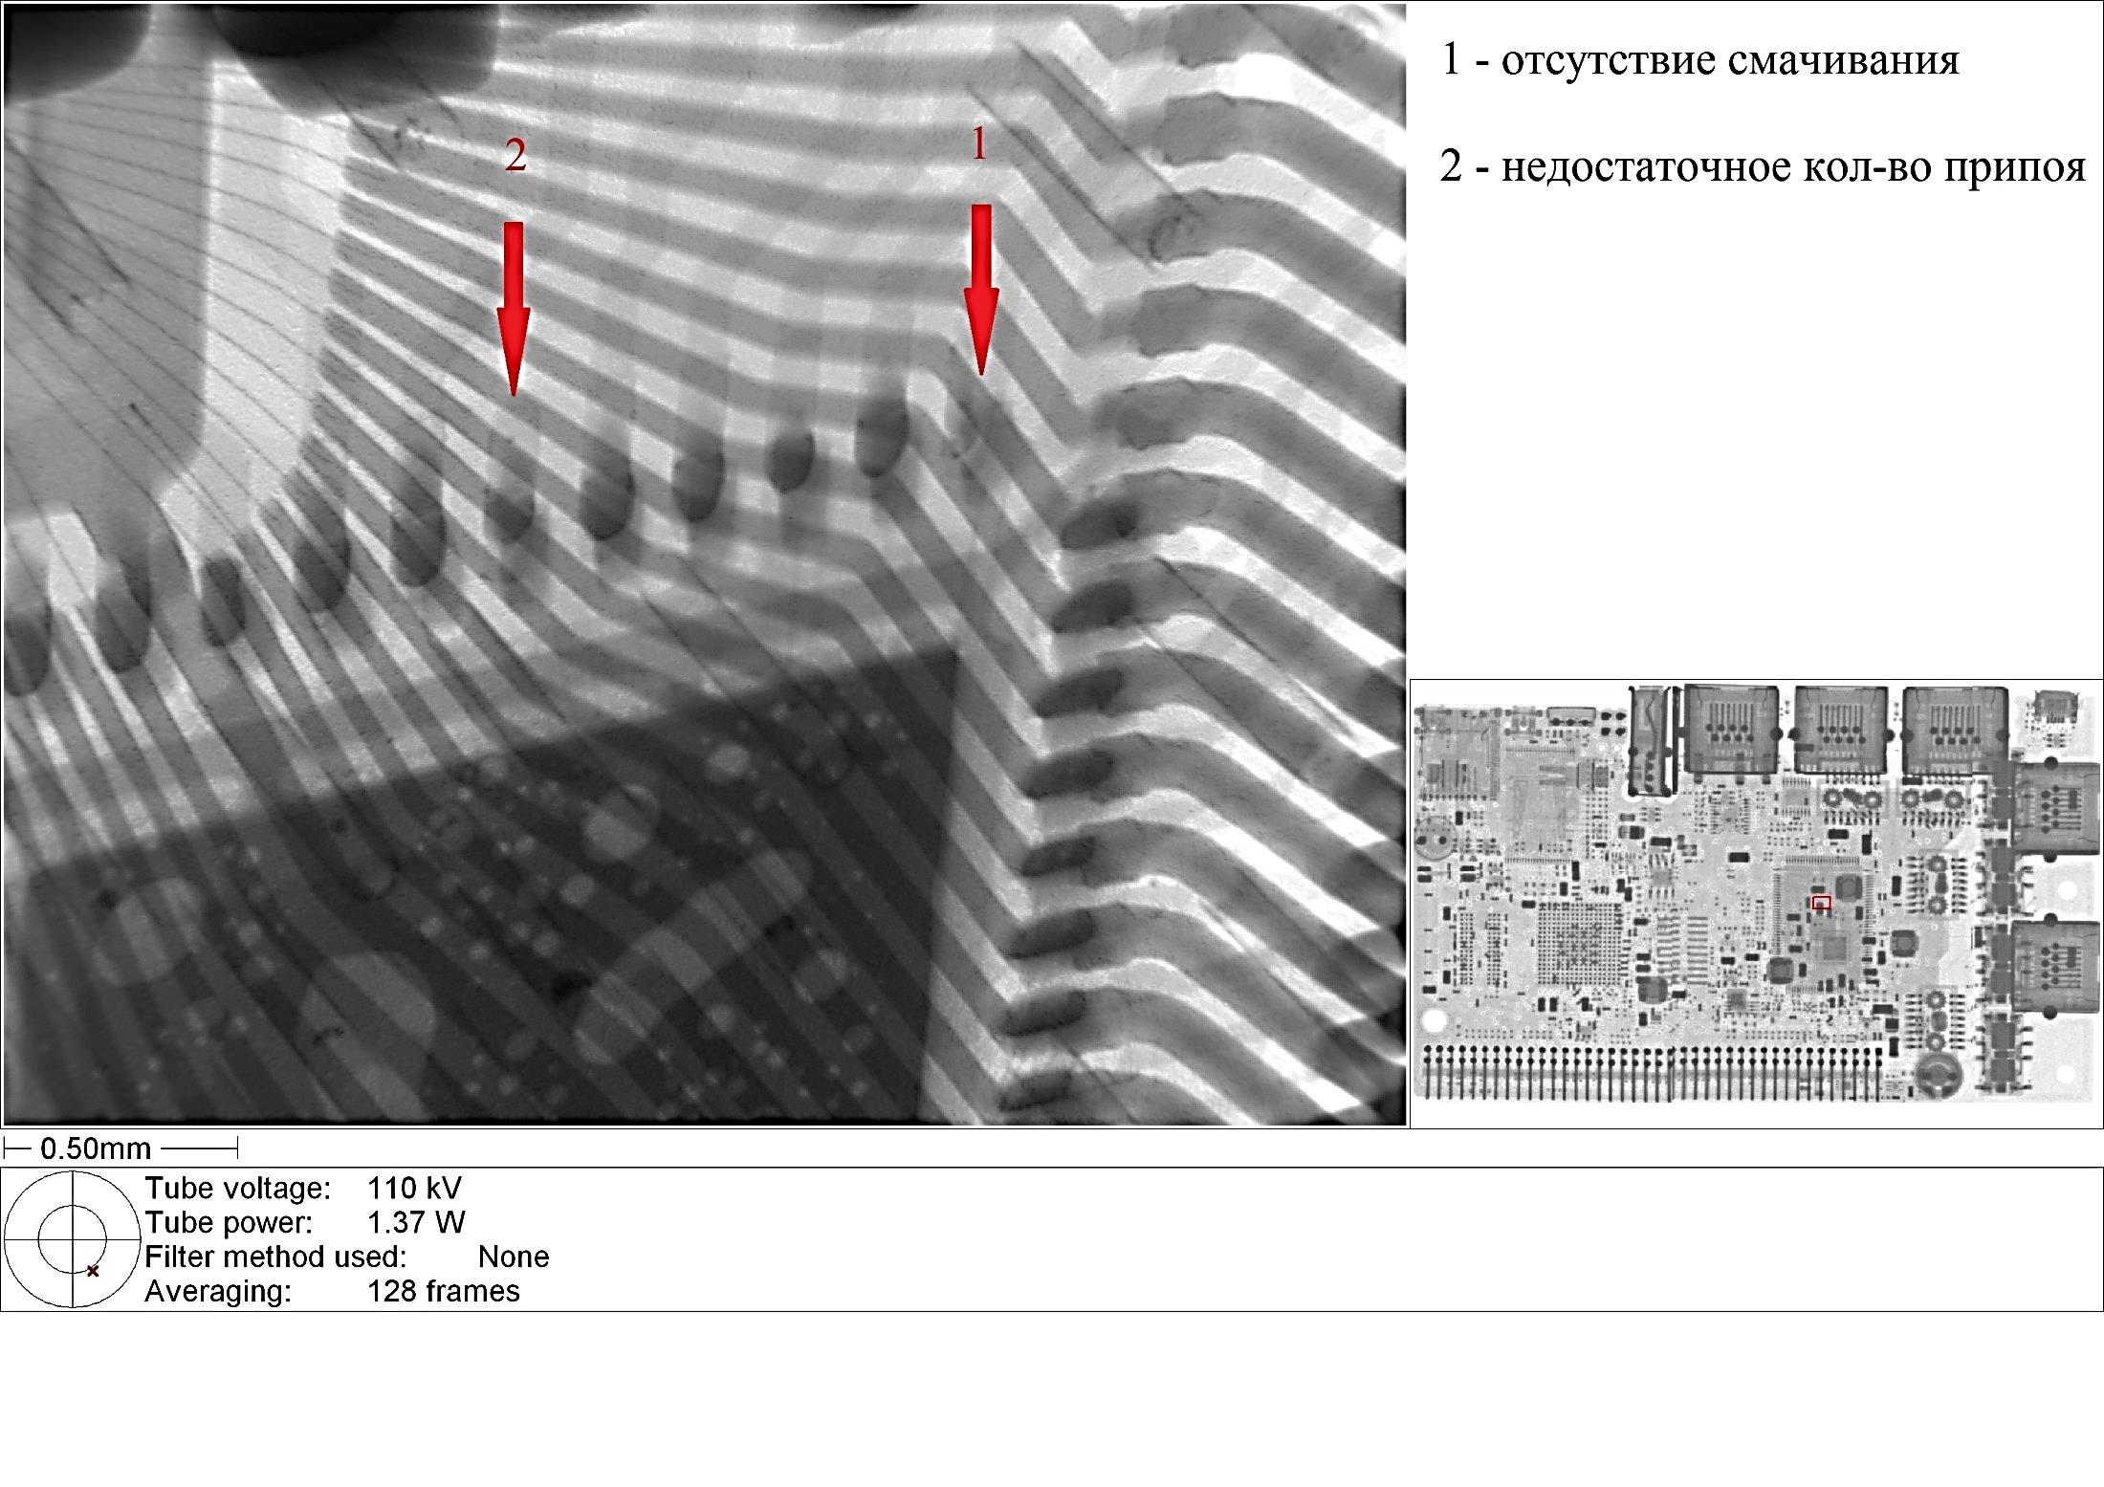
English Translation
No Wetting
Insufficient Solder
TI Comments
Serious insufficient solder
Insufficient solder

Slide 2
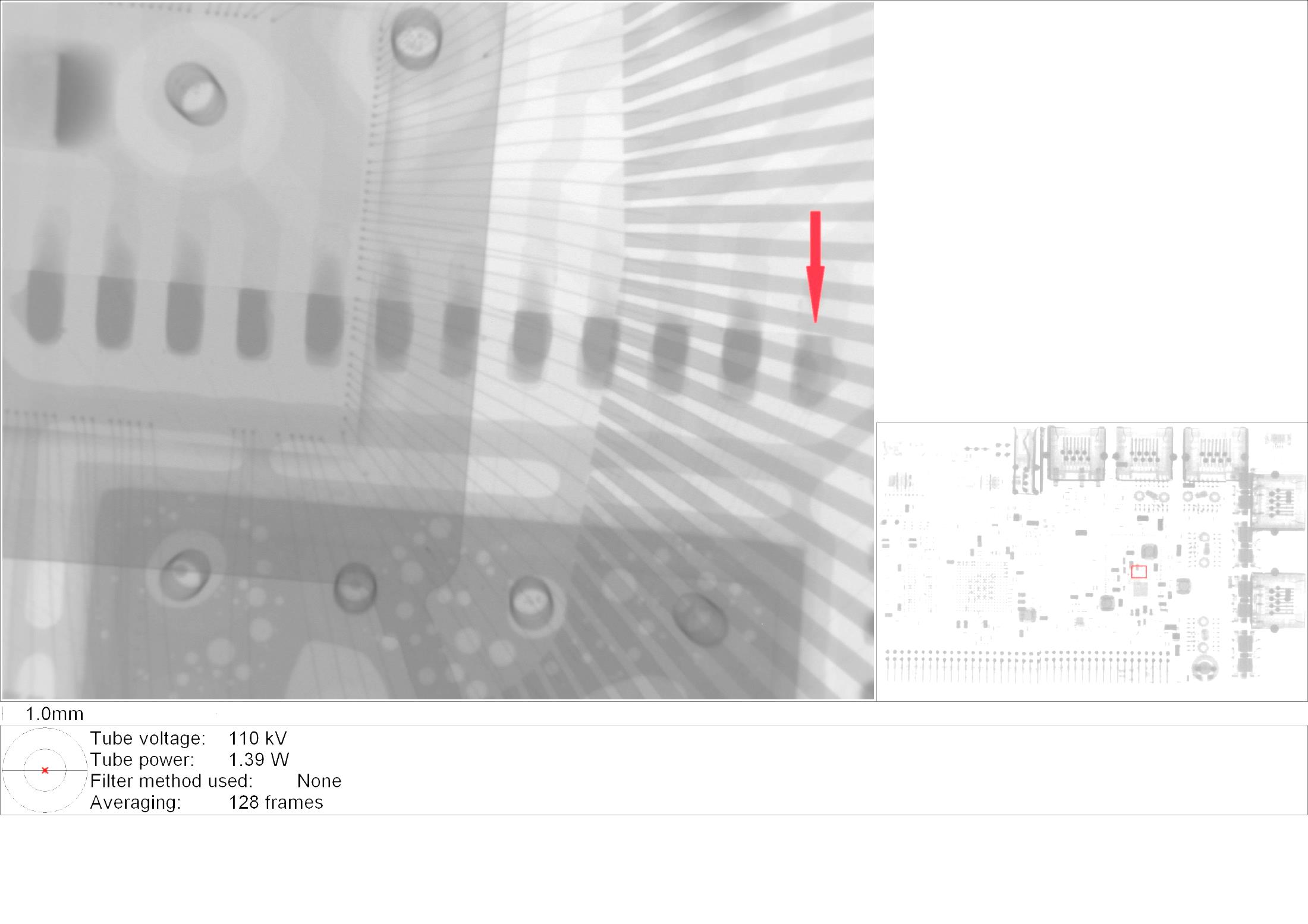
Serious Insufficient Solder

