Slide 1

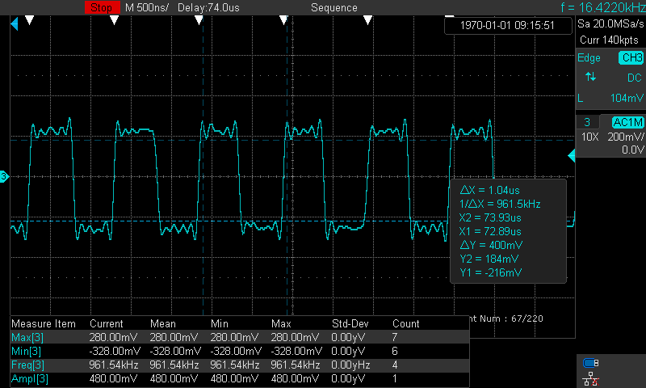
Problem : decrease the swing of AUX after pass through TUSB1064
10-May-2023 Y.Nakanishi
0.23962V by digital multimeter
2.6144V by digital multimeter
0.24016V by digital multimeter
Converter Block from DP to USB typeC
2.613V by digital multimeter
Main block
3.3V
3.3V
USB Displayport
ALT Mode Re-driver
TUSB1064
3.3V
PC
USB Displayport
ALT Mode Re-driver
TUSB1046
100kΩ
1MΩ
DP-MIPI converter
1MΩ
DP repeater
Type-C Port Protector
Type-C Connector(DP Alt)
Type-C Connector(DP Alt)
AUXRX_P
0.1uF
0.1uF
SBU1
SBU1
Dp
0.1uF
AUXRX_N
SBU2
SBU2
Dn
DP cable
0.1uF
0.1uF
USB type C
Cable
1MΩ
100kΩ
0.1uF
2Mohm
2Mohm
1MΩ
The 100kohm is put before TUSB1046.
( it is NOT TUSB1064).
There is NO 100kohm before and after TUSB1064.
Do I need to put 100kΩ before or after TUSB1064?
FLIP pin : 3.4384V
CTRL0 : 0V
CTRL1 : 3.4385V
 | Before DP-Retimer | After DP-Retimer | Before TUSB1064 | After TUSB1064 | Before DP-MIPI converter
measured by Laptop OMEN 17-ck1009TX | 424 mV | 492 mV | 400 mV | 348 mV | 276 mV
measured by Desktop PC OMEN Obelisk desktop | 516 mV | 528 mV | 420 mV | 380 mV | 296 mV
Measured the swing level
( eye diagram )
The swing level is different depending on source device.

Slide 2
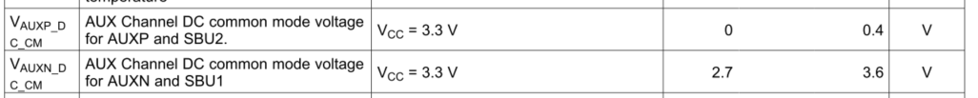
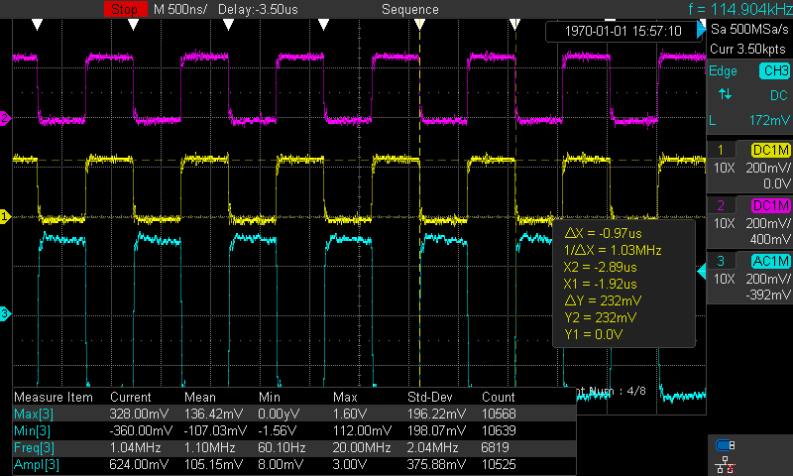
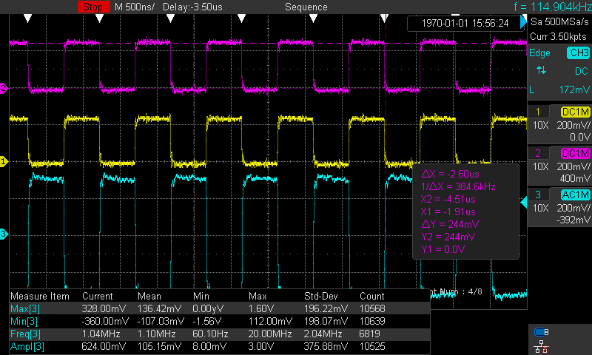
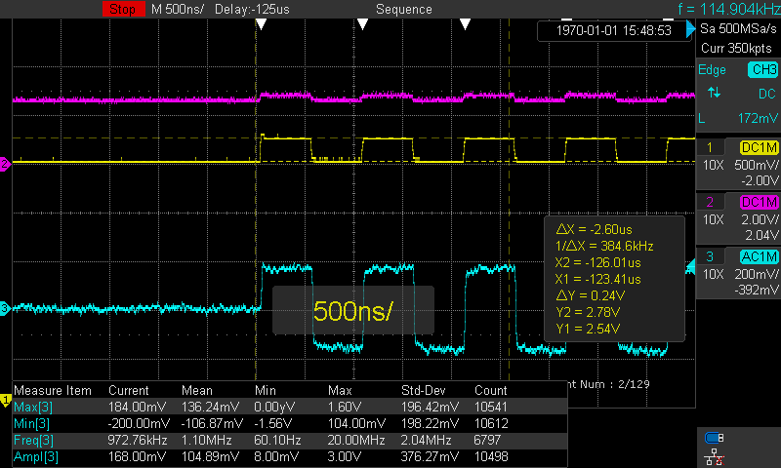
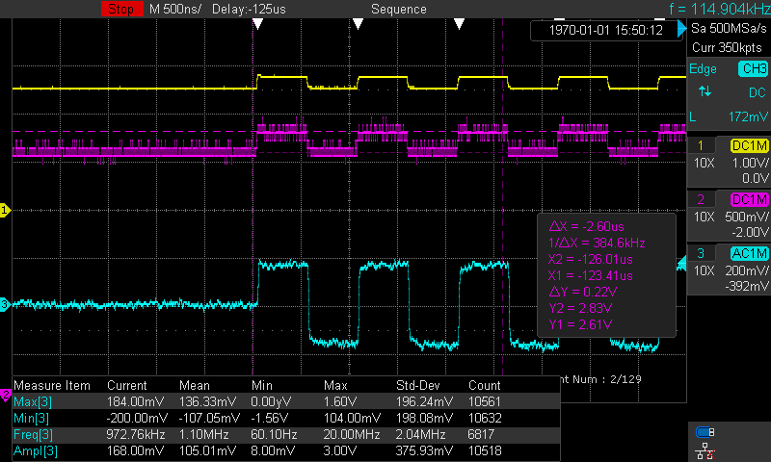
Problem : decrease the swing of AUX after pass through TUSB1064
21-April-2023 Y.Nakanishi
Check the voltage before input to TUSB1064(Positive)
Check the voltage output from TUSB1064 (Positive)
V_{AUXP}(output from TUSB1064)
V_{AUXP}(output from TUSB1064)
SBU(before input to TUSB1064)
SBU(before input to TUSB1064)
The voltage is 0.232V
Center 0.116V
The voltage is 0.244V
Center 0.122V
Check the voltage before input to TUSB1064(Negative)
Check the voltage output from TUSB1064 (Negative)
V_{AUXN}(output from TUSB1064)
SBU(before input to TUSB1064)
SBU(before input to TUSB1064)
V_{AUXN}(output from TUSB1064)
The voltage is 2.54V～2.78V
Center 2.66V
The voltage is 2.61V～2.83V
Center 2.72V

Slide 3
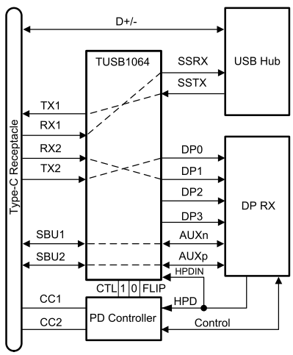
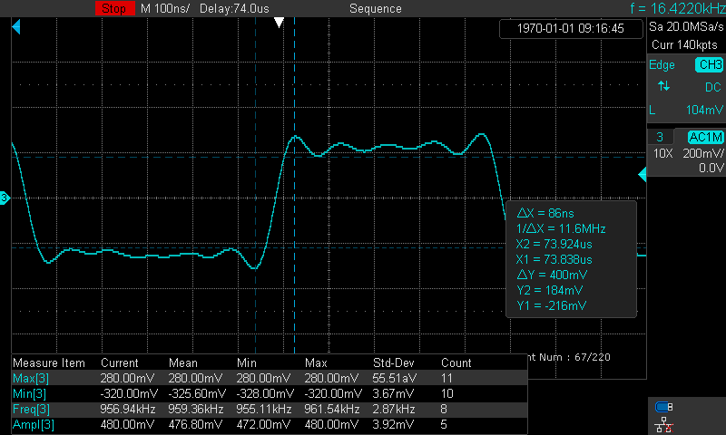
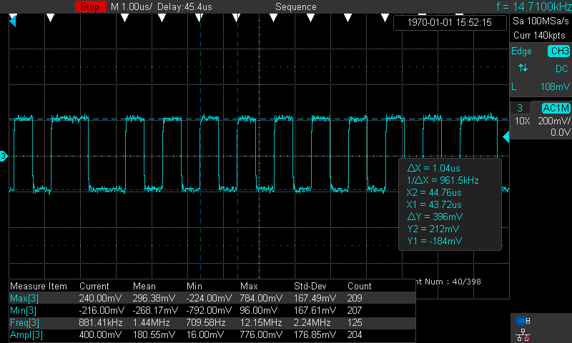
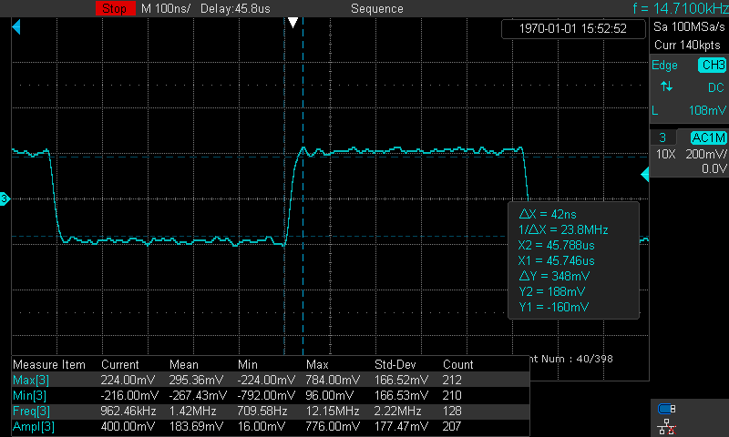
Problem : decrease the swing of AUX after pass through TUSB1064
18-April-2023 Y.Nakanishi
Measured before TUSB1064
It is measured by differential probe for AUX positive and negative
400mV
400mV
Measured after TUSB1064
It is measured by differential probe for AUX positive and negative
348mV
348mV

