Slide 1
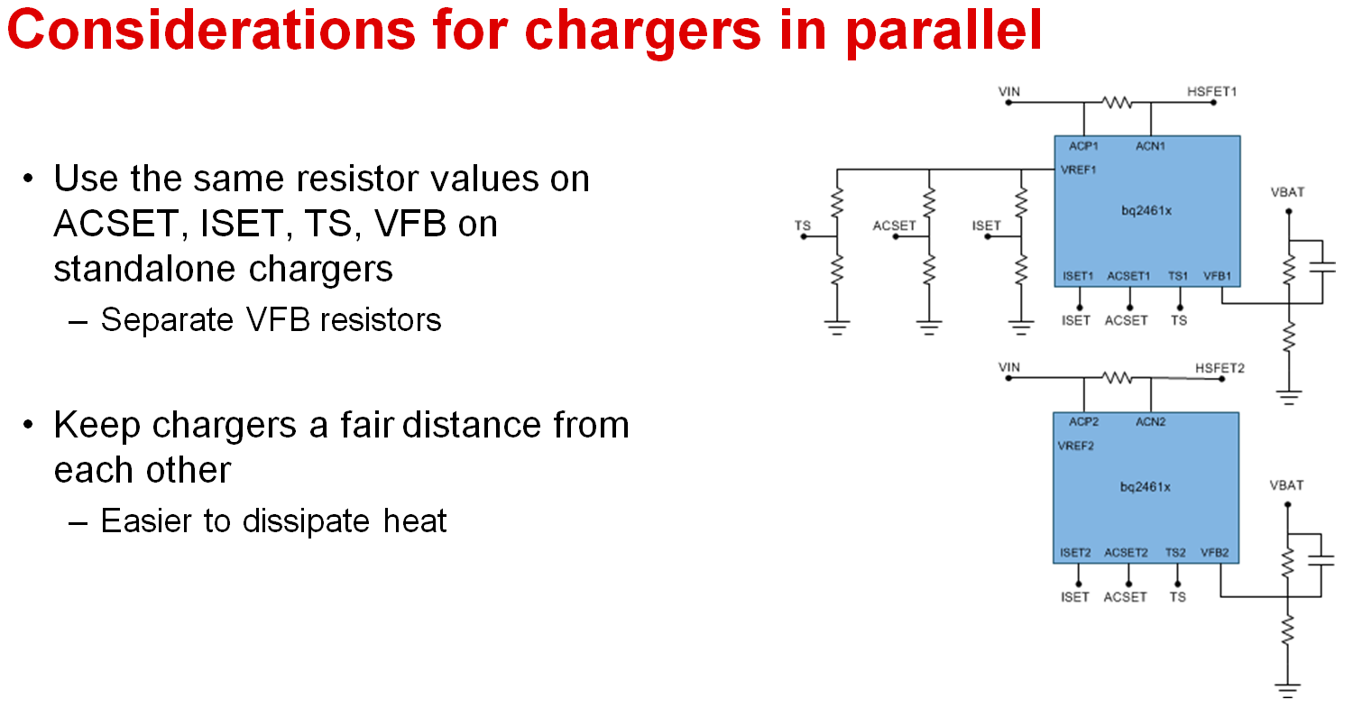
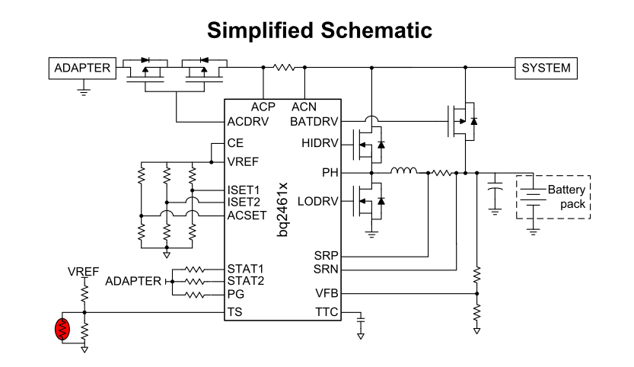
Is this connection OK？
Does NTC uses together both devices? OK？
ISET2 is not described, do resistors use together both devices ? Is it OK？
TTC capacitor should separate? Should it not connect together？
NTC

