Slide 1
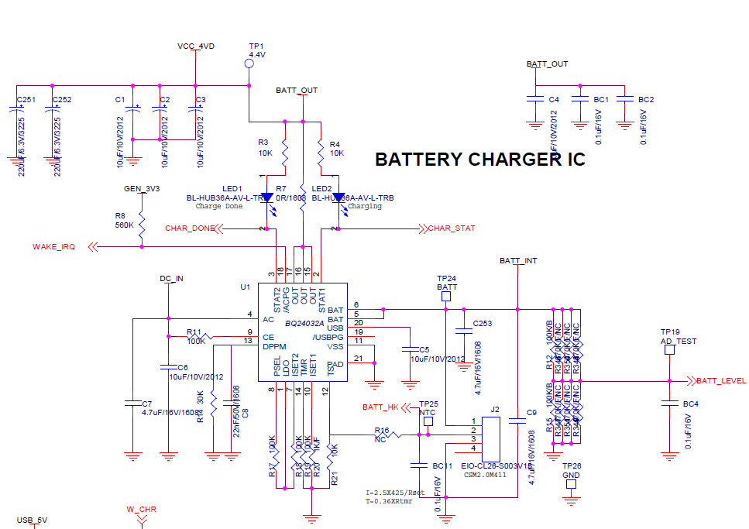
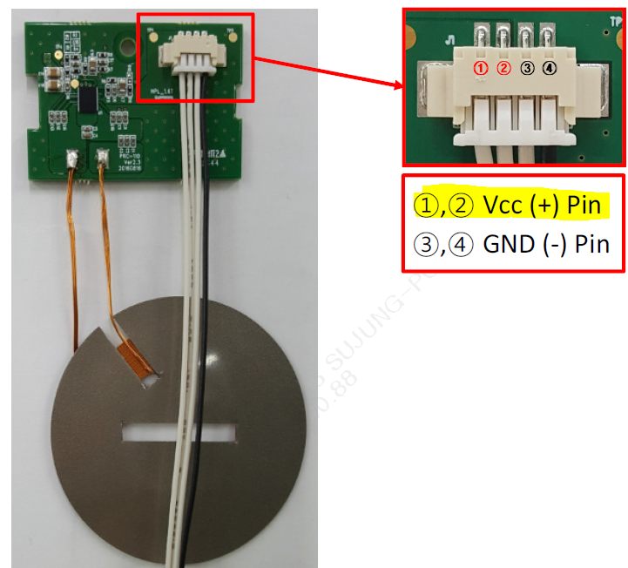
[ Cable charge ]
Product(TDC-7100RC)
BATT_OUT(VCC_4VD) -> PM IC -> System
USB C-type
[ Wireless charge ]
RX Module
TX Module
(Cradle)
5V
Power (5V)
Li-ion
Rechargeable
Battery(J2)
Charge voltage : 4.2V
Nominal voltage : 3.7V

