Slide 1
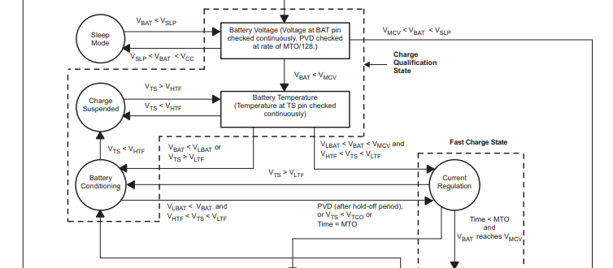
Question 1
According to the datasheet, there are 2 descriptions about LED blinking.
P6, in “Initiation and Charge Qualification”: During charge qualification, the LED pin blinks at a 1Hz rate,
P8, in “Maximum Charge Time (NiCD, NiMH, and Li-Ion)”: Since the IC is in the battery conditioning state, the LED flashes at the 1 Hz rate.
Which is correct the LED blinking condition, at Charging qualification state or at only the battery conditioning state?

Slide 2
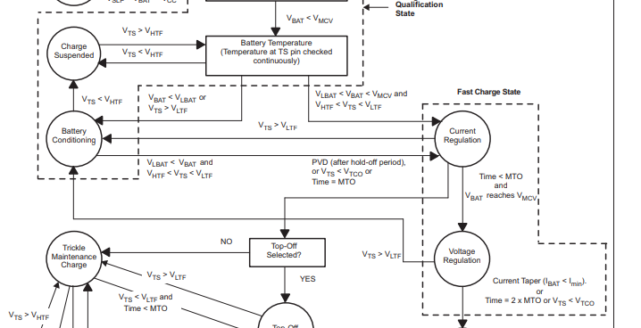
Question 2
What is the difference of trickle charging operation between “Battery Conditioning” and “Trickle Maintenance Charge”?

Slide 3
Question 3
<Our understanding>
The peak current: Imax = 0.05 / Rsns
Pulse width: calculate by figure 8 in datasheet
T: 1sec
Is it ok that our understanding of the current waveform in trickle charge? Please refer to above figure for the detail.

Slide 4
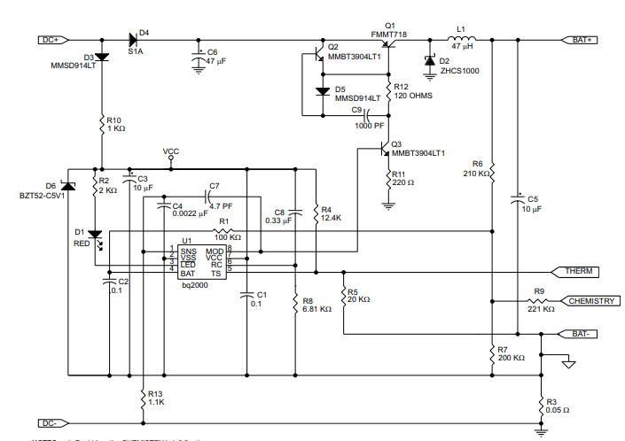
Question 4
What is the purpose of the D3(Is this the reverse voltage protection?)? If the D3 is removed, are there any concerns?

