Slide 1
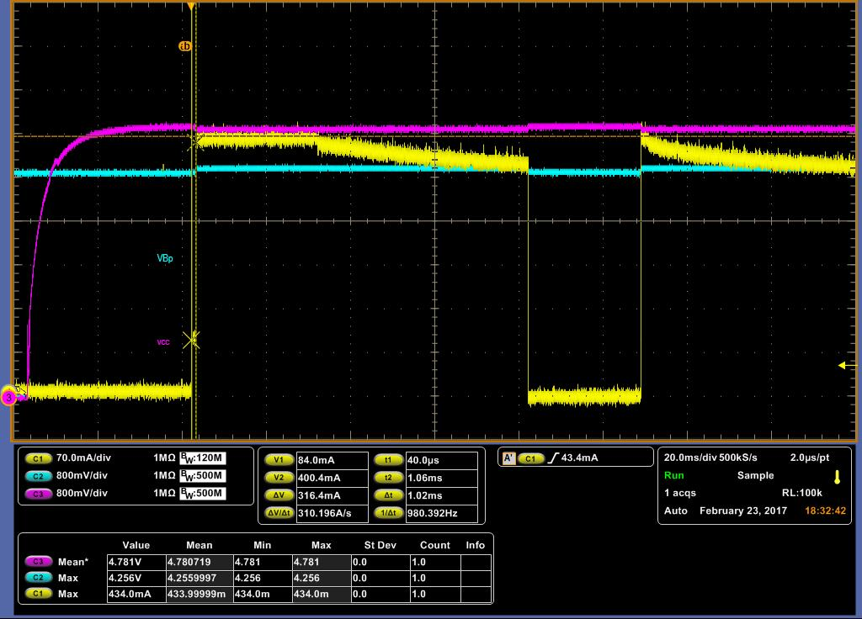
bq21040 Start-up 1/3 ch1: Ichg, ch2: Vout, ch3: Vin
Ichg fall to 0A temporary.
Measurement by EVM-777

Slide 2
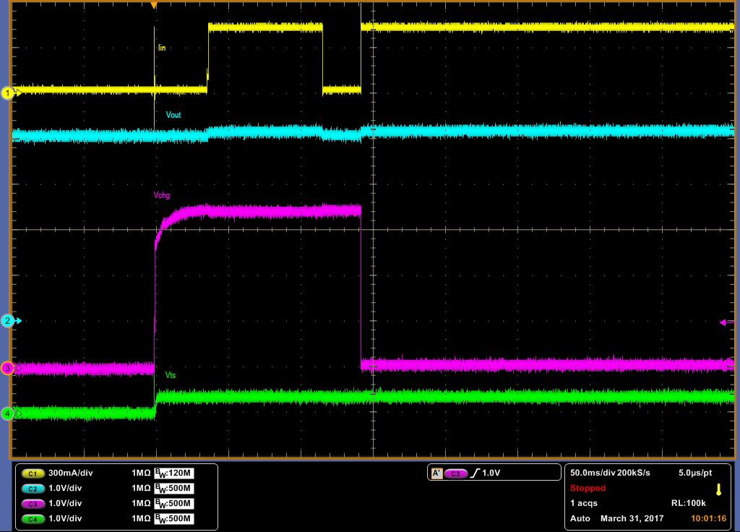
bq21040 Start-up 2/3 ch1: Ichg, ch2: Vout, ch3: /CHG, ch4: TS
Ichg back to charge current which is set by resistor. And current falling will not occur.
Vbatt=4V
Measurement by EVM-777

Slide 3
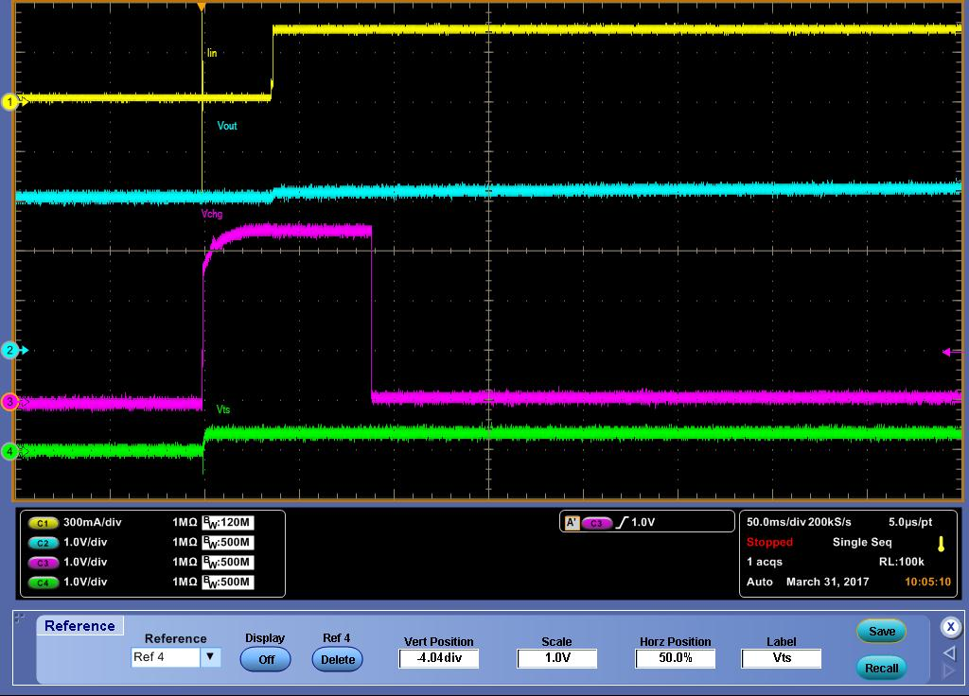
bq21040 Start-up 3/3 ch1: Ichg, ch2: Vout, ch3: /CHG, ch4: TS
Vbatt=3.2V
When Vbatt is 3.2V, the behavior is normal. The period of /CHG=high is shorter than Vbatt=4V.
Measurement by EVM-777

