Slide 1
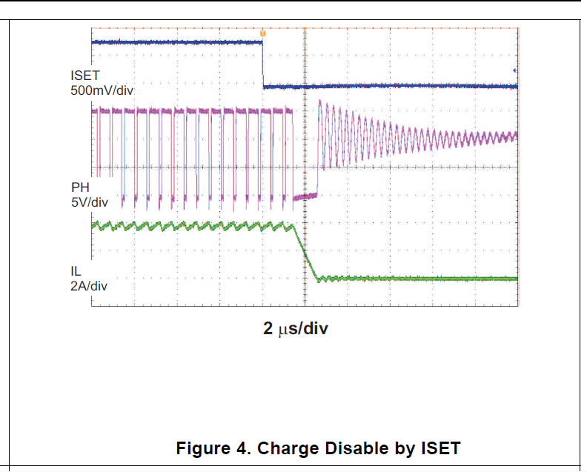
This is the signal that I have on SW pin

Slide 2
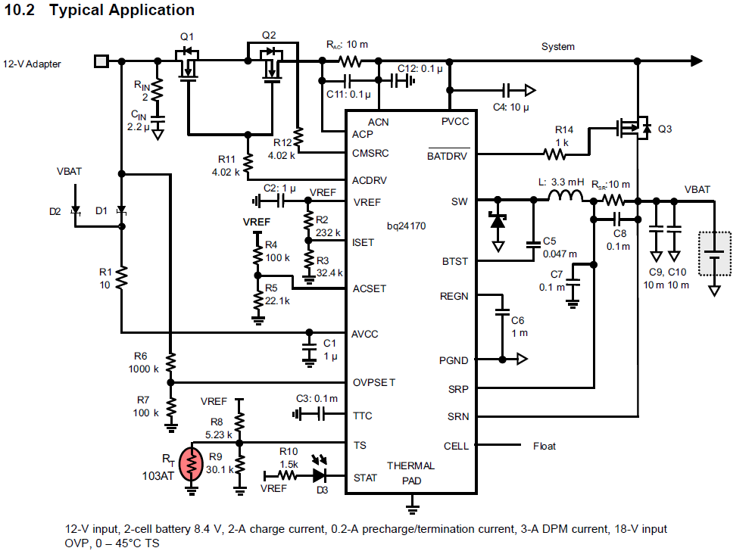
Oscilloscope is measuring here to ground
Vin is 15.4 Volts instead 12v
I’m following this diagram except for the next changes:
Vin
Number of cell
I send this pin to Vref to setup the ic for 4 Cells

