Slide 1
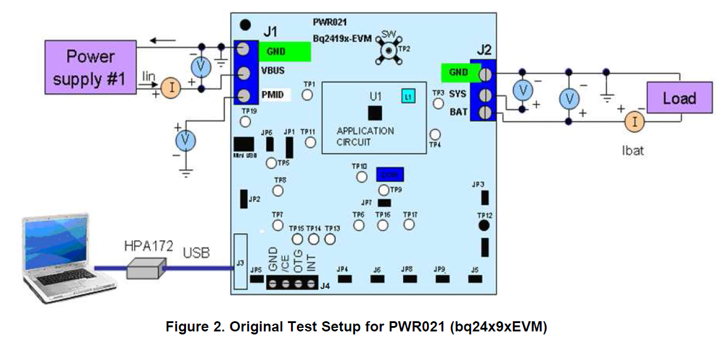
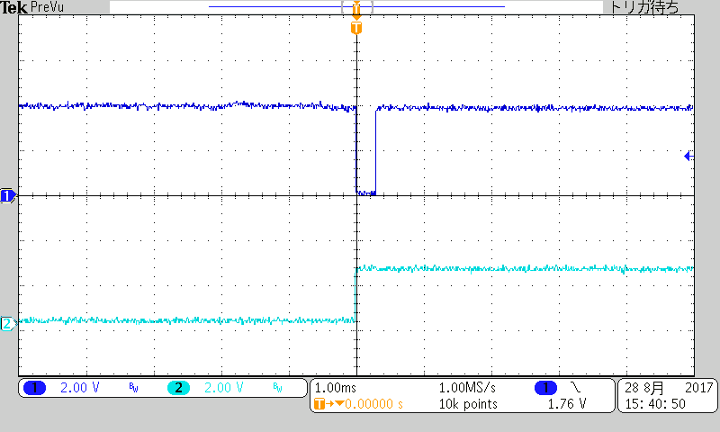
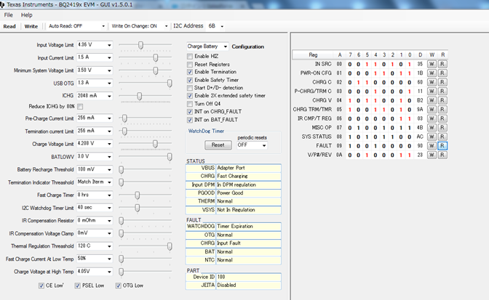
VBUS
(Power Supply#1)
BAT
(Power Spply#2)
* TEST RESULT
condition
Keep VBAT (power supply #2) =3.6V > 3.55V(VBATGD)
VBUS (Power Splly#1) 5V to decrease➔ INT low pulse
If
3.5V* < VBUS < 3.8V , REG09[5:4] stays 01
If
VBUS < 3.5V* , REG09[5:4] become 00 in second read
INT
STAT
Read
(click)
twice
INT goes low
(250us)➔
Read twice

Slide 2
Question1
In my EVM test, REG09 [5:4] became 00 in second read when VBUS < ≒3.5V
Is it reasonable?
Question 2
In the data sheet page34 Table17, we found following description.
01 – Input fault (VBUS OVP or VBAT < VBUS < 3.8 V),
Please let us know more detail criteria as following.
Is following correct isn’t it? Also let me know 3.5V is correct or not
01 – Input fault (VBUS OVP or VBAT> 3.55V and 3.5V?< VBUS < 3.8V)

