Slide 1
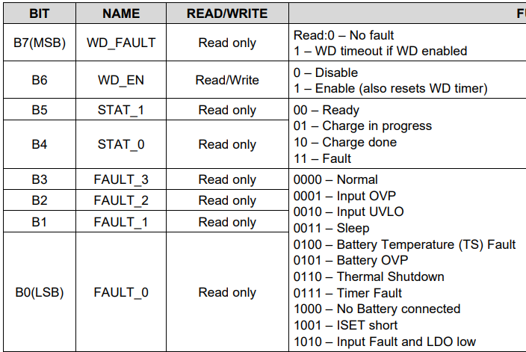
VBAT ≒ VBATREG + 50~60mV
VIN=5V
Turn off
Turn on
VBAT ≒ VBATREG+ 50~60mV
When VBAT ≒ VBATREG + 50~60mV with VIN,
STAT shows 01(charge in progress)
FAULT shows 0000(Normal)
Buck converter turns off
Battery FET turns on

Slide 2
VBAT ≒ VBATREG
VIN=5V
Turn on
Turn on
VBAT ≒ VBATREG
When VBAT ≒ VBATREG ,
STAT shows 10(Charge done)
FAULT shows 0000(Normal)
Buck converter turns on
Battery FET turns on

Slide 3
Question
When VBAT is in between VBATREG and VBOVP(VBAT ≒ VBATREG+50~60mV < VBOVP) with VIN, bq24250 status shows “charge in progress”. Under such situation, buck converter turns off and source current is supplied from battery. The status shows “charge in progress”.
Q1: in below e2e thread shows “when VBAT >VBATREG, charge is complete so /CHG will go high Z. When VBAT>VBOVP, the buck converter turns off and the internal battery FET turns on, tying BAT=SYS. ” and I assume bq24250 VBOVP function is the same as it.
bq24250 VBAT doesn’t exceed VBOVP in this case but it looks bq24250 doing similar behavior of “VBAT>VBOVP”(When VBAT>VBOVP, the buck converter turns off and the internal battery FET turns on, tying BAT=SYS). Why is bq24250 doing such behavior?
https://e2e.ti.com/support/power-management-group/power-management---internal/f/power-management---internal-forum/294922/bq24167-ts-disable-threshold-vbovp-behavior?tisearch=e2e-quicksearch&keymatch=VBOVP
Q2: bq24250 status shows “charge in progress” but why bq24250 shows “charge in progress” with above setting?

