Slide 1
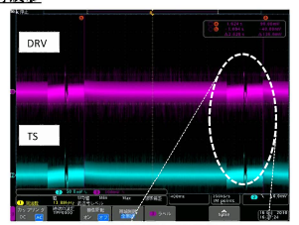
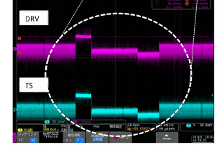
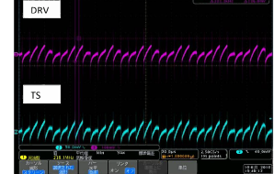
bq24266EVM
VIN=5V
CE=Low
IUSB1=Low
IUSB2=Low
IUSB3=Low
DRV normally outputs every 2.6s.
DRV is oscillation

