Slide 1
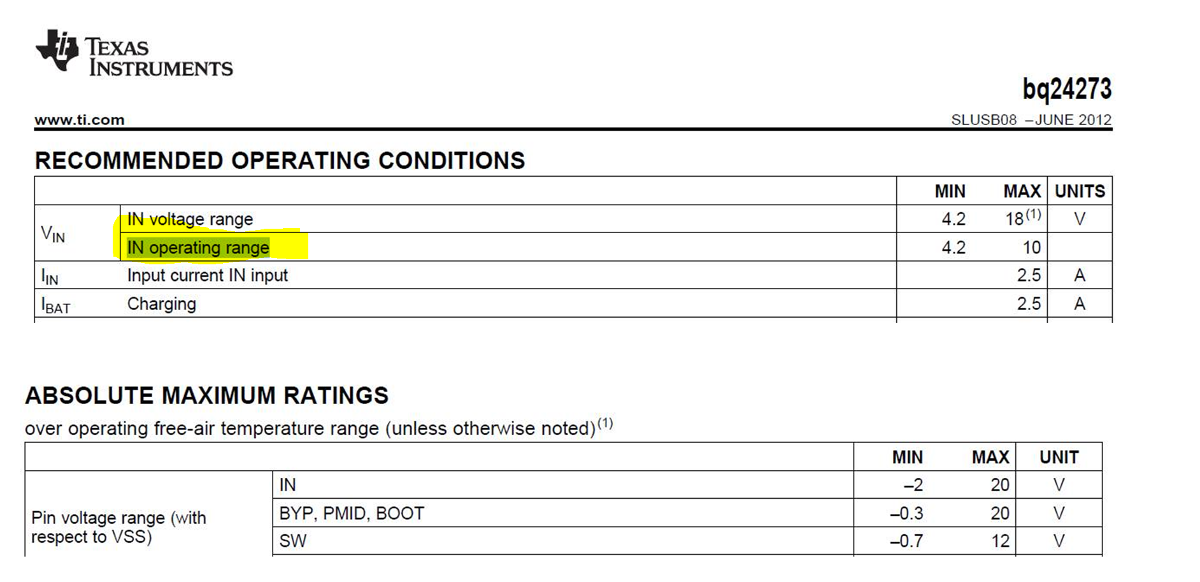
The Max input voltage is 18V but the max operating range is only 10V and the max SW voltage is only 12V. I am confused. Could you tell me what is the different between input voltage range and operating range?
Can I use this IC on my Vin 12V and output 3.3V (provide power to system (TMS320F28035 Vin min 2.95V to 3.65V) and charges battery?

