Slide 1
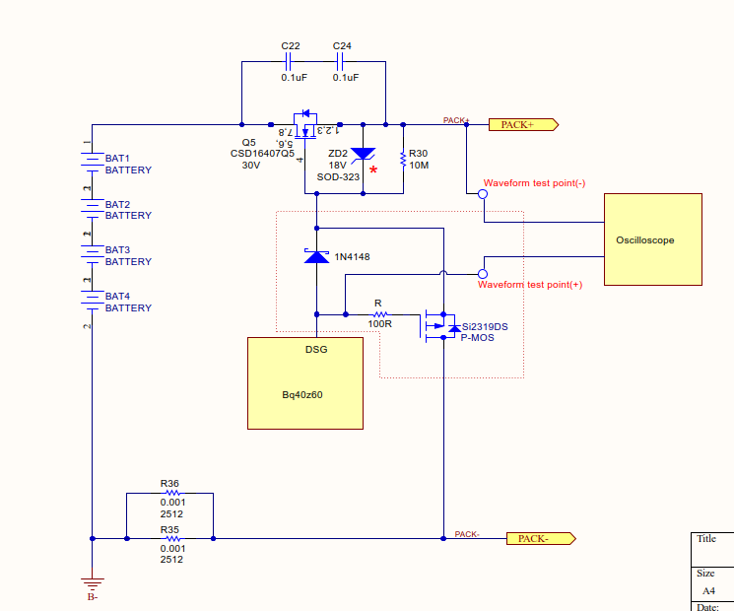
Change the DSG drive circuit
(Using P-MOS to guide the DSG FET to turn off)

Slide 2
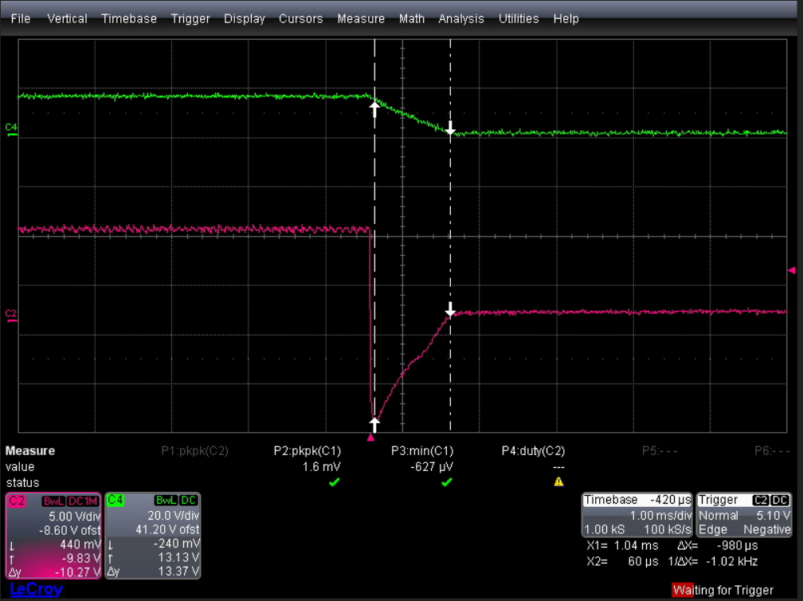
Load condition : 4.0A
Pack+
Bq40z60 – DSG Pin

Slide 3
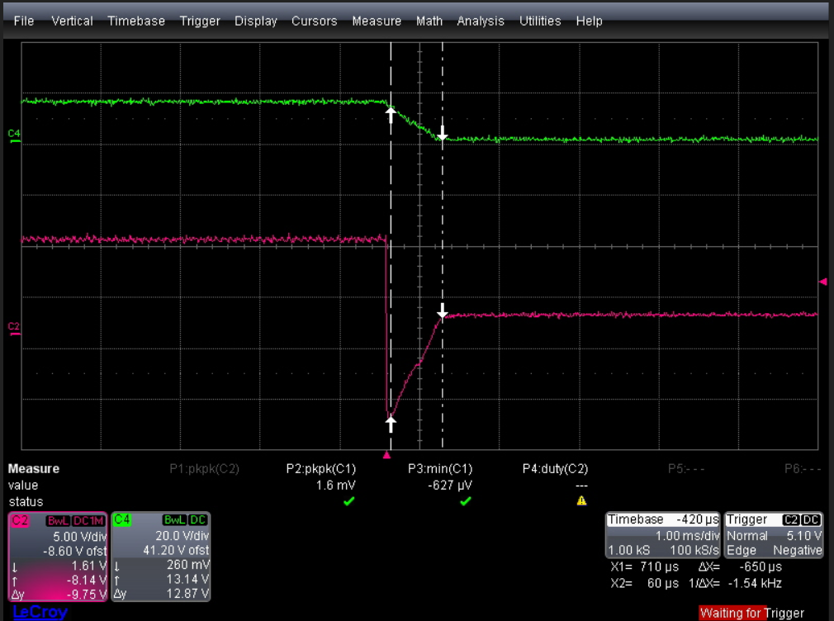
Load condition : 5.0A
Pack+
Bq40z60 – DSG Pin

Slide 4
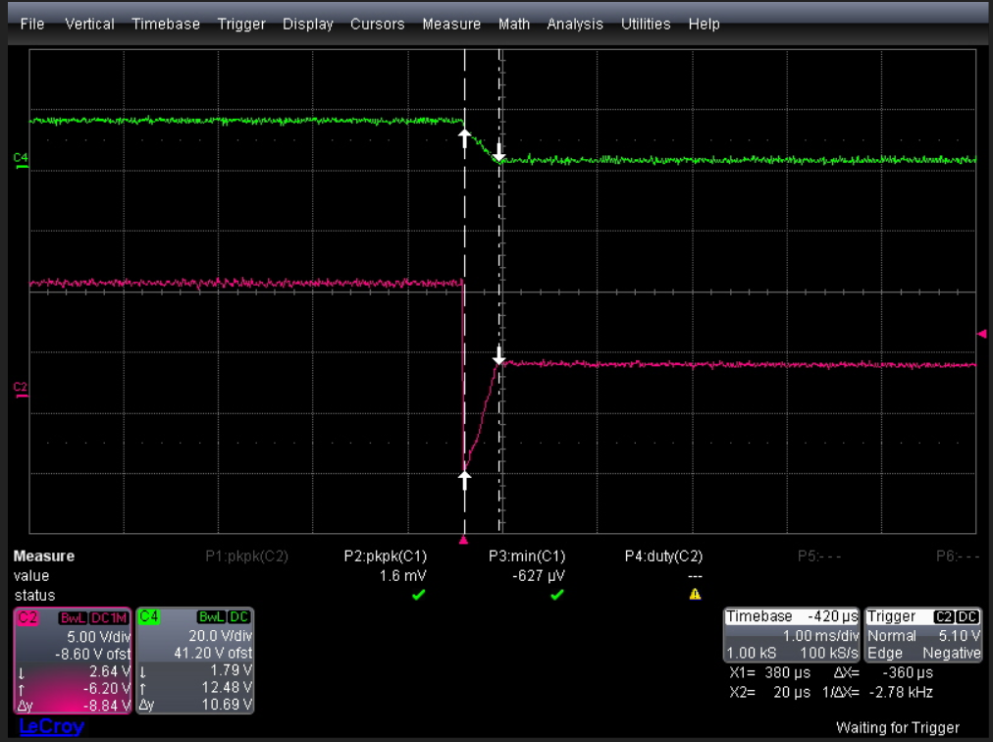
Load condition : 6.0A (MOS FET Damage)
Pack+
Bq40z60 – DSG Pin

Slide 5
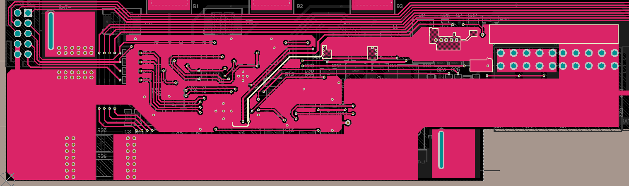
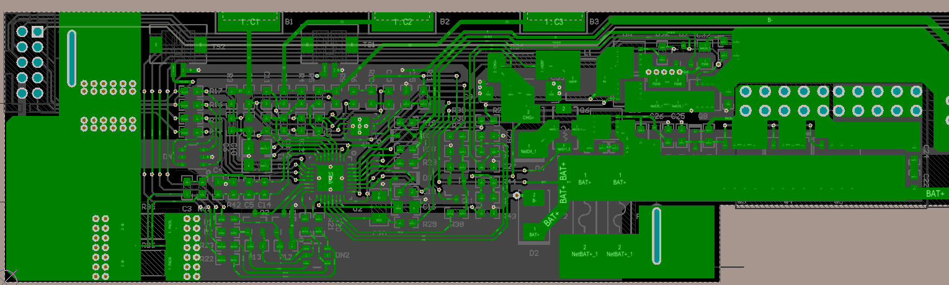
PCB Layout
Charger GND
BAT-
BQ40Z60 GND
PACK-
BQ40Z60 PGND
(highlight traces)
BAT+
PACK+

