Slide 1
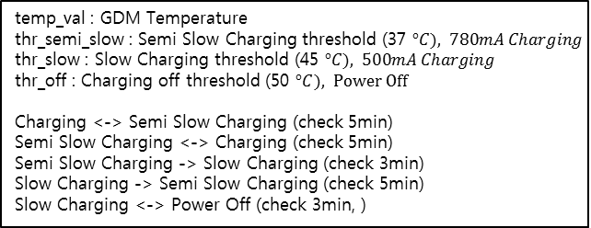
temp_val : GDM Temperature
thr_semi_slow : Semi Slow Charging threshold (37 $°C), 780mA Charging$
thr_slow : Slow Charging threshold (45 $°C), 500mA Charging$
thr_off : Charging off threshold (50 $°C), Power Off$
Charging <-> Semi Slow Charging (check 5min)
Semi Slow Charging <-> Charging (check 5min)
Semi Slow Charging -> Slow Charging (check 3min)
Slow Charging -> Semi Slow Charging (check 5min)
Slow Charging <-> Power Off (check 3min, )
Start
Read GDM Temperature
YES
End
NO
USB
YES
temp_val < thr_semi_slow
Charging(1100mA)
YES
NO
thr_semi_slow <= temp_val < thr_slow
Semi slow Charging(780mA)
YES
NO
thr_slow <= temp_val < thr_off
Slow Charging (500mA)
YES
NO
temp_val >= thr_off
Power Off
1min warning alert
YES
NO

