Slide 1
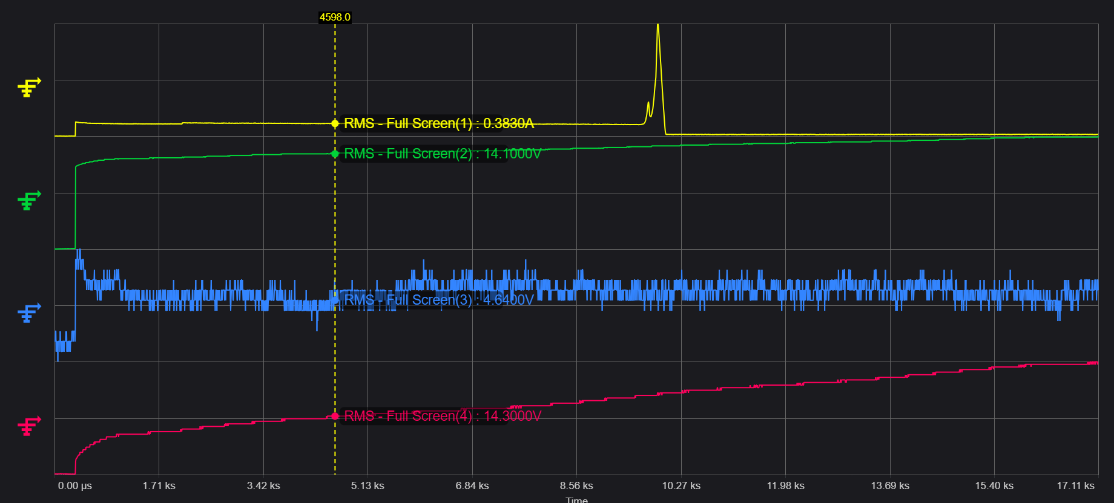
1. Charging issue of BQ25798
1). Issue and Symtom : During charging, the current increases and then Stop the fast charging.
ⓐ Charging start : CE High to Low. Charging status of Register is indicate Fast charging.
ⓑ IBAT register shows always 0mA ( after set 80h of Index 2Eh ), but low current charging is continuing.
ⓒ Charging Current was ramp-up rapidly(around 2.3mA) at battery voltage 15~15.1V after that, stop Fast charging
( refer to below figure1 of page 1)
2) Test enviroment
- Battery Pack : Li-ion 4s1p, Fast Charging (0.5C), Discharging current (1C typ, 2c max)
Output Voltage (14.4V typ), Charging Voltage(16.8V)
Cutoff discharging voltage(11.2V), Recover Voltage(12V)
3) Requtst: Please give me advice on solving problems in circuit or PCB design.
※ Figure 1
CH1(BAT current), CH2(VBAT), CH2(VBUS), CH4(VSYS)
※ Please note that the oscilloscope's measured waveform values ​​have high deviation. Looking at the dumped register value, it is VSYS≥VBAT.

Slide 2
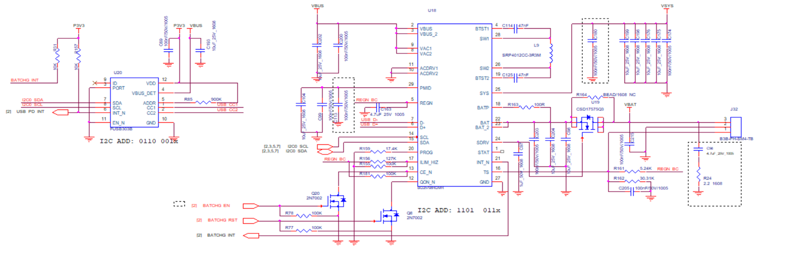
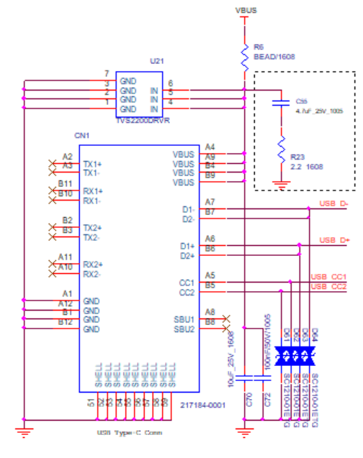
1. Charger schematic
※ The dotted boxes are pictures after rework.

Slide 3
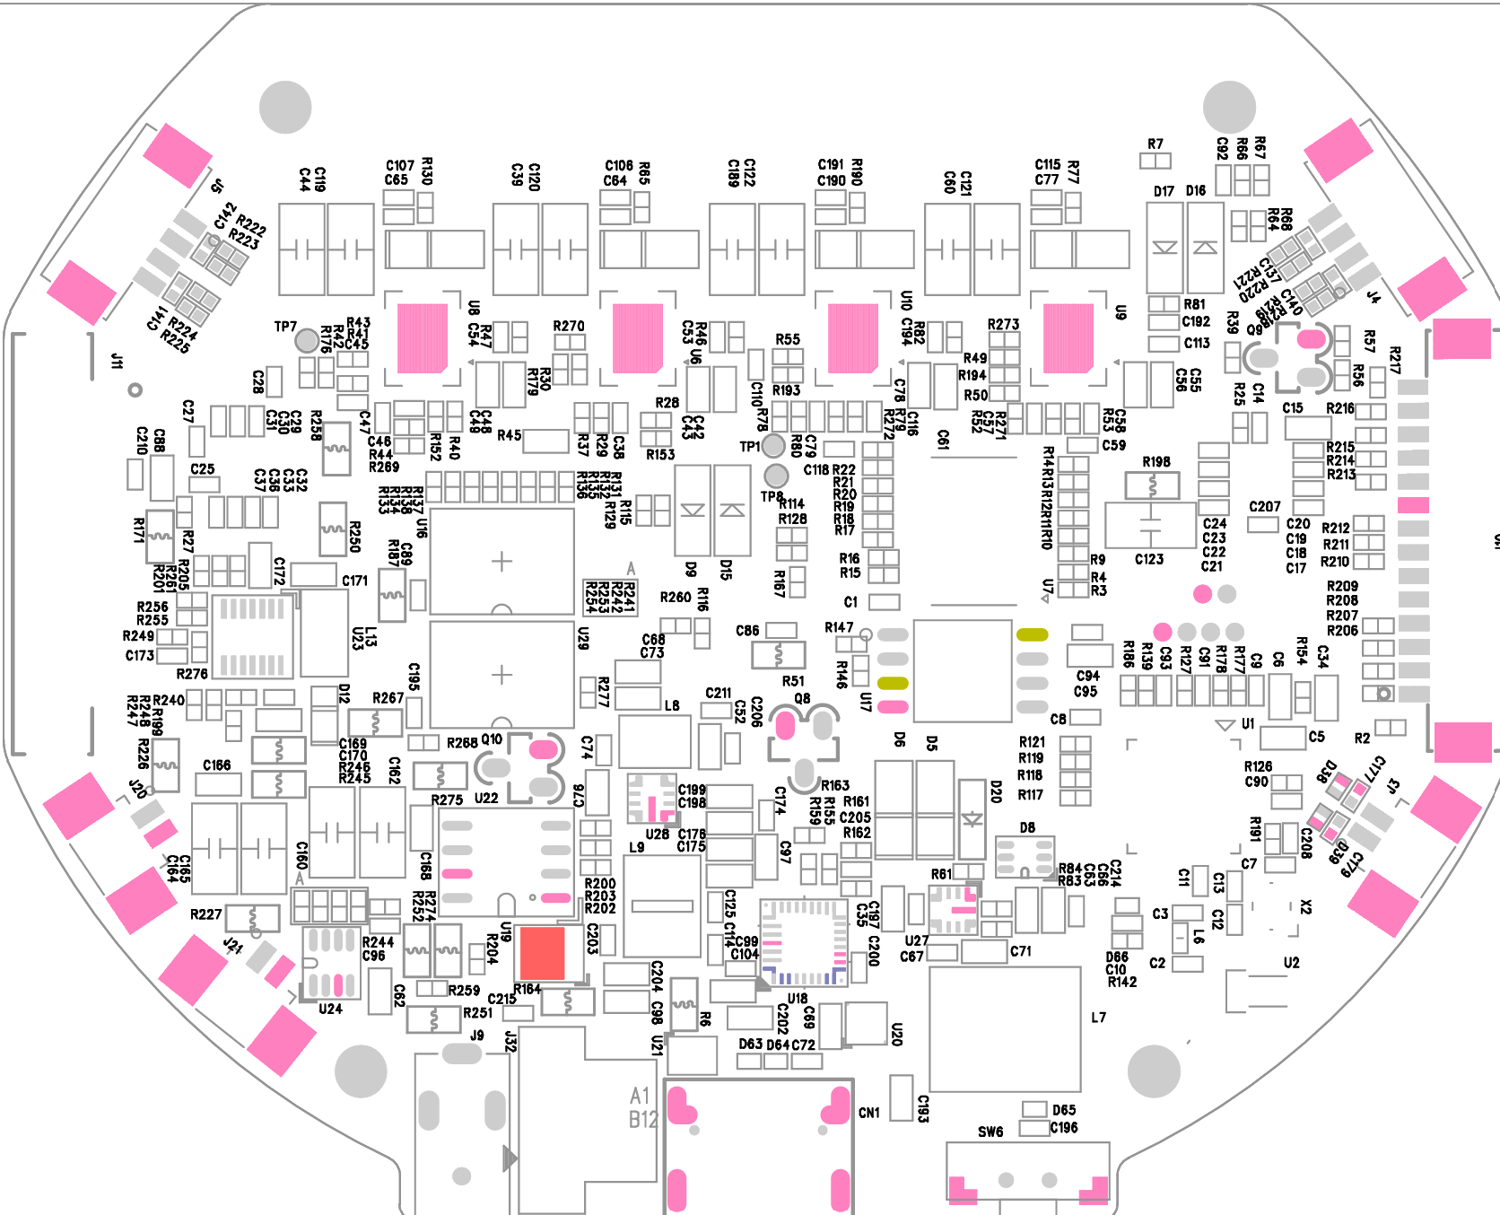
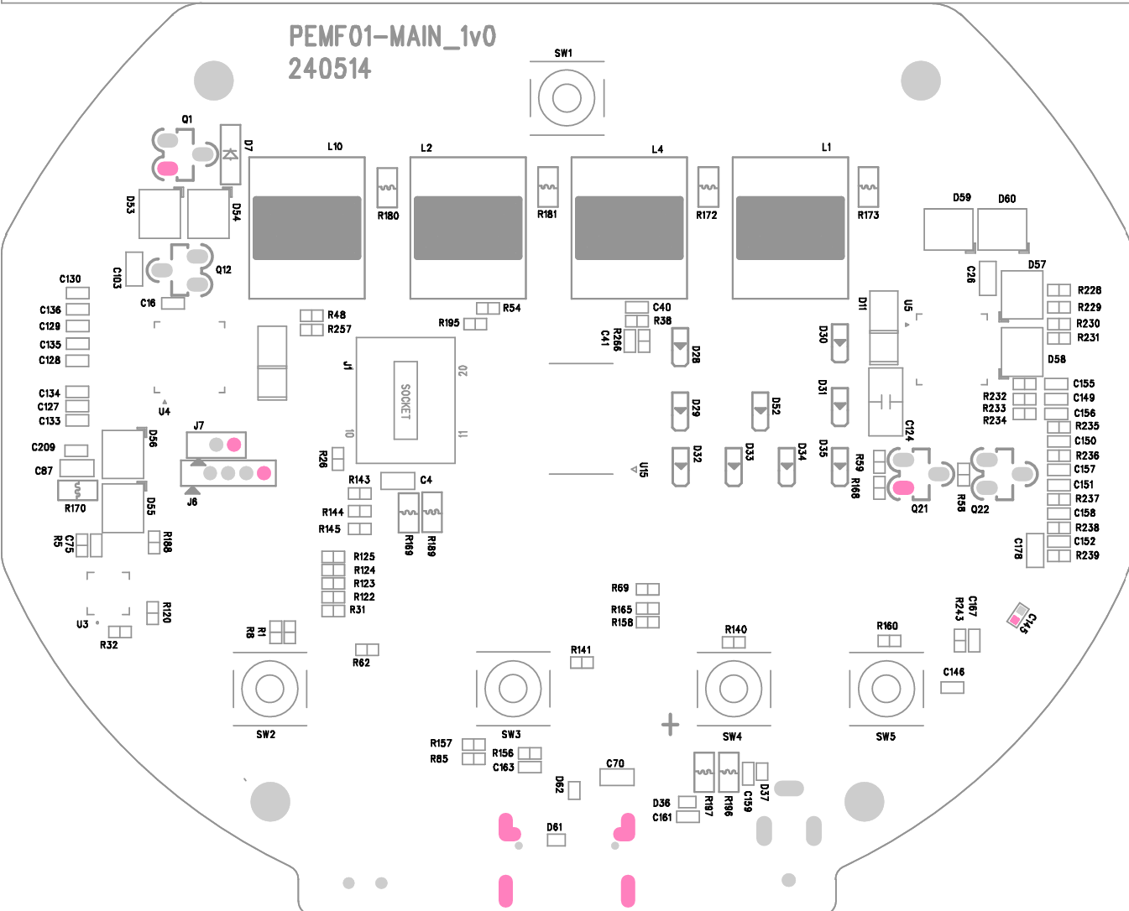
2. Ref number of PBA
image area

Slide 4
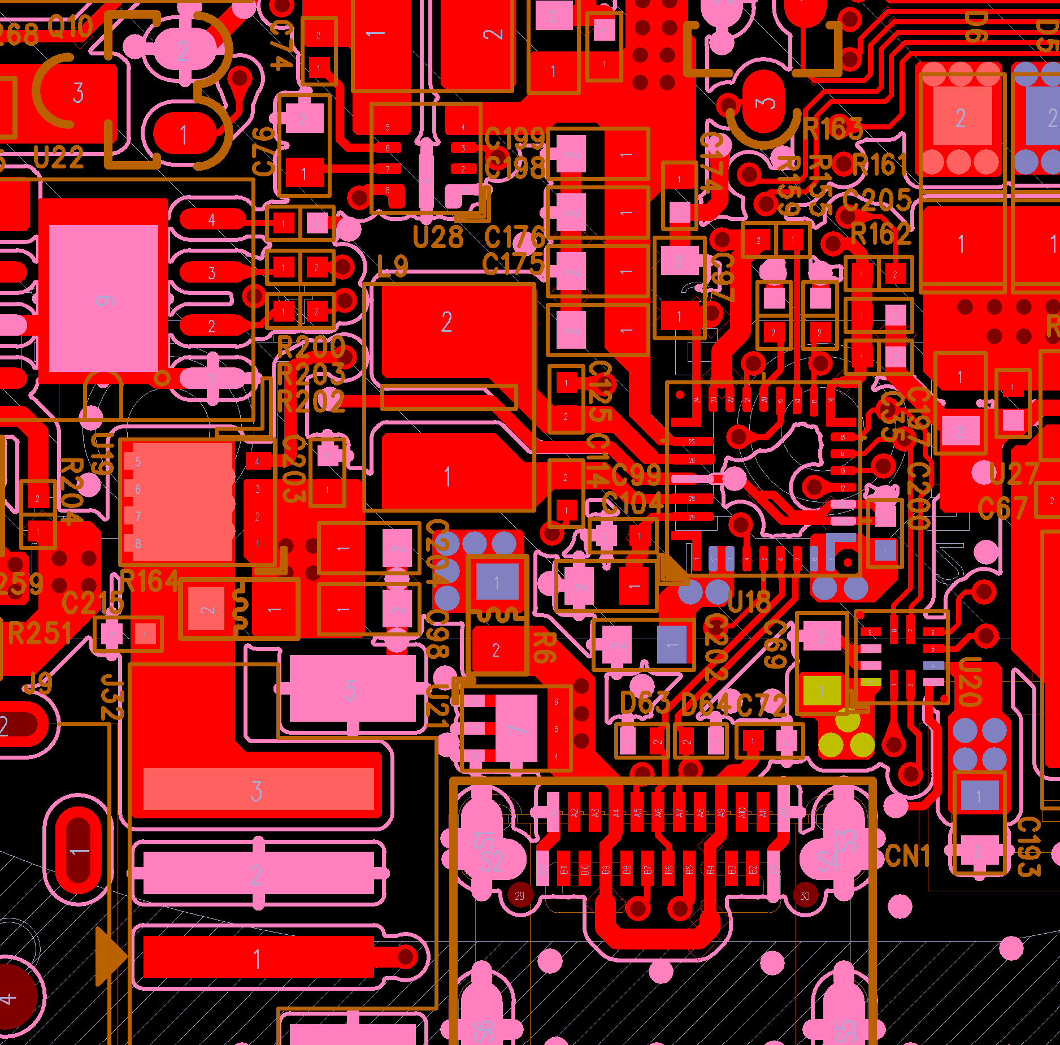
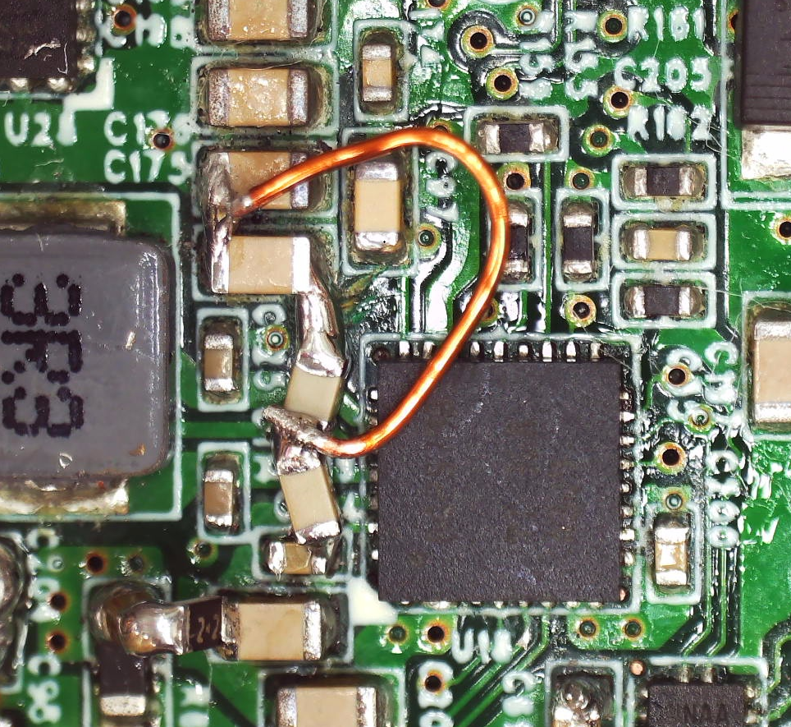
3. Bottom (4L). Bottom view
★ 1. Add 100nF Capacitor rework
PMID(Pin29) ~ GND(Pin27)
VSYS(Pin25) ~ GND(Pin27)
2. Add wire VSYS Cap gnd ~ GND(Pin27)

Slide 5

4. GND (3L)

Slide 6

5. PWR (2L)
VSYS
VBAT
VBUS
P3V3

Slide 7
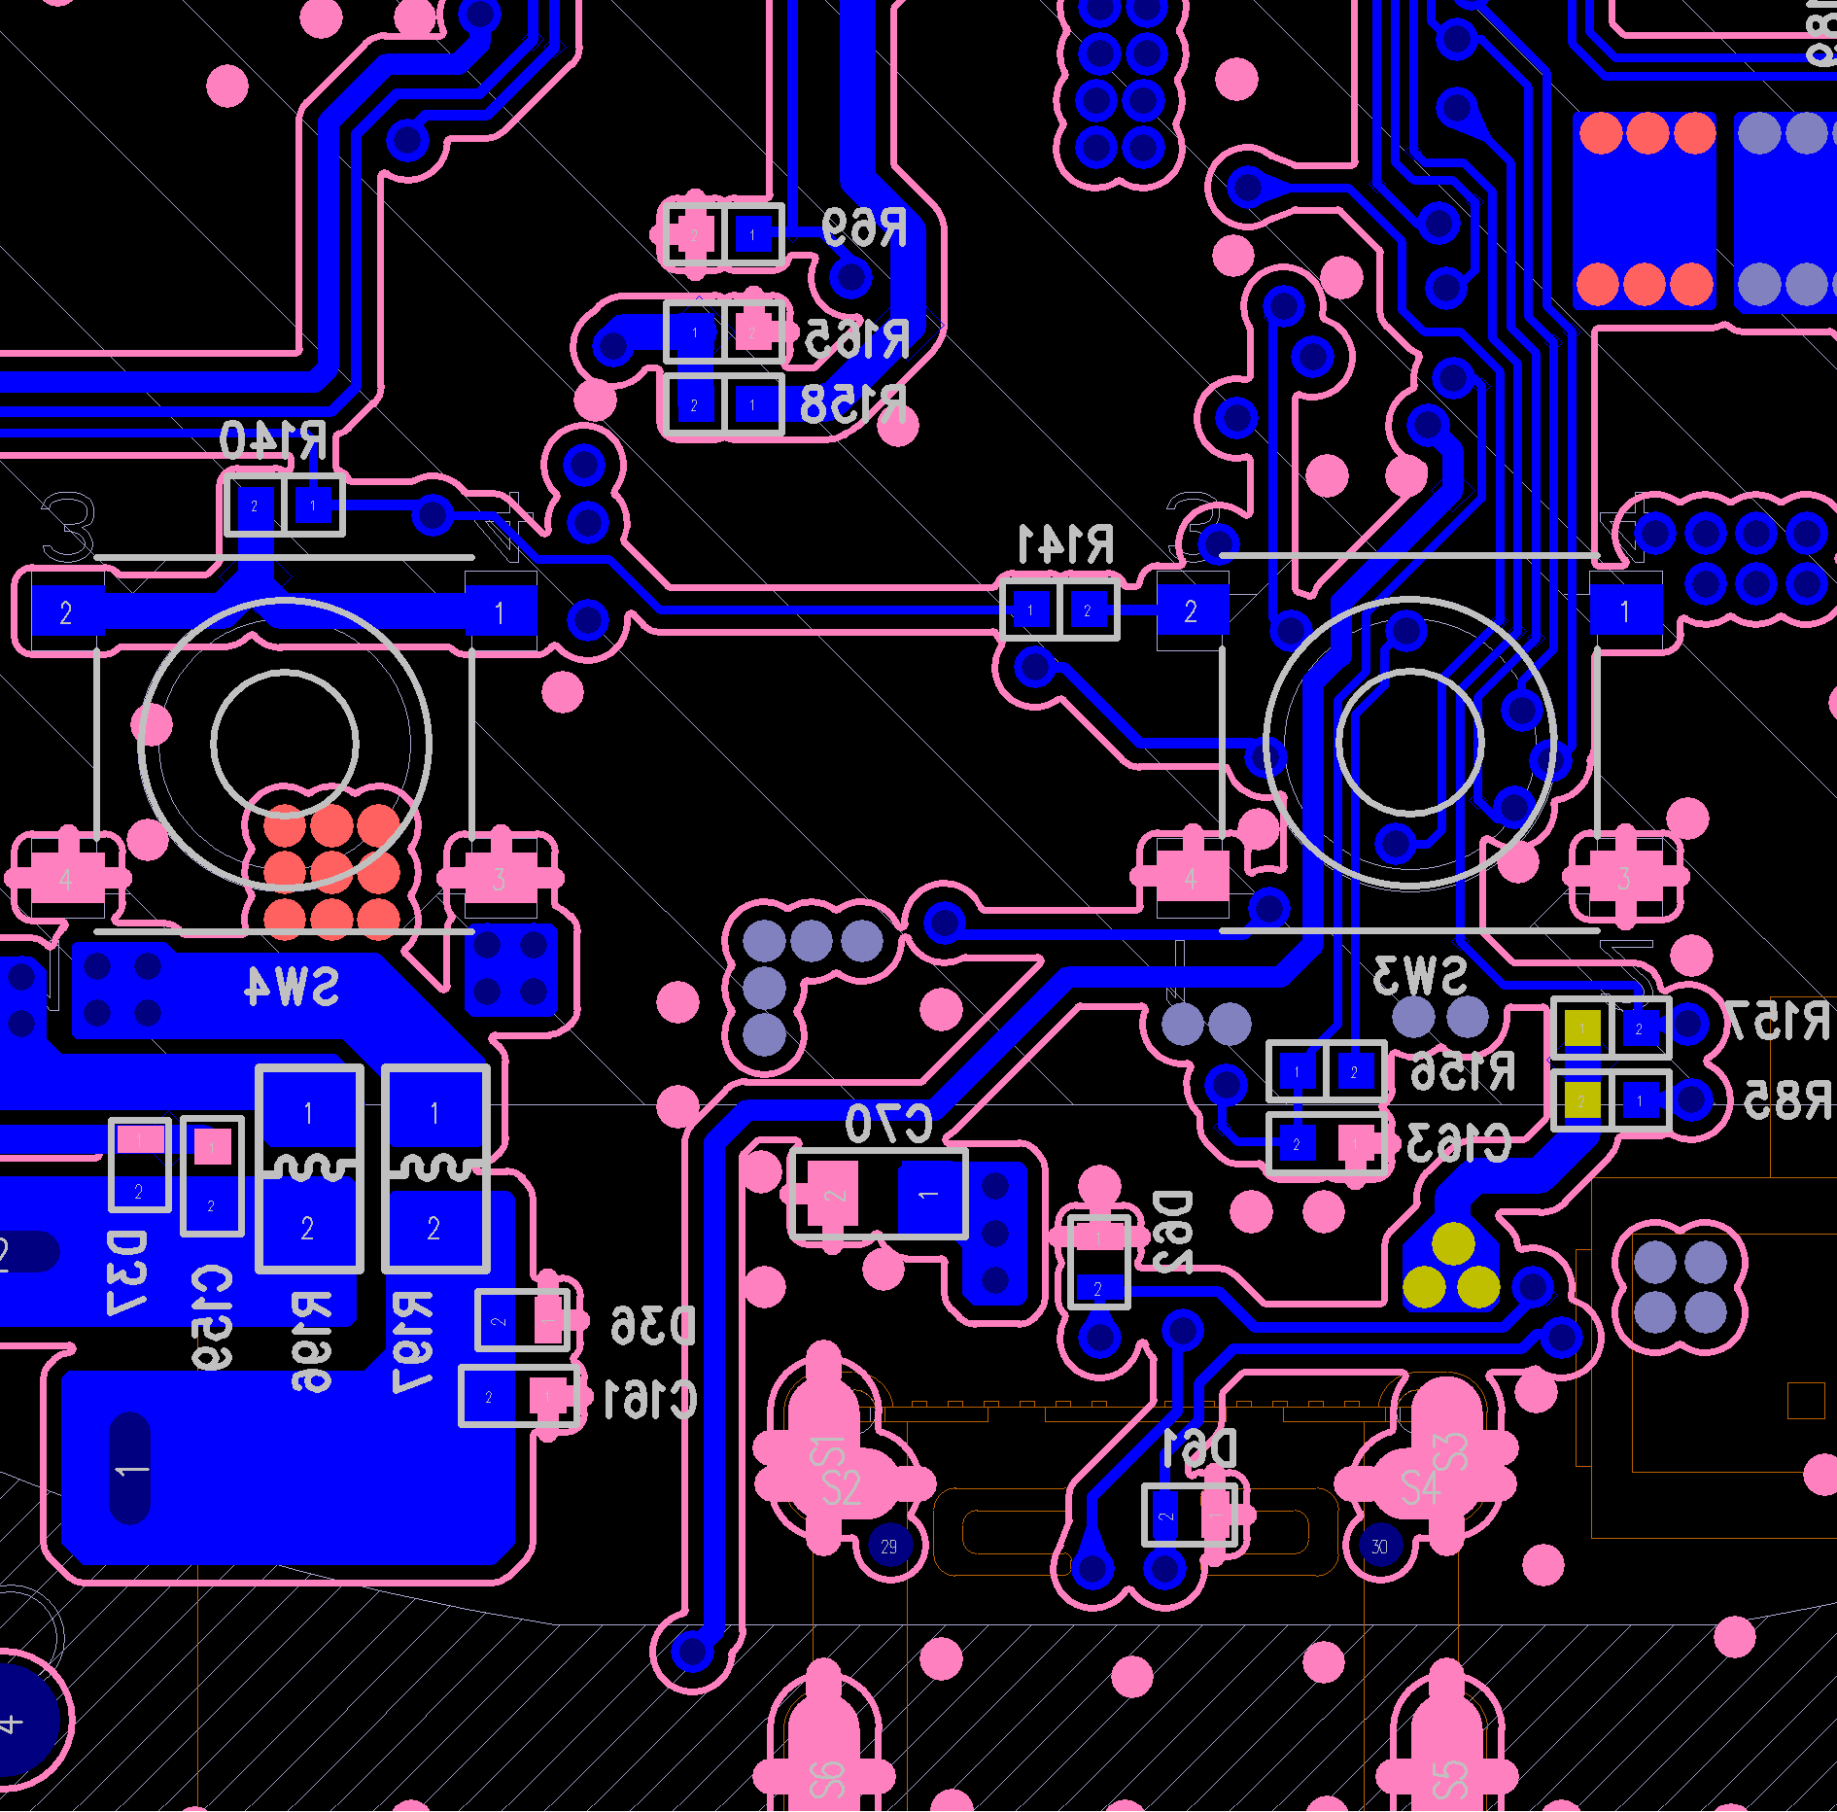
6. Top (1L)

