Slide 1
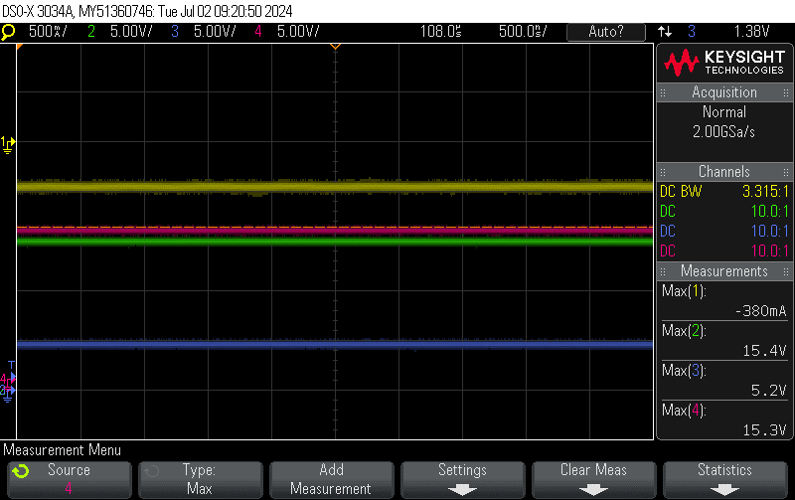
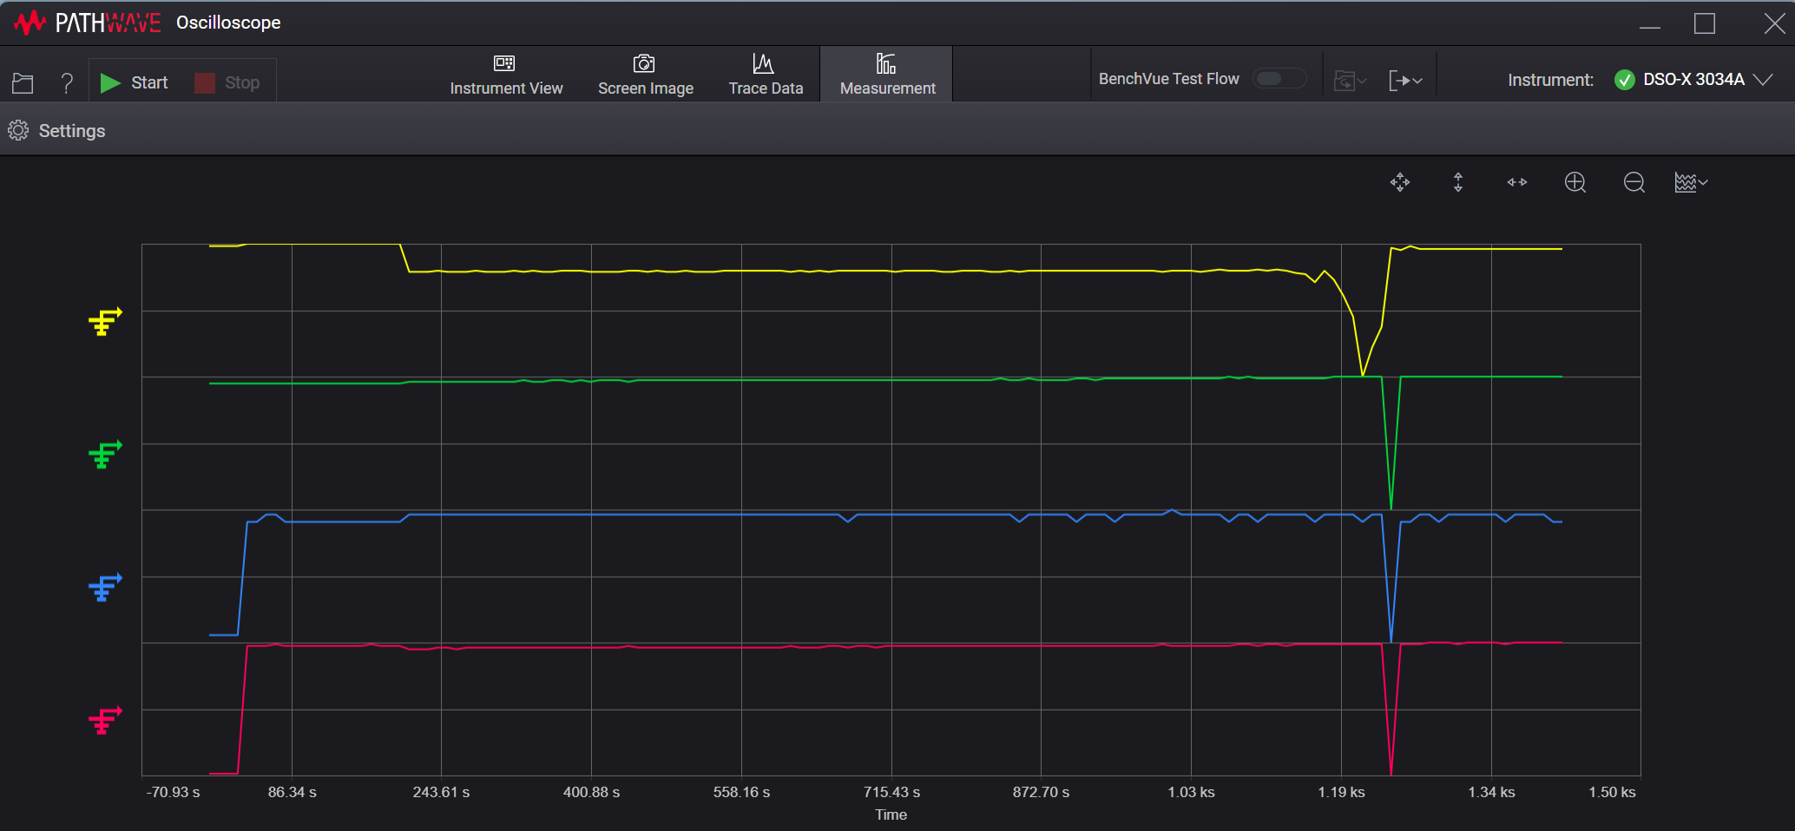
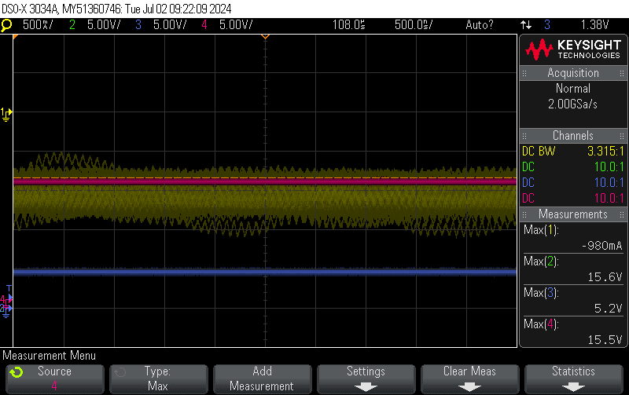
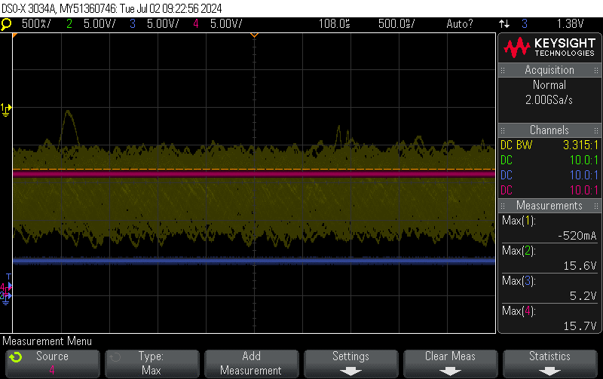
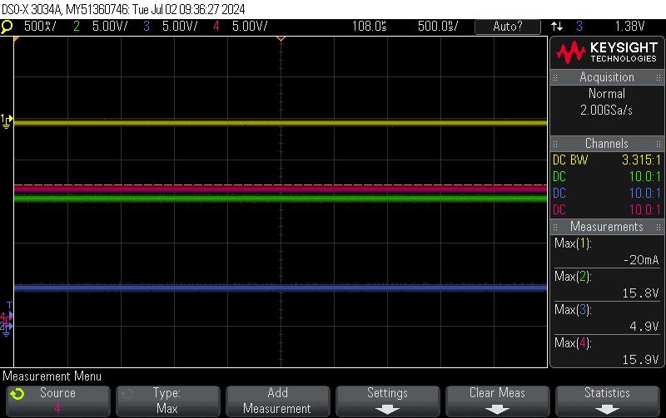
1. Charging issue of BQ25798 ( PBA#13 ). 20240701 Report
220Sec
1). Issue and Symtom : During charging, the current increases and then Stop the fast charging.
ⓐ Charging start : CE High to Low. Charging status of Register is indicate Fast charging.
ⓒ Charging Current was ramp-up rapidly(around 2.3mA) at battery voltage 15~15.1V after that, stop Fast charging. Issue to Focus on.
( refer to below figure1 of page 1)
2) Requtst: Please give me advice on solving problems in circuit or PCB design.
around 1200Sec
150Sec
220Sec
1210Sec
1240Sec
1320Sec
around 1230Sec
around 1320Sec
CH1(BAT current), CH2(VBAT), CH2(PMID), CH4(VSYS)
. TA : Samsung EP-TA50KWK 001. Output(5V 1.55A)
. - Battery Pack : Li-ion 4s1p, Fast Charging (0.5C), Discharging current (1C typ, 2c max)
Output Voltage (14.4V typ), Charging Voltage(16.8V)
Cutoff discharging voltage(11.2V), Recover Voltage(12V)

Slide 2
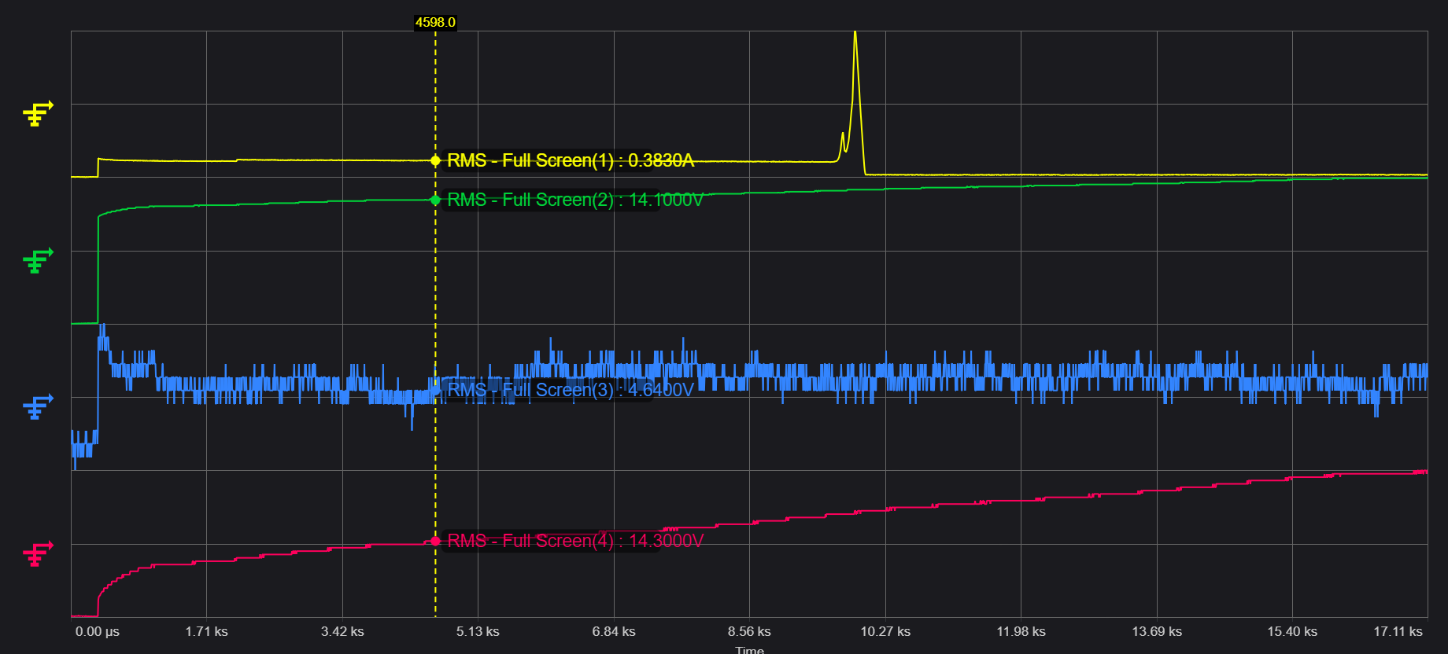
1. Charging issue of BQ25798 ( PBA#12 ). 20240701 Report
1). Issue and Symtom : During charging, the current increases and then Stop the fast charging.
ⓐ Charging start : CE High to Low. Charging status of Register is indicate Fast charging.
ⓑ IBAT register shows always 0mA ( after set 80h of Index 2Eh ), but low current charging is continuing.
ⓒ Charging Current was ramp-up rapidly(around 2.3mA) at battery voltage 15~15.1V after that, stop Fast charging
( refer to below figure1 of page 1)
2) Test enviroment
- Battery Pack : Li-ion 4s1p, Fast Charging (0.5C), Discharging current (1C typ, 2c max)
Output Voltage (14.4V typ), Charging Voltage(16.8V)
Cutoff discharging voltage(11.2V), Recover Voltage(12V)
3) Requtst: Please give me advice on solving problems in circuit or PCB design.
※ Figure 1
CH1(BAT current), CH2(VBAT), CH2(VBUS), CH4(VSYS)
※ Please note that the oscilloscope's measured waveform values ​​have high deviation. Looking at the dumped register value, it is VSYS≥VBAT.

