Slide 1
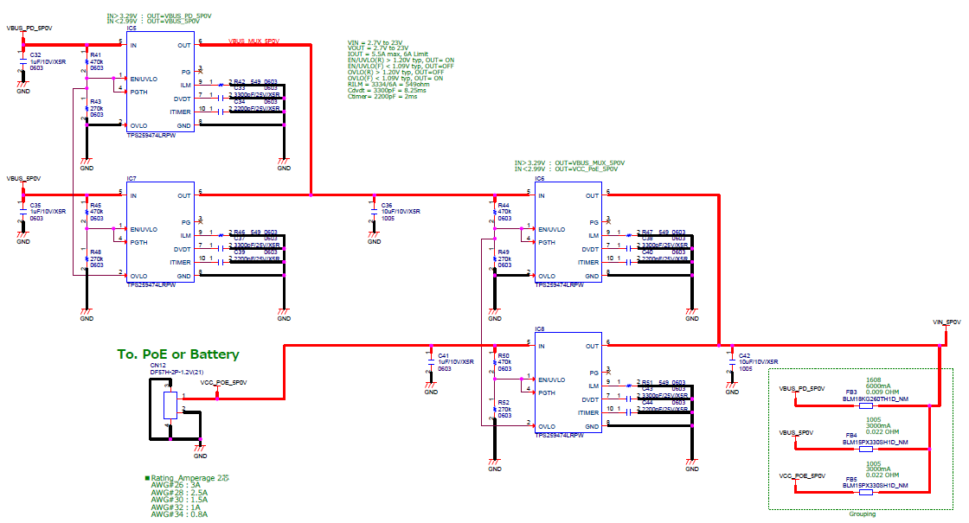
Target IC：TPS259474LRPWR
★Use case you want to realize
①USB_PD入力 | ②USB3.0入力 | ③Battery/PoE入力 | 選択電源
× | × | × | 電源無し
× | × | ○ | ③Battery/PoE入力
× | ○ | × | ②USB3.0入力
× | ○ | ○ | ②USB3.0入力
○ | × | × | ①USB_PD入力
○ | × | ○ | ①USB_PD入力
○ | ○ | × | ①USB_PD入力
○ | ○ | ○ | ①USB_PD入力
①USB-PD
Voltage： 9V or 12V
Current ：3A MAX
②PC_BUS
Voltage：5V
Current：3A MAX
③Battery / PoE
Voltage： 5V
Current：3A MAX
◆Request
① Please check the circuit diagram.
② If there are any problems, please point them out.
③ Is the list of use cases in ★ possible?

