Slide 1
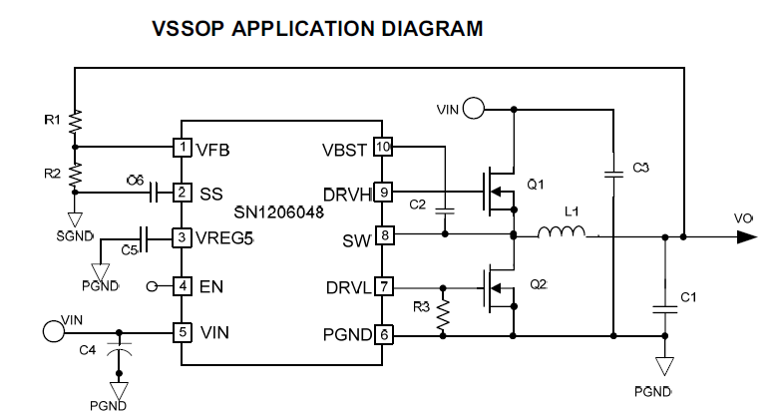
VIN=24V Vout=5V

Slide 2
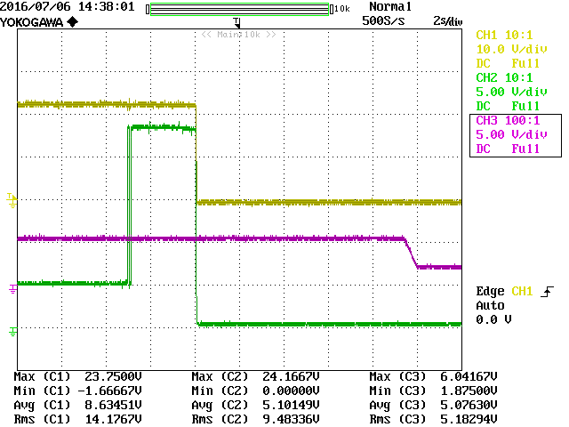
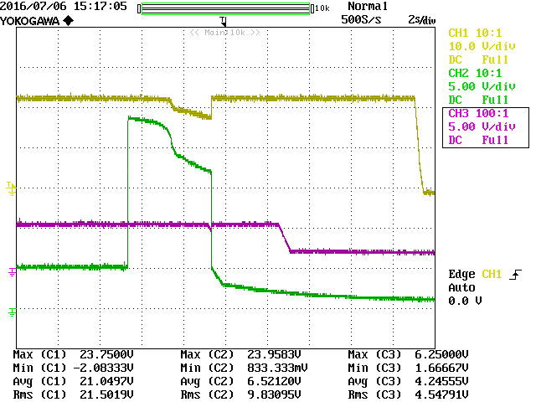
IC 8PIN open timing
IC 9PIN open timing
24V
24V
5V-C
5V-C
+5V
+5V
Gold:VIN
Green:Vout

