Slide 1
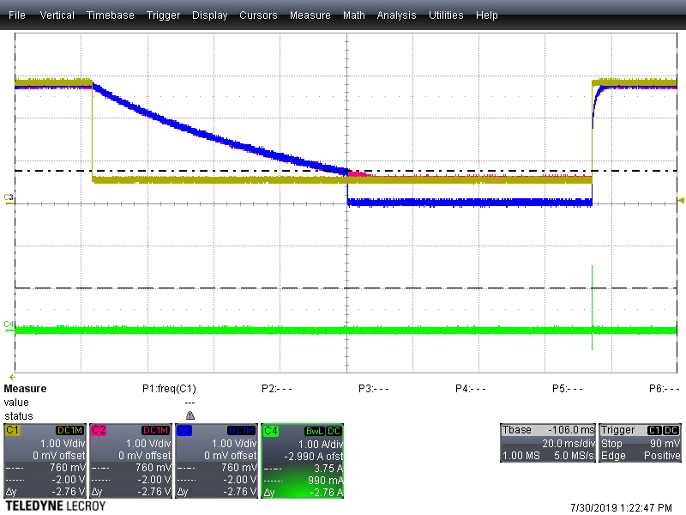
NR/SS input
Vout
PG
Iin
Notes:
Vin = 3.8 V
NR/SS pin: Vhigh = 2.8 V
Vlow = .5 V
lead time = 50 us
period = 300 ms
pulse width = 150 ms
Rload = 3300 ohm
Iload = 2.8/3300 = .84 mA

Slide 2
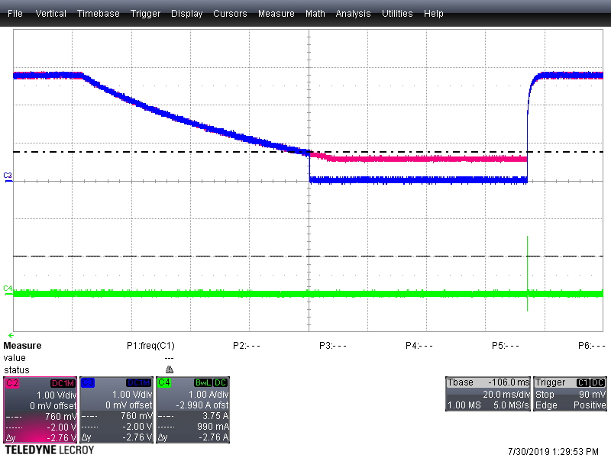
NR/SS input
Vout
PG
Iin
Notes:
Vin = 3.8 V
NR/SS pin: Vhigh = 2.8 V
Vlow = .5 V
lead time = 50 us
period = 300 ms
pulse width = 150 ms
Rload = 3300 ohm
Iload = 2.8/3300 = .84 mA

Slide 3
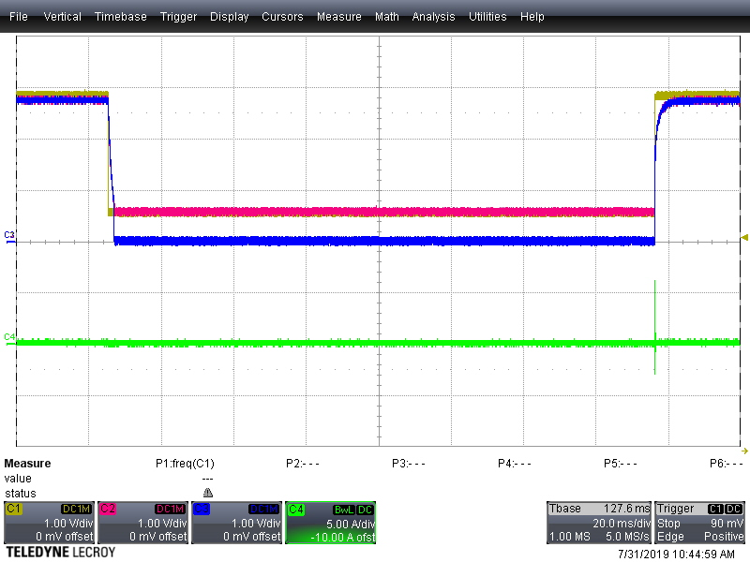
NR/SS input
Vout
PG
Iin
Notes:
Vin = 3.8 V
NR/SS pin: Vhigh = 2.8 V
Vlow = .5 V
lead time = 15 us
period = 300 ms
pulse width = 150 ms
Rload = 33 ohm
Iload = 2.8/33 = 84 mA

Slide 4
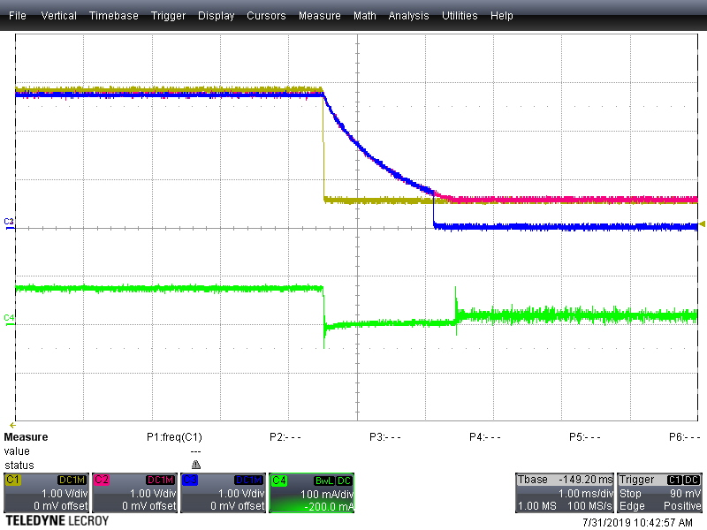
NR/SS input
Vout
PG
Iin
Notes:
Vin = 3.8 V
NR/SS pin: Vhigh = 2.8 V
Vlow = .5 V
lead time = 15 us
period = 300 ms
pulse width = 150 ms
Rload = 33 ohm
Iload = 2.8/33 = 84 mA

Slide 5
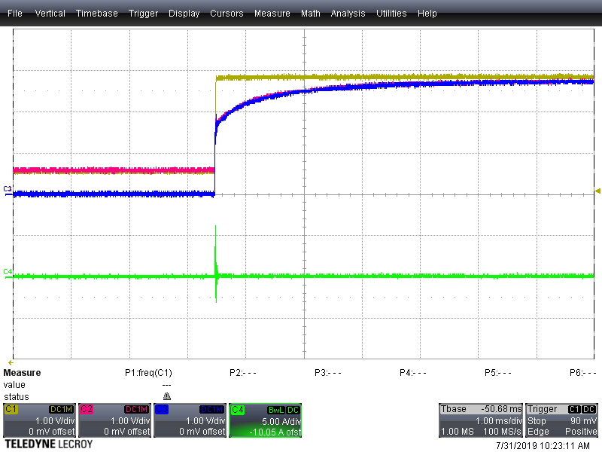
NR/SS input
Vout
PG
Iin
Notes:
Vin = 3.8 V
NR/SS pin: Vhigh = 2.8 V
Vlow = .5 V
lead time = 15 us
period = 300 ms
pulse width = 150 ms
Rload = 33 ohm
Iload = 2.8/33 = 84 mA

