Slide 1
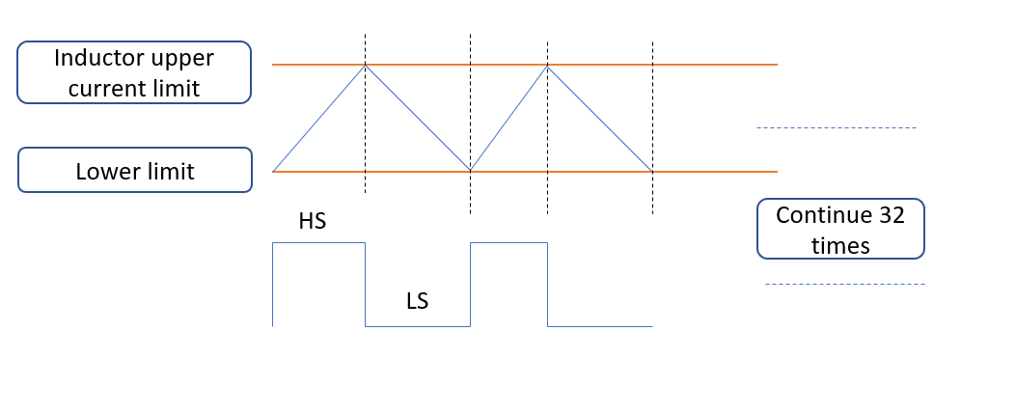
High-side peak current limit
Low-side valley current limit

