Slide 1
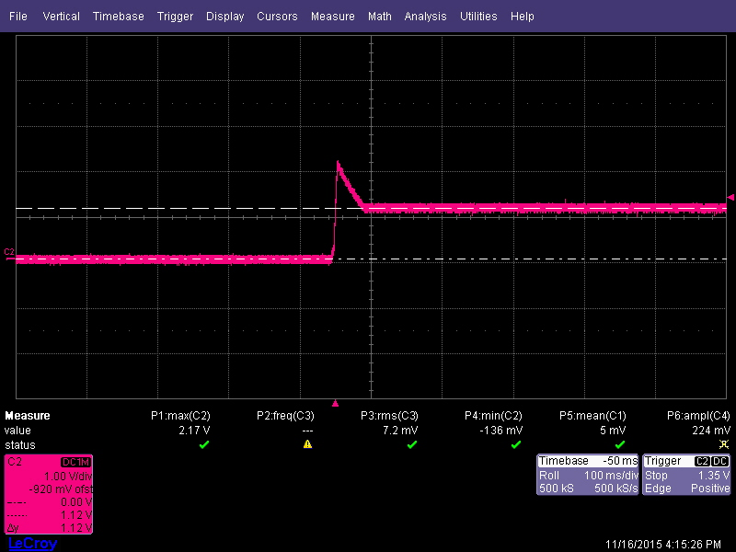

AFB waveform LED normal
AFB waveform LED flicker , DLY pin autorestart

Slide 2
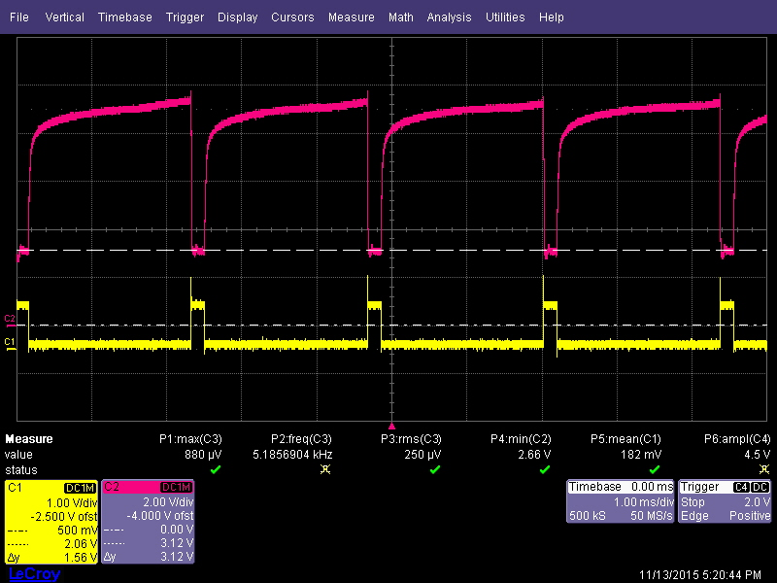
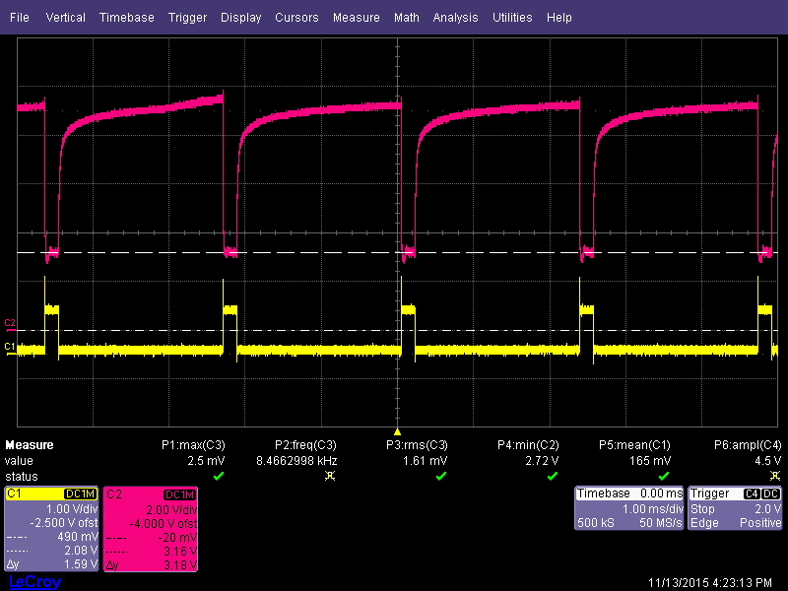
SC waveform LED normal
SC waveform LED flicker , DLY pin autorestart

Slide 3
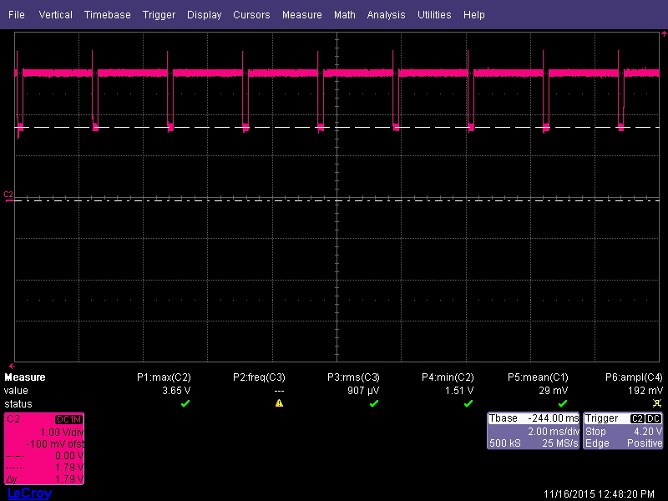

CFB waveform LED normal
VCFB=1.8V
CFB waveform LED flicker , DLY pin autorestart
VCFB=1.38V

