Slide 1
Boost Circuit

Slide 2
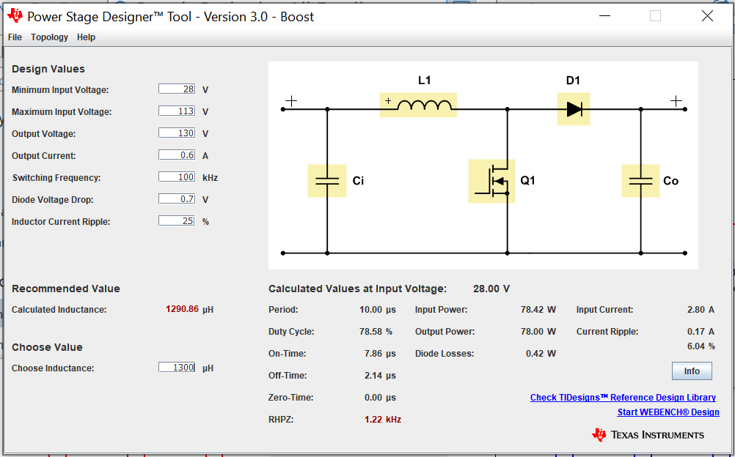
Circuit values

Slide 3
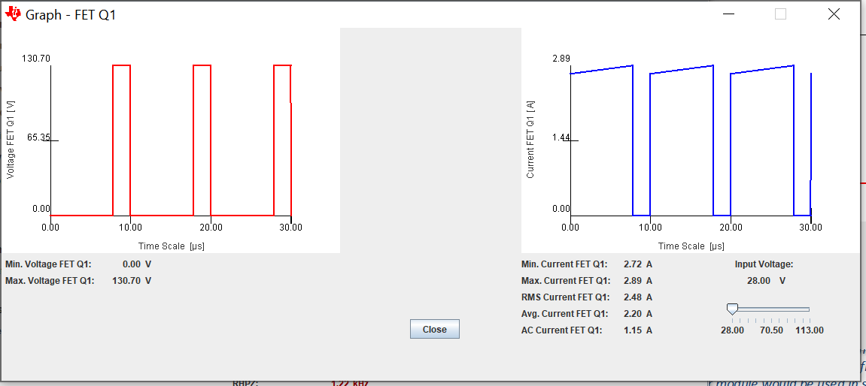
Mosfet

Slide 4
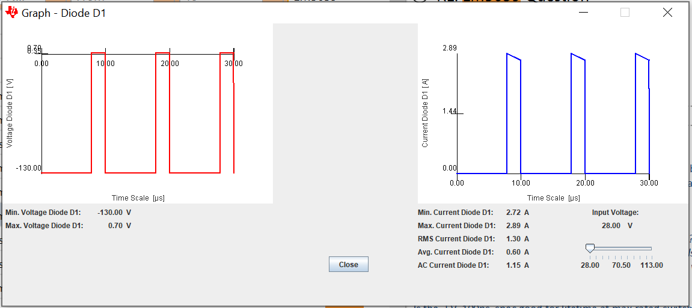
Boost Diode

Slide 5
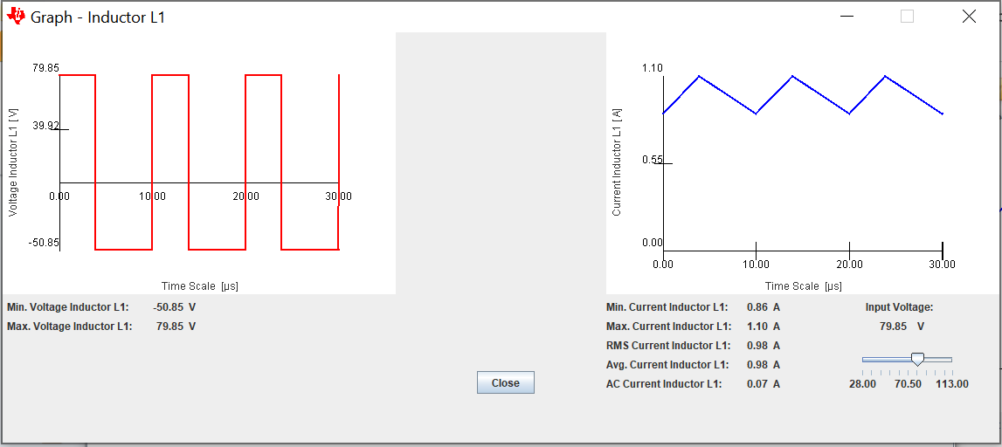
Boost Inductor

Slide 6
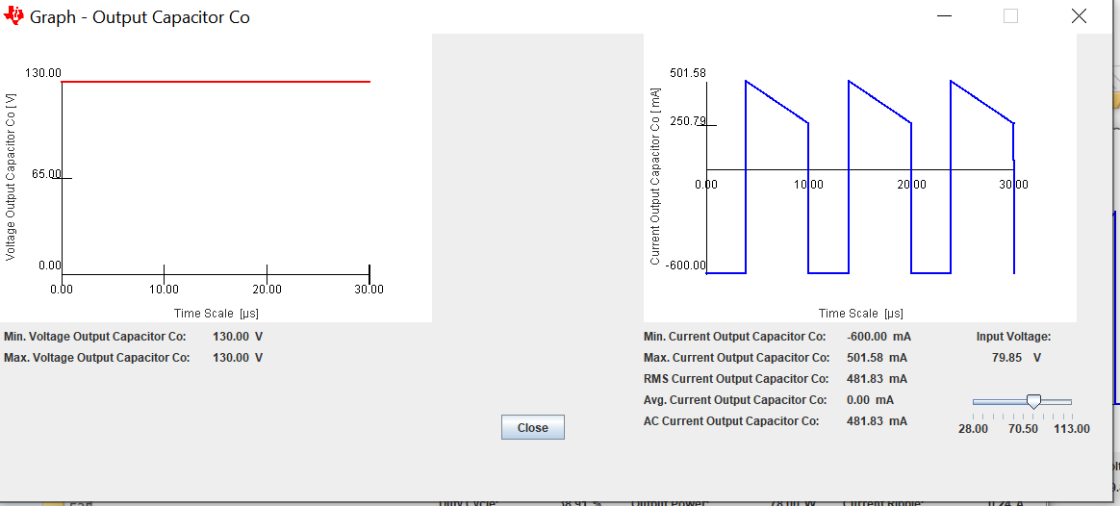
Output Capacitor

Slide 7
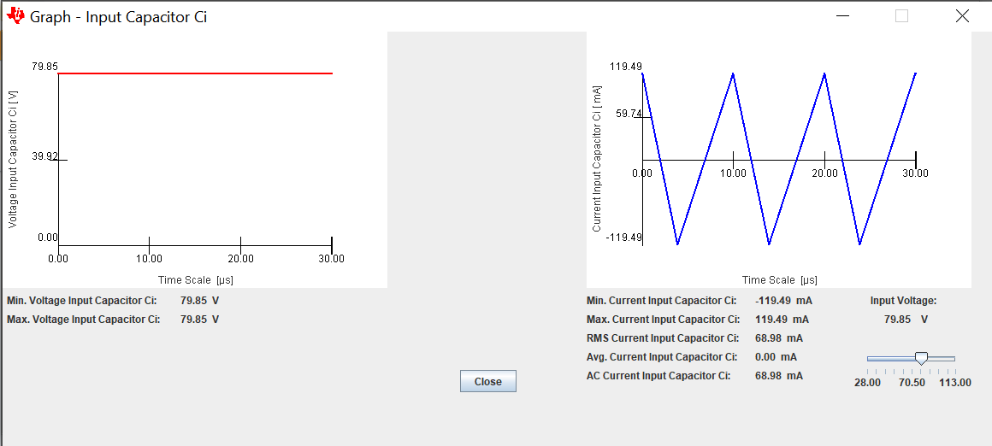
Input Capacitor

