Slide 1
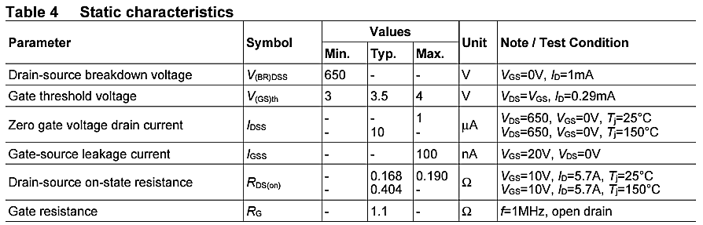
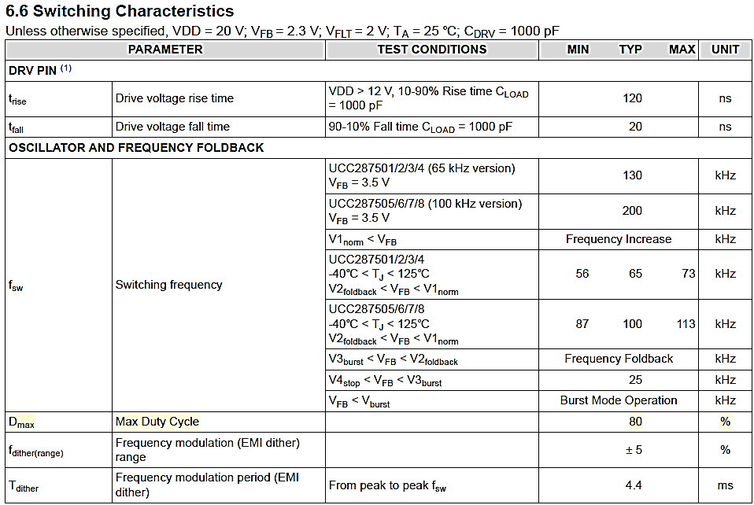
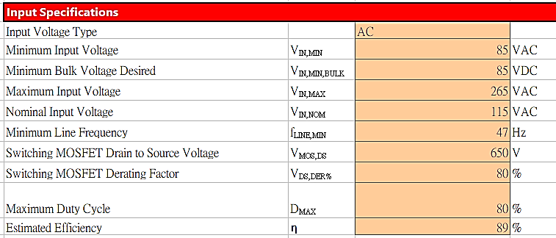
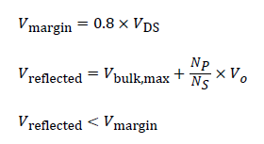
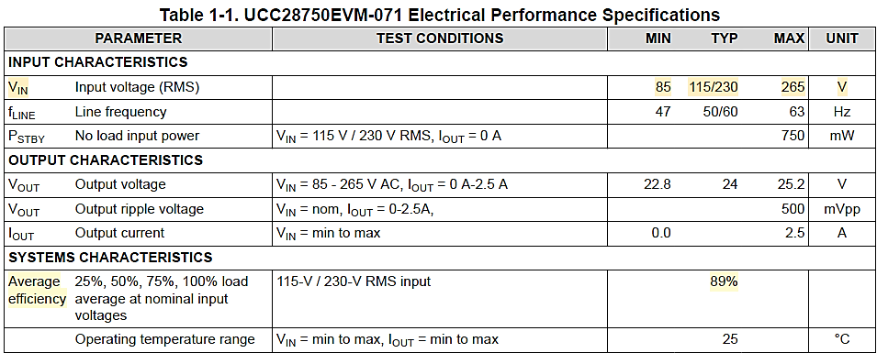
1、input specifications
IPP65R190C7 SPEC
UCC28750 SPEC
UCC28750 SPEC
Notes:
Please note that the UCC28750EVM is a CCM flyback converter. In slide 3 you decided to design for DCM by choosing to enter CCM at 100% duty.

Slide 2
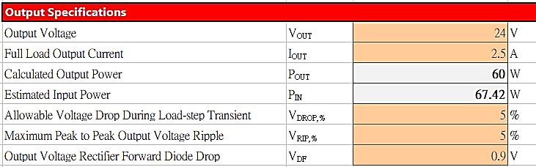
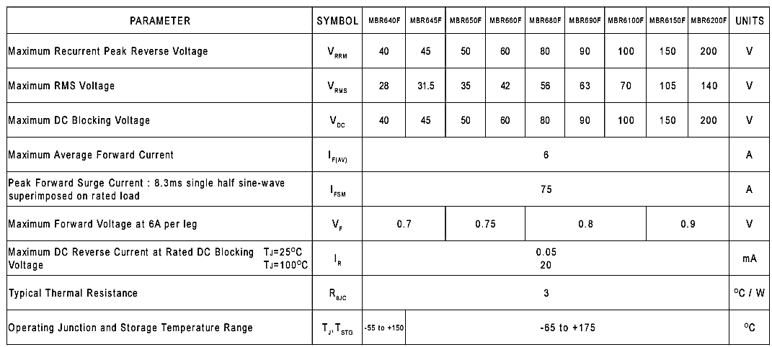
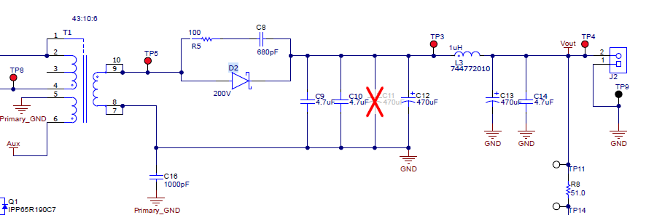
2、output specifications
Can't find relevant information, fill in 5% temporarily
MBR6200F_T0_00001 SPEC
Schematic of UCC28750EVM-071
Notes:
This is in regards of how much you want the output to drop during large signal transients.

Slide 3
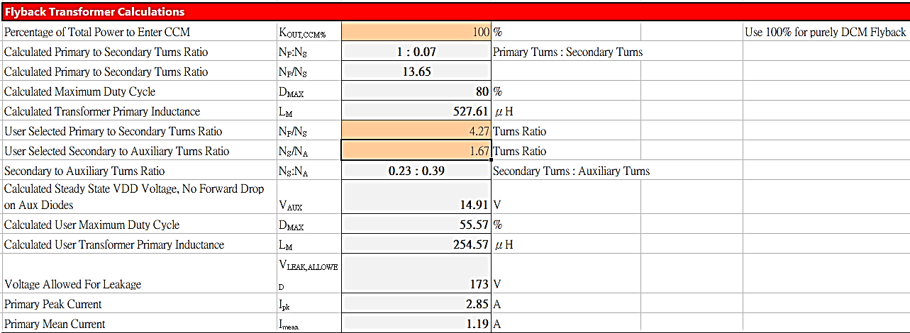
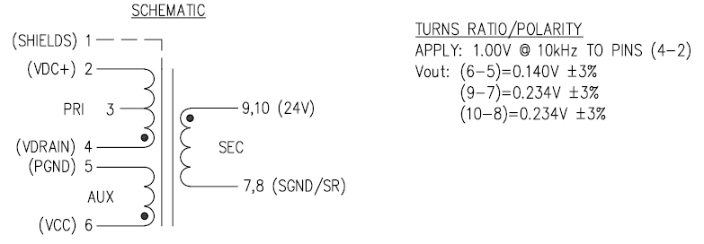
3、flyback transformer calculations
Can't find relevant information, fill in 100% temporarily
Transfomer RLTI-1450 SPEC
Notes:
If you select 100% this will be designed for CCM based on LM selection.
In your design it recommend that you use a transformer turns ratio Np/Ns = 14:1, you used 4.3 to 1. This might be a problem.
In your design it is recommend that you use a transformer turns ratio Na/Ns = 0.6, you used 1.67. You might have a problem with regulating VDD.

Slide 4
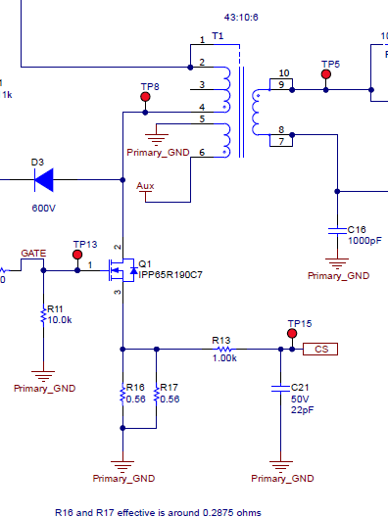
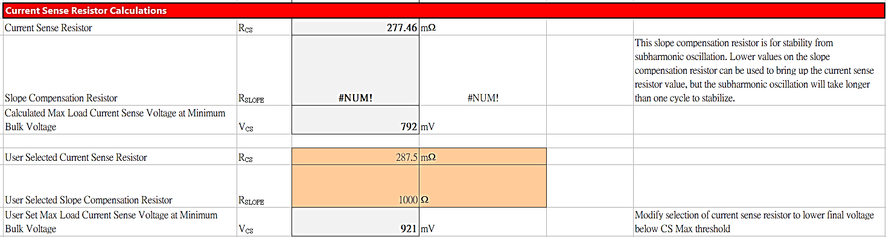
4、current sense resister calculations
Schematic of UCC28750EVM-071
Rslope
Rcs

Slide 5
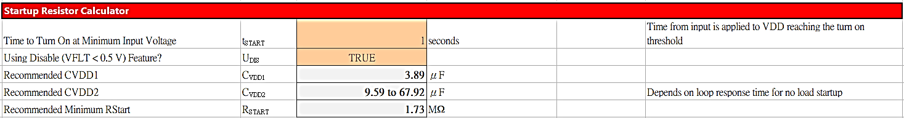
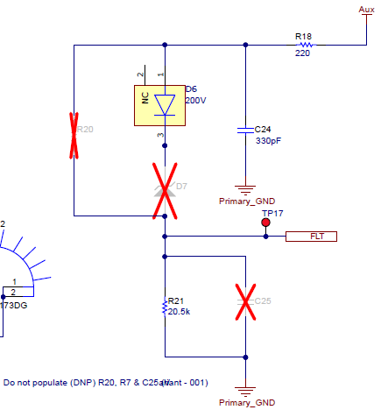
5、startup resistor calculator
Can't find relevant information, fill in 1 sec temporarily
Schematic of UCC28750EVM-071
X
Notes:
This is based on how fast do you want your controller to turn on.

Slide 6
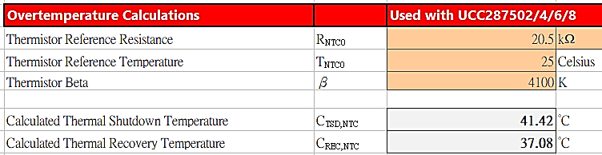
6、overtemperature calculations
Schematic of UCC28750EVM-071
R21 is a normal resistor where EVK design ,not an NTC，
these 2 item are temporarily value.
Notes:
If you used 41.42 k ohm you should be find.

Slide 7
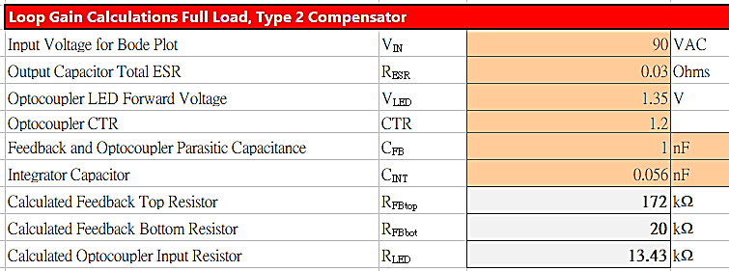
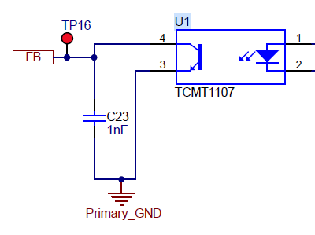
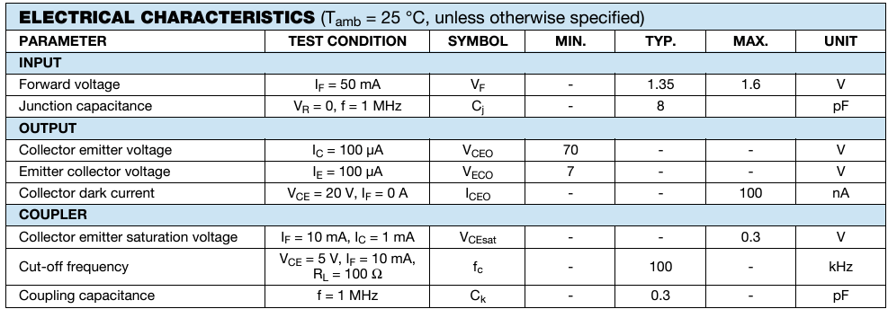
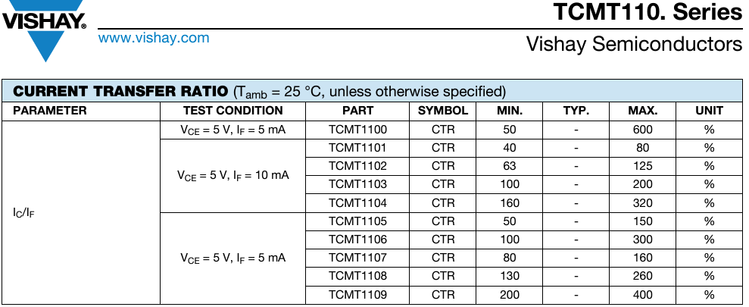
7、loop gain calculations full load, type 2 compensator
Can't find relevant information, fill in temporarily value
average
Can't find relevant information, fill in temporarily value
TCMT1107 SPEC
Schematic of UCC28750EVM-071
TCMT1107 SPEC
Notes:
This is your minimum AC input. For universal designs this is typically 90V AC. This should be O.K. for your 110 V design.

